Slide 1
Climate Change, COVID-19 and the Community
Module 2 | 2021
Notes:
Title slide + Image Option 2

Slide 2
Introduction
In stressed communities, one major disaster can trigger a number of smaller, interrelated disasters within the community, due to a history of socioeconomic vulnerability.
These disasters might occur at the individual scale or the community scale.
These issues have the potential to complicate efforts around addressing a major event and should be considered as part of the broader strategy for emergency response.
Notes:
Divider Slide

Slide 3
Caution
While the following are common examples of considerations within Indian Country, it is important to note that every Indigenous community is different and comes with its own unique history, cultural values, and community priorities, and experiences its own unique set of circumstances
Notes:
Divider Slide

Slide 4
Sections
Poverty
Housing Insecurity
Domestic, Gendered and Sexual Violence
Community Health

Slide 5
Learning Outcomes
To lay a foundation of knowledge regarding the effects of large environmental events on individual- and community-level issues
To examine the role that individual and community-level issues have on properly addressing major events, such as COVID-19 and climate change
To better understand the intersections of environmental catastrophe and community health

Slide 6
Poverty and the Income Gap

Slide 7
Poverty by the Numbers:
1 in 4 Native Americans lives in poverty [1]
32% of Native American and Alaskan Native families with children under the age of 5 lives in poverty [2]
Average median household income for Native Americans: $43,825, compared to $62,843 in the nation as a whole (2015-2019) [3]

Slide 8
Poverty on Reservations
While the poverty faced by many reservations is always an issue of concern and hardship, the presence of poverty during a natural disaster or public health emergency creates a situation whose impacts may remain devastating for years to come.

Slide 9
Poverty and Vulnerability
Elders and other vulnerable populations reliant upon their Tribe and families for assistance may suffer under a necessary reallocation of resources as a Tribal community tries to balance emergency response with long-term services and programs.
Further, income-driven communication gaps may hinder the ability to deliver emergency aid to those who need it most due to a lack of phone and internet service.

Slide 10
Tribes and Federal Assistance
Despite recent improvements to the Robert T. Stafford Disaster Relief and Emergency Assistance Act, only 228 of the 574 federally-recognized tribes have FEMA-approved hazard mitigation plans. [4]

Slide 11
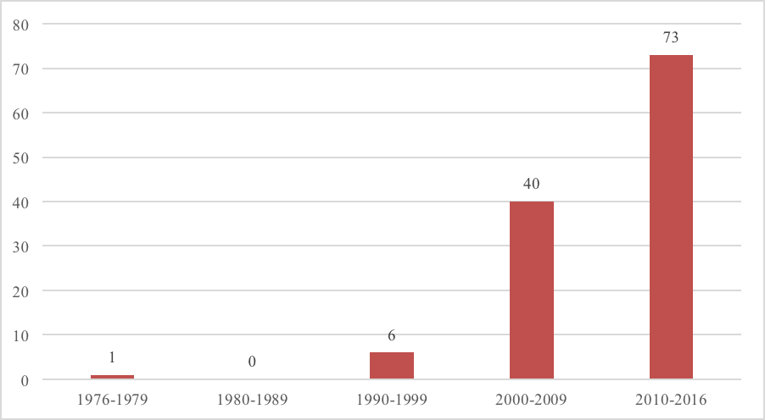
Disaster Frequency on Tribal lands
The Emergency Management gap is especially important because between 1976-2016, Tribal areas have been hit by 120 disasters. Those incidents have steadily increased in frequency.
The National Congress of American Indians has testified that the majority of disasters to hit Tribal communities are never designated for federal disaster declaration status.[7]
Number of Tribal disaster declarations by decade (1976-2016) [8]

Slide 12
Poverty and Climate Change
Individuals in communities stricken by poverty face unique challenges in the event of climate change-related disasters, such as:
A general increase in the exposure to the negative impacts of climate change
An increased susceptibility to the damage caused by climate change
A decreased ability to “bounce back” from the effects of climate change, due to a very small to nonexistent personal safety net [9]

Slide 13
Poverty and Pandemics
During the COVID-19 pandemic, poverty has been a factor in how many Native Americans get sick, as many are forced to work in frontline positions or dwell in overcrowded living situations
Some who have not gotten sick have been furloughed and have had difficulty putting food on the table

Slide 14
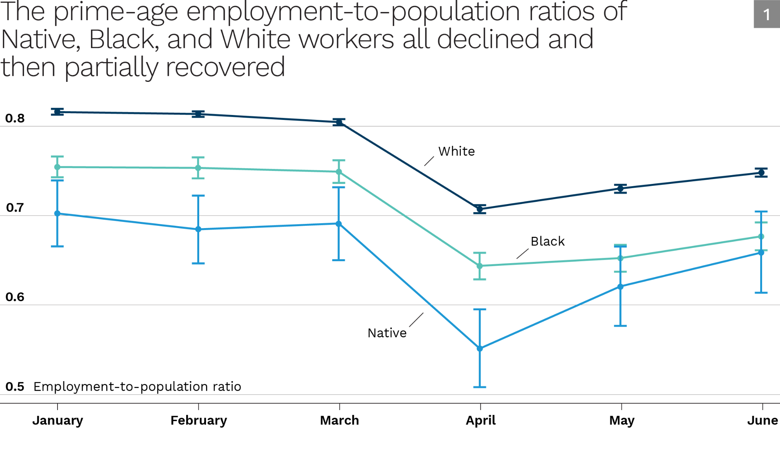
Unemployment and COVID-19
Prior to the COVID-19 recession, Native American employment already lagged behind both employment among White and Black employment rates (.81 for White Americans, .75 for Black Americans, and .68 for Native Americans).
After the pandemic hit, the Native American ratio showed the largest drop, falling from .7 in January 2020 to .55 in April 2020 [link]
Number of Tribal disaster declarations by decade (1976-2016) [8]

Slide 15
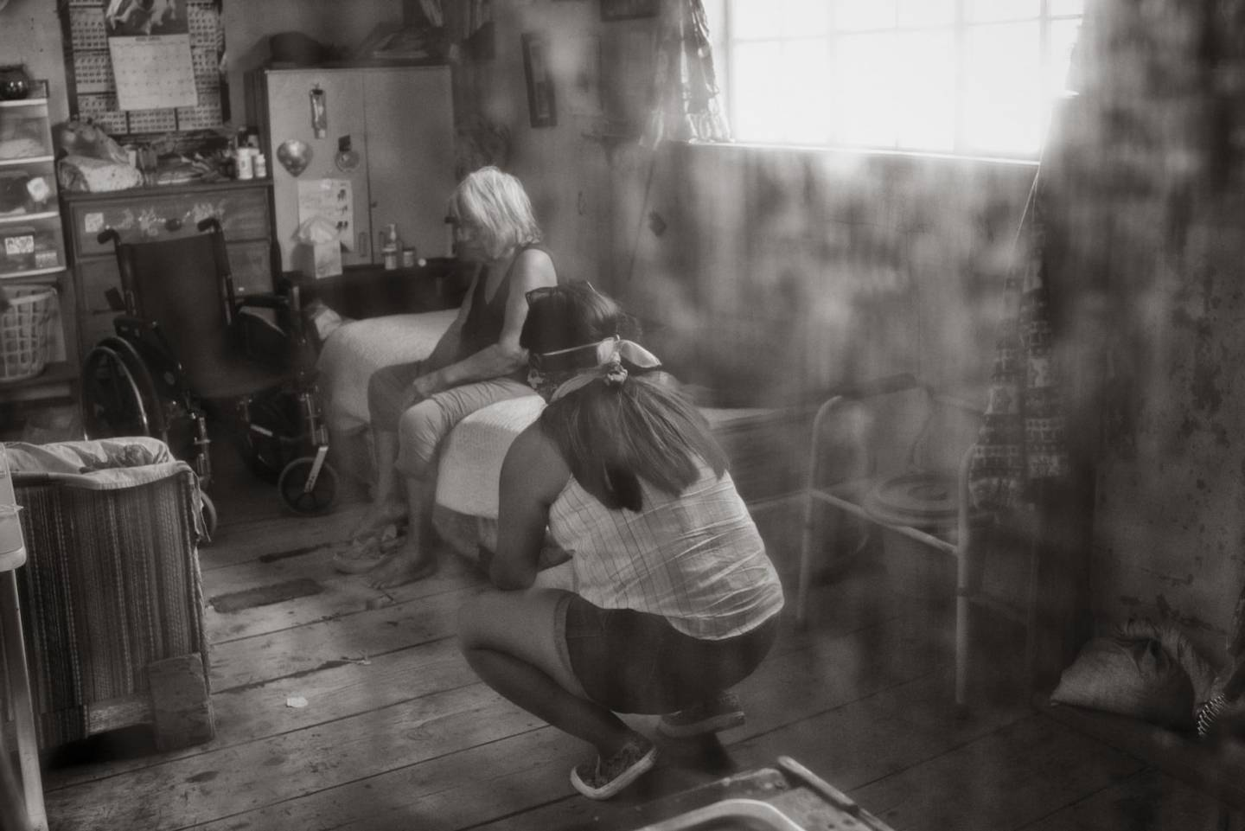
Case Study: Poverty and Elders
Read: Navajo elders: Alone, without food, in despair by Sunnie R. Clahchischiligi
Does the issues in this article seem like issues particular to the Navajo Nations or are there things that can be learned from the consideration of this article that translate to one’s own community?

Slide 16
Reliance On Subsistence
As a result of poverty and a continuation of Indigenous ancestral relationships with the land, many Indigenous people rely on subsistence hunting, fishing and gathering to supplement their income and provide for their families.

Slide 17
Treaties and Tension
In the case of treaty tribes, these activities are often rights guaranteed to them in perpetuity as well as important cultural practices that strengthen intergenerational relationships.
These rights have been the subject of vitriolic and even violent racial tensions between Indigenous people and surrounding non-Native communities.

Slide 18
Case Study: Treaty Rights and Spearfishing
Read: “Hate Crime Dropped Against Wisconsin man who shot gun near spearfishers”
“Non-Native Fires Gun at Tribal Harvesters on Lac du Flambeau Reservation”
In May 2019, Lac du Flambeau Tribal members Tyler Chapman and T.J. Maulson were harvesting fish on Gunlock Lake in northern Wisconsin when a non-Native individual fired on them with his gun. Also in the boat was Chapman’s 13-year-old daughter.
The individual who fired on them was a non-Tribal resident who owned a home on Gunlock Lake. This incident was just one of several reported that season, including racial epithets and death threats issued to Tribal members exercising their Treaty rights in the Ceded Territory.

Slide 19
Housing Insecurity

Slide 20
Housing Insecurity
As of 2019, Native Americans account for approximately 1.5% of North America’s population but more than 10% of the national homeless population (Invisible People)
Native Americans are 26 times more likely to experience homelessness than white people (Greater Twin Cities United Way)
Overcrowding affected 16 percent of American Indian and Alaska Native households in tribal areas and 10 percent in urban areas compared with 2 percent of all U.S. households. (HUD User)

Slide 21
Housing Insecurity on the Reservation
Homelessness in American Indian communities is difficult to accurately measure and track, because it often takes the form of “doubling up”-- moving from the home of one family member or friend to another to avoid having to literally sleep on the street where they are vulnerable to the elements or further exploitation (link)
This housing gap has been exacerbated on reservations by a combination of socioeconomic factors, drug and alcohol abuse, mental illness and cuts to federal funding allocated for reservation housing

Slide 22
Urban Natives and Homelessness
While much of the focus on Indigenous homelessness focuses on the reservation, more than half of self-identified AIAN live in or near cities.
Like many people of color, Indigenous people have historically been subject to discriminatory housing practices which force them into poorly kept living situations
People of color in general also rent at a higher rate than the general population, making them more vulnerable to eviction. (National Law Center on Homelessness and Poverty)
Urban AIAN face great challenges in accessing affordable quality healthcare. Urban AIAN are much more likely to seek treatment at urban Indian Health organizations but only 1% of the Indian Health budget is allocated to urban areas.

Slide 23
Climate change and homelessness
Whether in an urban setting or on the reservation, homelessness leaves people vulnerable to the extreme weather of climate change.
Lack of shelter and exposure to the elements, as well as limited capacity to flee to safer ground in the event of emergency, places these individuals on the front lines of climate change no matter where they are.

Slide 24
Housing insecurity limits an individual’s access to:
Nutritious food
Hygiene and sanitation
General health care
During a pandemic, those without permanent housing may find it more difficult to follow recommended protocols for outbreak prevention and care (such as social distancing, mask wearing and hand sanitizing) despite their best efforts

Slide 25
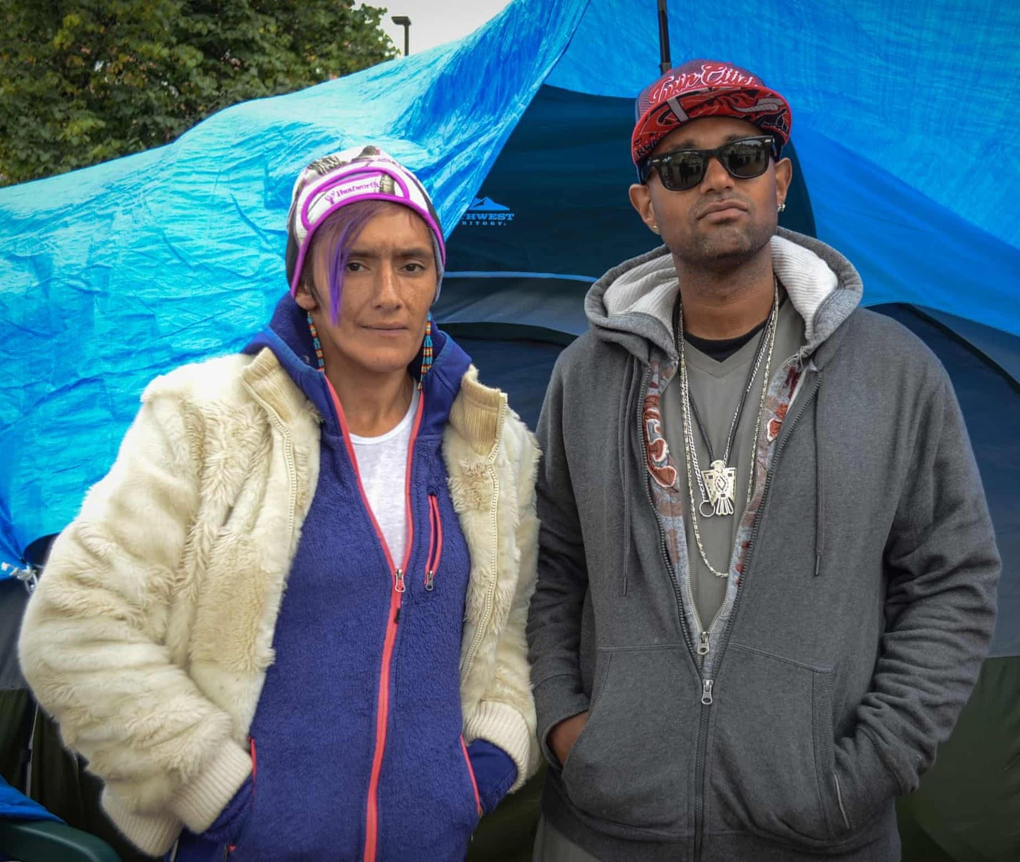
Case Study: the Wall of Forgotten Natives
Read: “City Camp is Site of Native American homelessness, heroin and hope” - the Guardian, 2018
“Encampment returns to Wall of Forgotten Natives, bringing call to action from Indigenous leaders” - StarTribune, 2020
The Wall of Forgotten Natives (also known as the Franklin Hiawatha encampment) was a makeshift camp near downtown Minneapolis. This camp consisted of several tents covered in tarps, as well as a few tipis and a communal kitchen. At its peak in the summer of 2018, this camp housed an estimated 300 people-- mostly Indigenous-- including children, elders, and pregnant women.
The Wall of Forgotten Natives: Serena and Joachim, who are staying at the makeshift camp. Photograph: Heidi Inman, the Guardian

Slide 26
Sexual and Domestic Violence

Slide 27
When compared to national averages, Indigenous women are:
2 ½ times more likely to be assaulted
2 times more likely to be stalked
5 times more likely to experience interracial violence
10 times more likely to be murdered (on some reservations)
More than 1 in 3 (or 34.1 %) Indigenous women will be raped in her lifetime
6 in 10 Indigenous women will be physically assaulted
-A Primer on Missing and Murdered Indigenous Women, Portland, OR

Slide 28
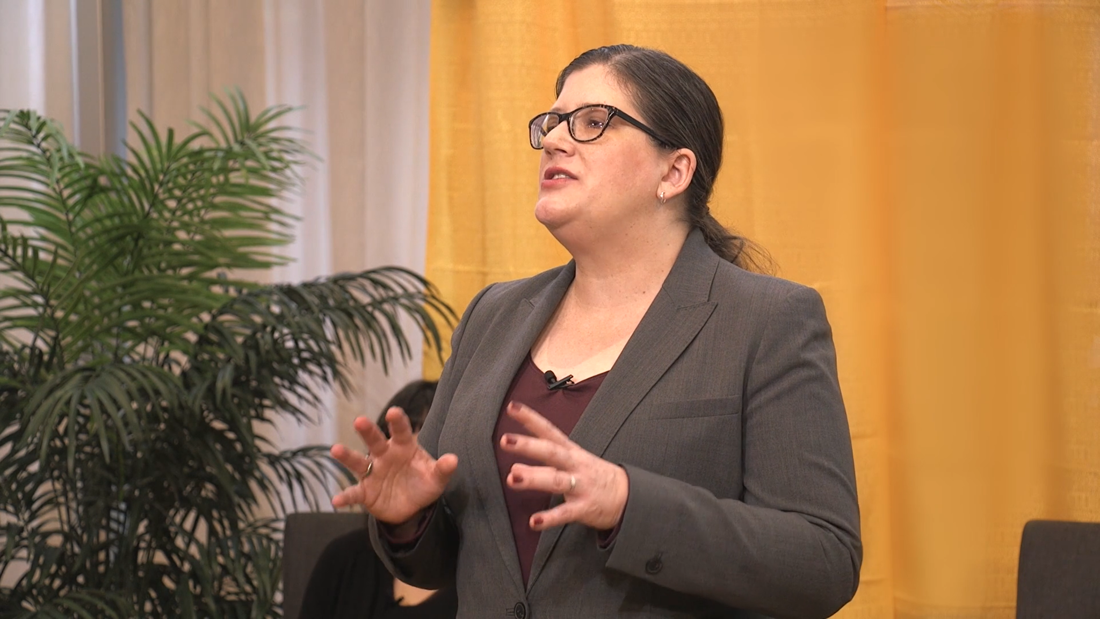
Video: Sarah Deer: Injustice in Indian Country: Native Women and Violent Crime

Slide 29
Climate Change and Violence
Research on the social impacts of climate change around the world have revealed that climate change is an important contributor to sexual, domestic and gender-based violence
This is especially important in Indigenous communities where the rate of sexual and domestic violence is already staggering
The MMIW (Murdered and Missing Indigenous Women) and MMIP (Murdered and Missing Indigenous People) movements have been a major player in the fight for climate justice, citing the increase of trafficking for “man camps”, temporary camps that house men working in oil and gas drilling operations.

Slide 30
Race, Gender and the Climate
Indigenous women and LLGBT people in the United States are vulnerable because their race and gender intersect to create socioeconomic and environmental challenges that affect their climate change resilience. (link)
Rapid environmental change, such as those caused by extreme hazard events, has been shown to increase domestic and sexual violence, as well as human trafficking.

Slide 31
Domestic Violence and Pandemics
While 1 in 3 women experience incidents of intimate partner violence, Indigenous women experience sexual and domestic violence at even higher rates and are more likely to be hurt by people they know than strangers.
34% of Indigenous women are raped in their lifetime
39% are victims of domestic violence (link)
During the COVID-19 pandemic, quarantine increased the occurrence of intimate partner violence, including severe intimate partner violence (link) by trapping women in abusive relationships in desperate situations and in more frequent proximity to their abusers

Slide 32
Community Health

Slide 33
Community Health
By the numbers:
Native Americans are twice as likely as whites to have diabetes
Kidney failure from diabetes was highest among Native Americans (CDC)
Native Americans have higher rates of multiple types of cancer than the general population, including lung (12%), colorectal (36%), cervical (69%), breast (26%), liver (three times higher), and stomach (two times higher) (CDC)
Native American and Alaskan Native adults are 50% more likely to be obese than non-Hispanic whites. AI/AN youth are 30% more likely to be obese. (HHS)

Slide 34
Defining Community Health
Community health is a medical specialty that focuses on the physical and mental well-being of the people in a specific geographic region. This important subsection of public health includes initiatives to help community members maintain and improve their health, prevent the spread of infectious diseases and prepare for natural disasters. (Rasmussen)
“Working at the community level promotes healthy living, helps prevent chronic diseases and brings the greatest health benefits to the greatest number of people in need,” reports the Centers for Disease Control and Prevention (CDC).

Slide 35
Pandemics and Pre-existing Conditions
The higher prevalence of pre-existing conditions makes Indigenous people more vulnerable in health emergencies
During the COVID-19 pandemic, the virus has been shown to be more deadly in obese individuals and those with pre-existing health conditions
Adjusted for age, COVID-19 mortality was 1.8 times higher in Indigenous communities than among white persons (CDC)

Slide 36
The Importance of Elders
Elders are an extremely important part of many Indigenous societies. They are often considered the pillars of the community and are beloved by many even outside of their own families. They are also often highly respected as knowledge-holders, Native language-speakers, leaders (both official and unofficial) and sources of important traditional guidance and wisdom.

Slide 37
The Importance of Elders
Losing a single elder has been likened to the loss of a great library.
During the COVID-19 pandemic, protecting elders, who are especially vulnerable, quickly became the rallying cry of AIAN communities. The loss of these valued community members is widely considered one of the most emotionally and culturally devastating impacts of the pandemic.

Slide 38
Climate change threats to health for already-vulnerable communities
Air quality: climate change is expected to increase health risks associated with air quality, including Chronic Obstructive Pulmonary Disorder, asthma and other respiratory illnesses
Water: Rising temperatures and more frequent rains in some areas will exacerbate existing water quality issues, including the prevalence of harmful algae, bacteria and waterborne viruses
Food: Climate change threatens many nutritious and culturally significant foods, exacerbating existing issues around food insecurity, food access (food deserts) and nutritional deficiencies

Slide 39
Climate change threats to infrastructure
Climate change threatens roads, bridges and other critical infrastructure through the frequency of intense weather events, such as storms and mudslides
Storms can damage already fragile communications infrastructure, especially in rural communities
Winter storms make it more difficult to reach spread-out communities, putting already vulnerable elders at risk from downed trees and extreme cold
These factors can make it difficult or impossible to get help in an emergency by making it harder to communicate and limiting (or even eliminating) routes to nearby hospitals

Slide 40
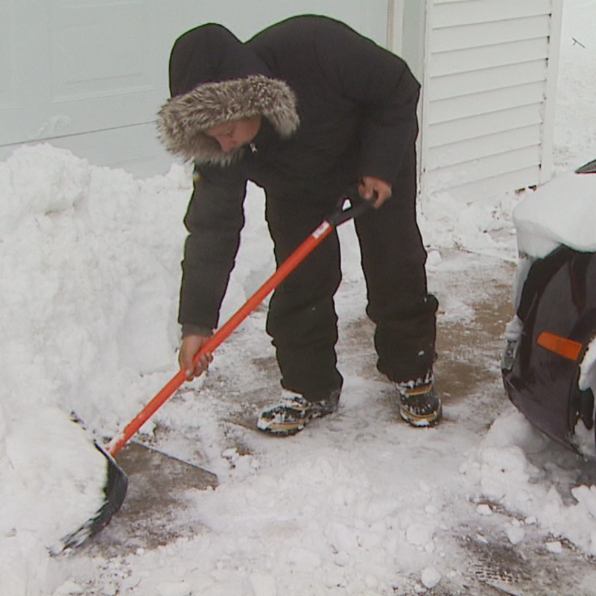
Case Study: Winter Storm Evelyn
In April 2018, Winter Storm Evelyn dropped over 30 inches of snow on northcentral Wisconsin, including the Menominee reservation and the community of Middle Village.
In addition to heavy snowfall, the storm included sleet, freezing rain and gusty winds. The weight of the snow caused roof collapses throughout the affected area. Winter conditions forced the closure of the Menominee Tribal Clinic and created dangerous travel conditions for even the most experienced drivers.

Slide 41
Thank you.

