Slide 1
Module #3:
Working with Indigenous Sovereignty
Image Credit:
Hoku Rivera
Notes:
Title slide + Image Option 2

Slide 2
Learning Outcomes
To build foundational knowledge of multifaceted solutions led by Indigenous communities to combat climate change, COVID-19, and colonization.
To gain a contextual understanding of Indigenous communities’ relationships to place as they inform community practices & decision-making
To gain a better appreciation for the integral role of trust in building relationships between oneself and Indigenous communities.
To understand individual and cultural resilience as a community effort.
Notes:
Definitions after

Slide 3
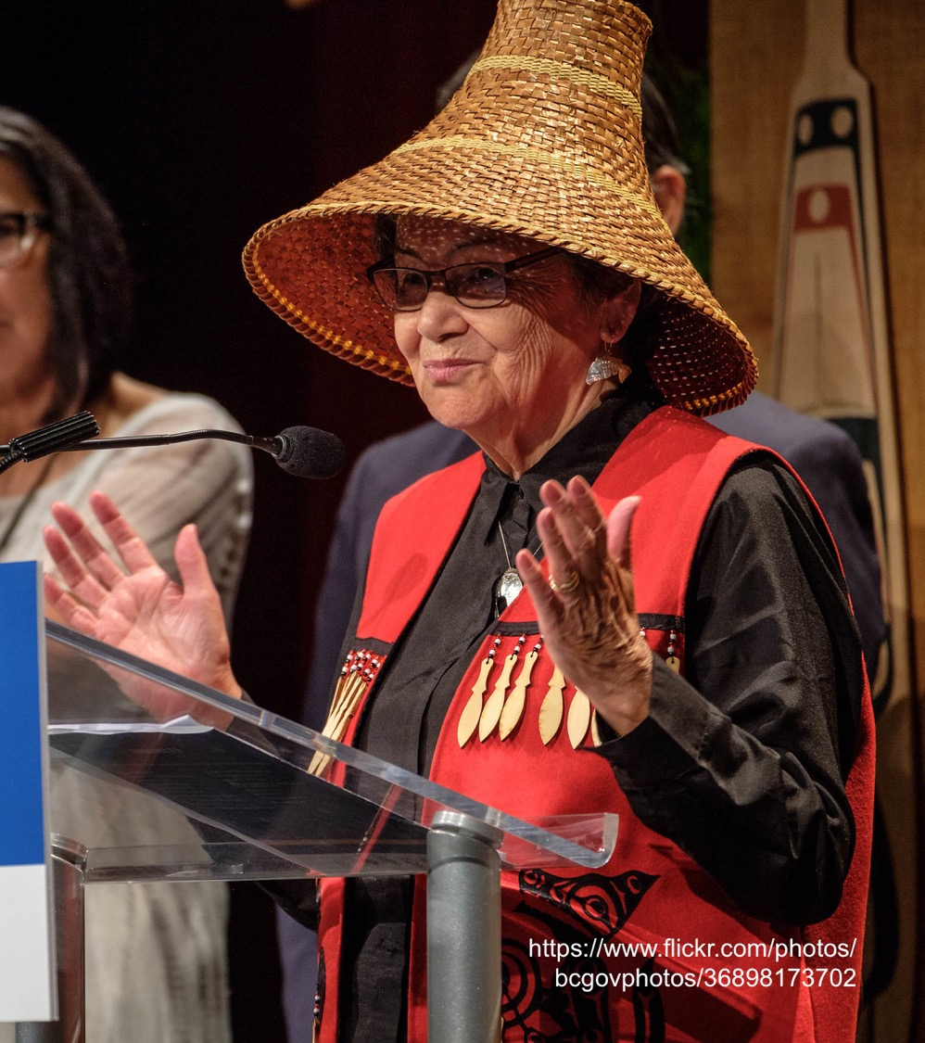
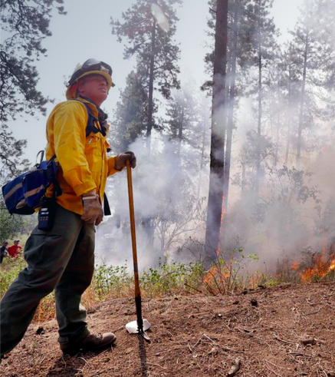
Together We Rise
The Role of the Emergency Responder
Indigenous Actions
Have a basic knowledge of treaties and Emergency Management (EM) policies impacting Tribal engagement:
What are the intentions of this document? What is it for?
Who is it intended to serve?
What improvements are needed in EM policies and plans?
What can I do to improve the state of relations and response?
Read policy documentation critically to identity that which is not written, but could have real relational impacts.
Traditional Ecological Knowledge & Language Revitalization
Fire Ecology
Food Sovereignty
Energy Sovereignty
Self-Determination in COVID-19 Response
So much more...
Image Credit:
Elaine Thompson
Notes:
Next Slide should be activity slide

Slide 4
Activity:
What can you do with this circle?

Slide 5
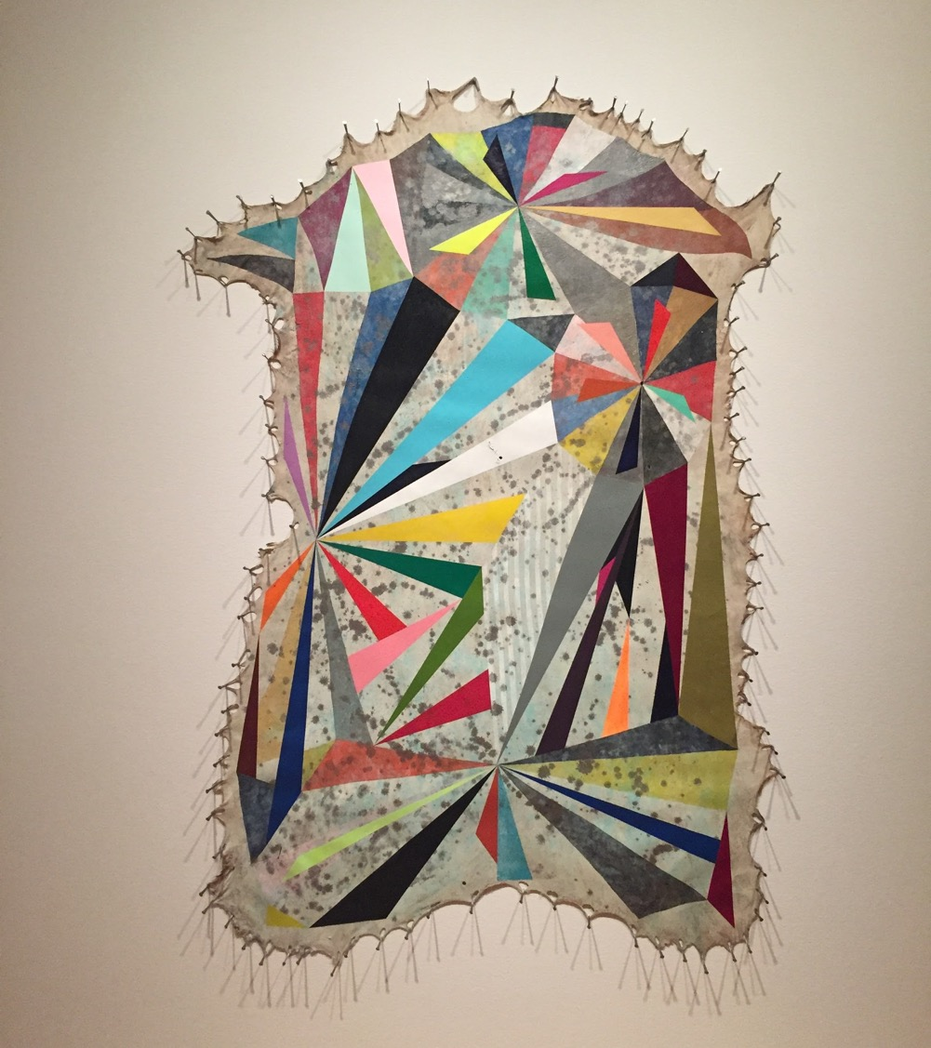
Mindsets for Meaningful Relationships
Indigenuity
The Growth Mindset
Image Credit:
Hoku Rivera

Slide 6
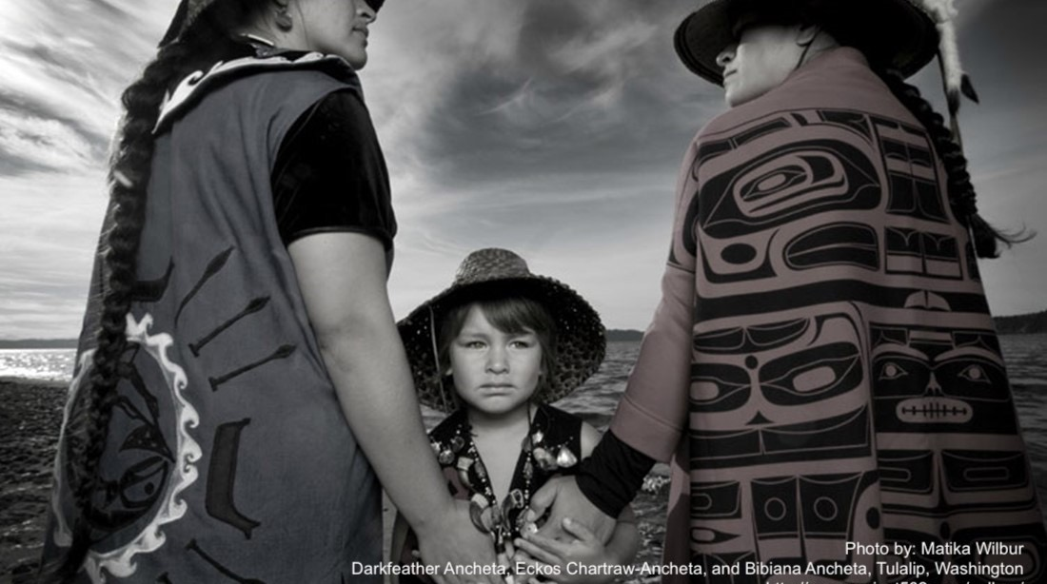
Indigenuity
“Indigenuity frames solutions in terms beyond a singular fixation on rights and counterbalances those concerns with a recognition of inalienable responsibilities humankind has to our plant, animal, and other natural relatives with whom we share this planet.”
Dr. Dan Wildcat
Notes:
https://www.monah.us/indigenuity

Slide 7
The Growth Mindset
Developed by Psychologist Carol Dweck
Limited vs. Growth
Limited: The belief that one’s talents, traits, and skills are fixed.
Growth: The belief that one’s basic abilities can be improved with hard work and dedication.
Having a growth mindset means we are always looking to improve our abilities in order to better serve our communities and those we visit.
Image Credit:
Hoku Rivera
Notes:
https://www.edglossary.org/growth-mindset/

Slide 8
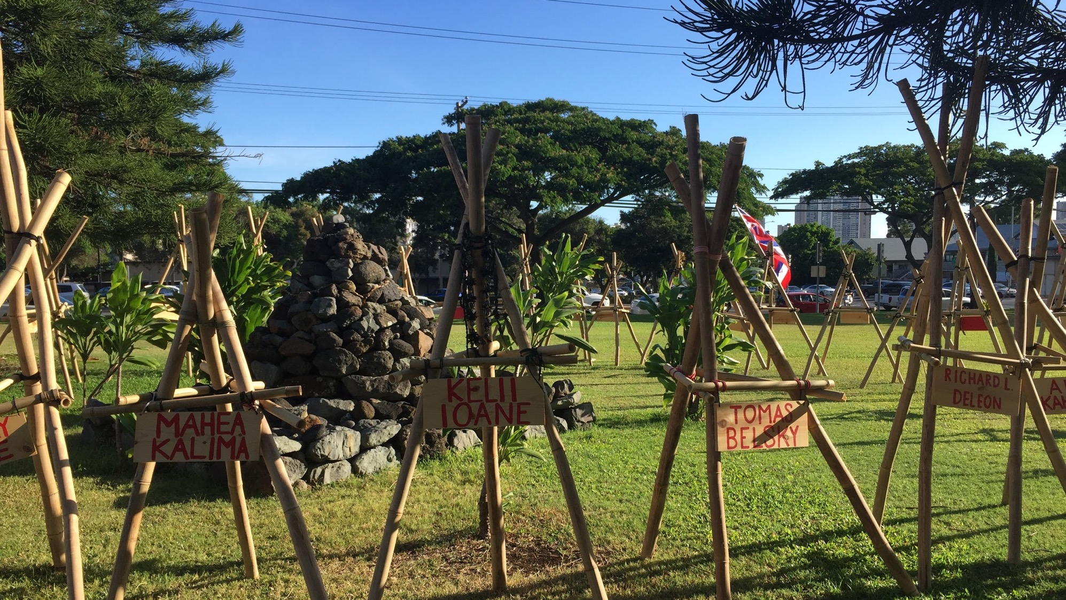
Modern Indigenous Practices
(Re-)Indigenizing approaches to land management and community response
Image Credit:
Hoku Rivera

Slide 9
Re-centering Traditional Ecological Knowledge (TEK)
According to Dr.s Dan Wildcat and Raymond Pierotti, there are two basic TEK concepts:
“All things are connected, which is conceptually related to Western community ecology, and…
“All things are related, which changes the emphasis from the human to the ecological community as the focus of theories concerning nature” (2000).
TEK (a.k.a. “Indigenous Knowledge” (IK) or Native Sciences) is based in observations of the physical world by Indigenous Peoples since time immemorial.
TEK was nearly lost to forced assimilation, but gained popularity through Indigenous Scholarship.
Notes:
https://www.fws.gov/nativeamerican/pdf/tek-pierrotti-wildcat-2000.pdf

Slide 10
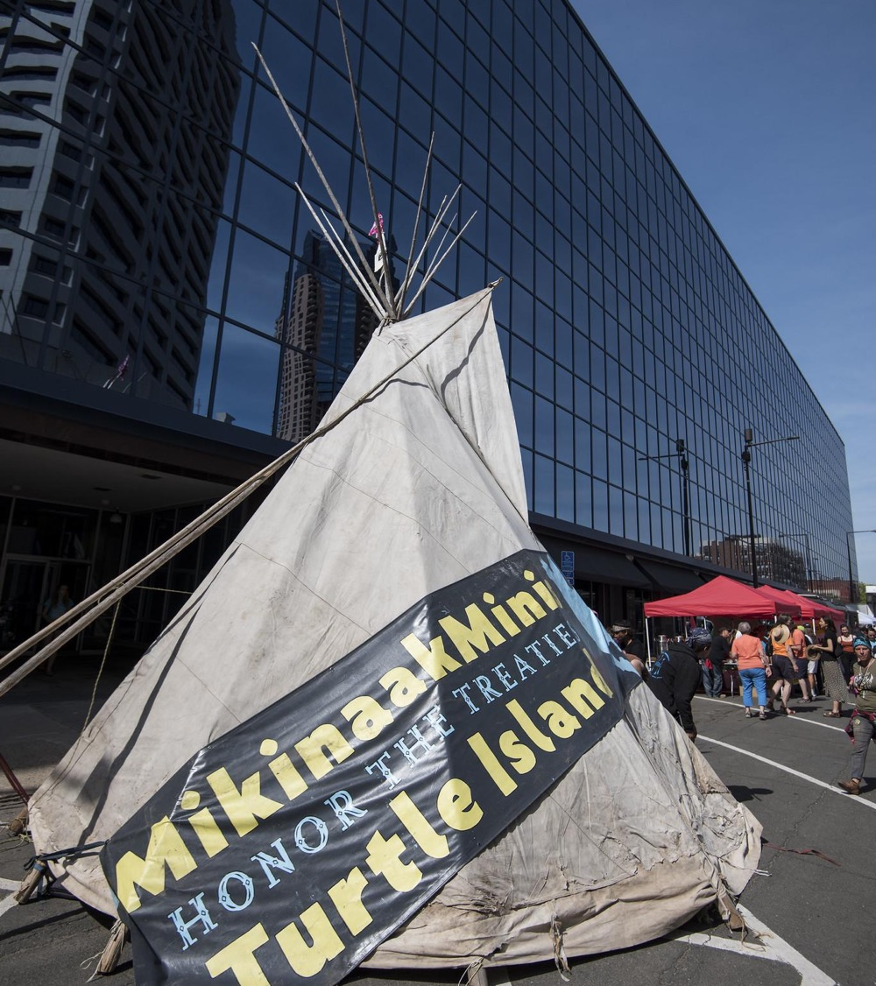
Traditional Ecological Knowledge...
https://www.flickr.com/photos/fibonacciblue/28329302828
Promotes Indigenous science and scholarship in white-dominated fields;
Incorporates spirituality and relation into epistemology;
Calls for Indigenous language revitalization; and
“Is a practical tool that helps Indigenous communities adapt to climate risks and promotes socio-ecological resilience, which upholds social empowerment and sustainable resource management” (Hamzah et. al. 2019)
Notes:
https://www.mdpi.com/2071-1050/12/2/676/htm

Slide 11
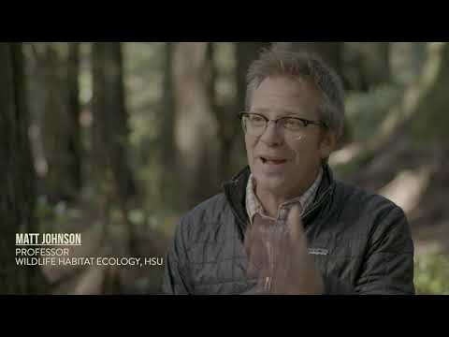
Review and Reflect
Traditional Ecological Knowledge & Place-based Learning Communities (2019)
Notes:
https://youtu.be/liKV74avPso

Slide 12
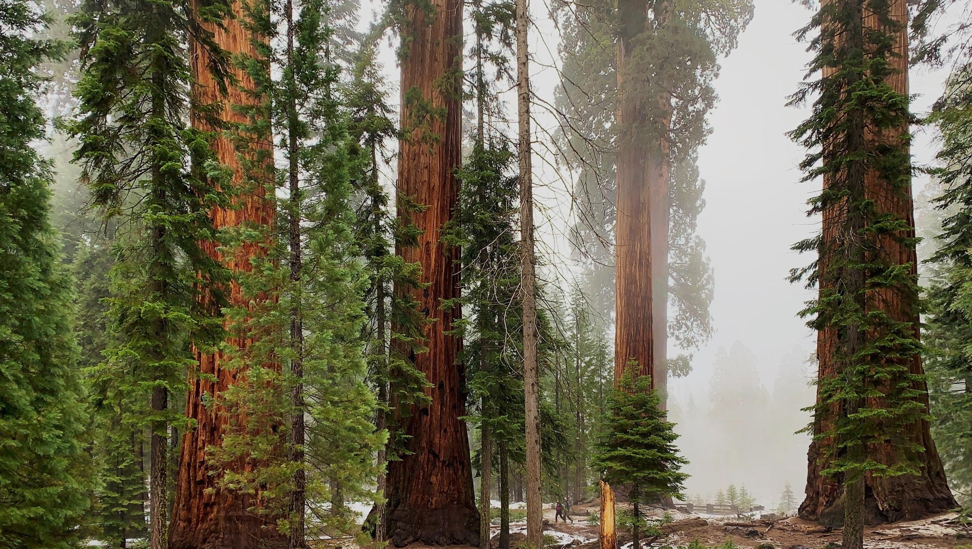
Fire Ecology
Fire ecology is a branch of ecology that focuses on the origins of wildland fire and its relationship to the environment that surrounds it, both living and non-living. A wildland fire is defined as any fire that is burning in a natural environment. Fire ecologists recognize that fire is a natural process, and that it often operates as an integral part of the ecosystem in which it occurs.
Pacific Biodiversity Institute
Image Credit:
Oleksii Yasinskyi
Notes:
http://www.pacificbio.org/initiatives/fire/fire_ecology.html

Slide 13
Fire Ecology - Management by Fire
One of the most devastating and immediately visible impacts of climate change is the increase of severe wildfires.
The intensity of these wildfires is amplified in part by the steady accumulation of fuels in areas where controlled burning has been prohibited.
Following a series of devastating wildfires, the US Forest Service adopted a policy of reflexively extinguishing all wildfires – a policy quickly adopted by other land management agencies at the state and federal level in the interest of saving lives.

Slide 14
Fire Ecology - Management by Fire
Indigenous Peoples all over the world have long used controlled burning as a land management tool to clear land for camp, create habitat for certain wildlife, and manage culturally-significant, fire-adapted tree and plant species such as high-elevation white pine and several types of eucalyptus.

Slide 15
Fire Ecology - Management by Fire
Controlled burning also has the effect of mitigating the intensity of wildfires by reducing available fuel loads – dead and dry timber which acts as kindling for fires.
This is achieved through the use of “good fire” – carefully timed, closely monitored fires that are allowed to burn in favorable weather conditions. This important cultural practice is as integral to the identity of some Tribes as it is the landscape.

Slide 16
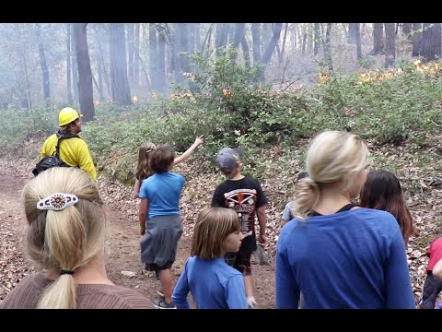
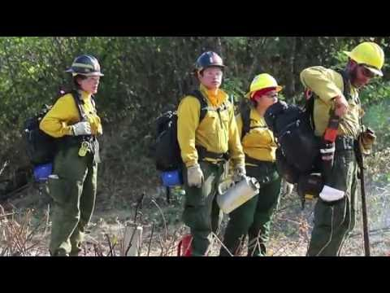
Fire Ecology - Management by Fire
Fire Belongs Here
TREX 2016 - Tishaniik Ceremonial Burn

Slide 17
Karuk Tribe
Since time immemorial, the Karuk Tribe of California has been using prescribed burns to manage their ancestral homelands. When the zero-tolerance policy on wildfires was instated, it put an end to tens of thousands of years of culturally- and ecologically-crucial burning.
In the 60s and 70s, the National Park Service and the US Forest Service rolled back their policy, realizing the devastating effect is was having on certain tree species, such as the sequoia. But public fears and political pressure still prohibited controlled burns on certain public lands – a problem for the Karuk in particular, as many of their ancestral lands were appropriated for the Klamath National Forest.

Slide 18
Karuk Tribe
After many years of intertribal efforts, the Karuk and other California tribes have been given the green light to resume prescribed burns. Indigenous wildland firefighters give gratitude to the fire and to the land and work with agency partners to coordinate the burn.
Click here for more information

Slide 19
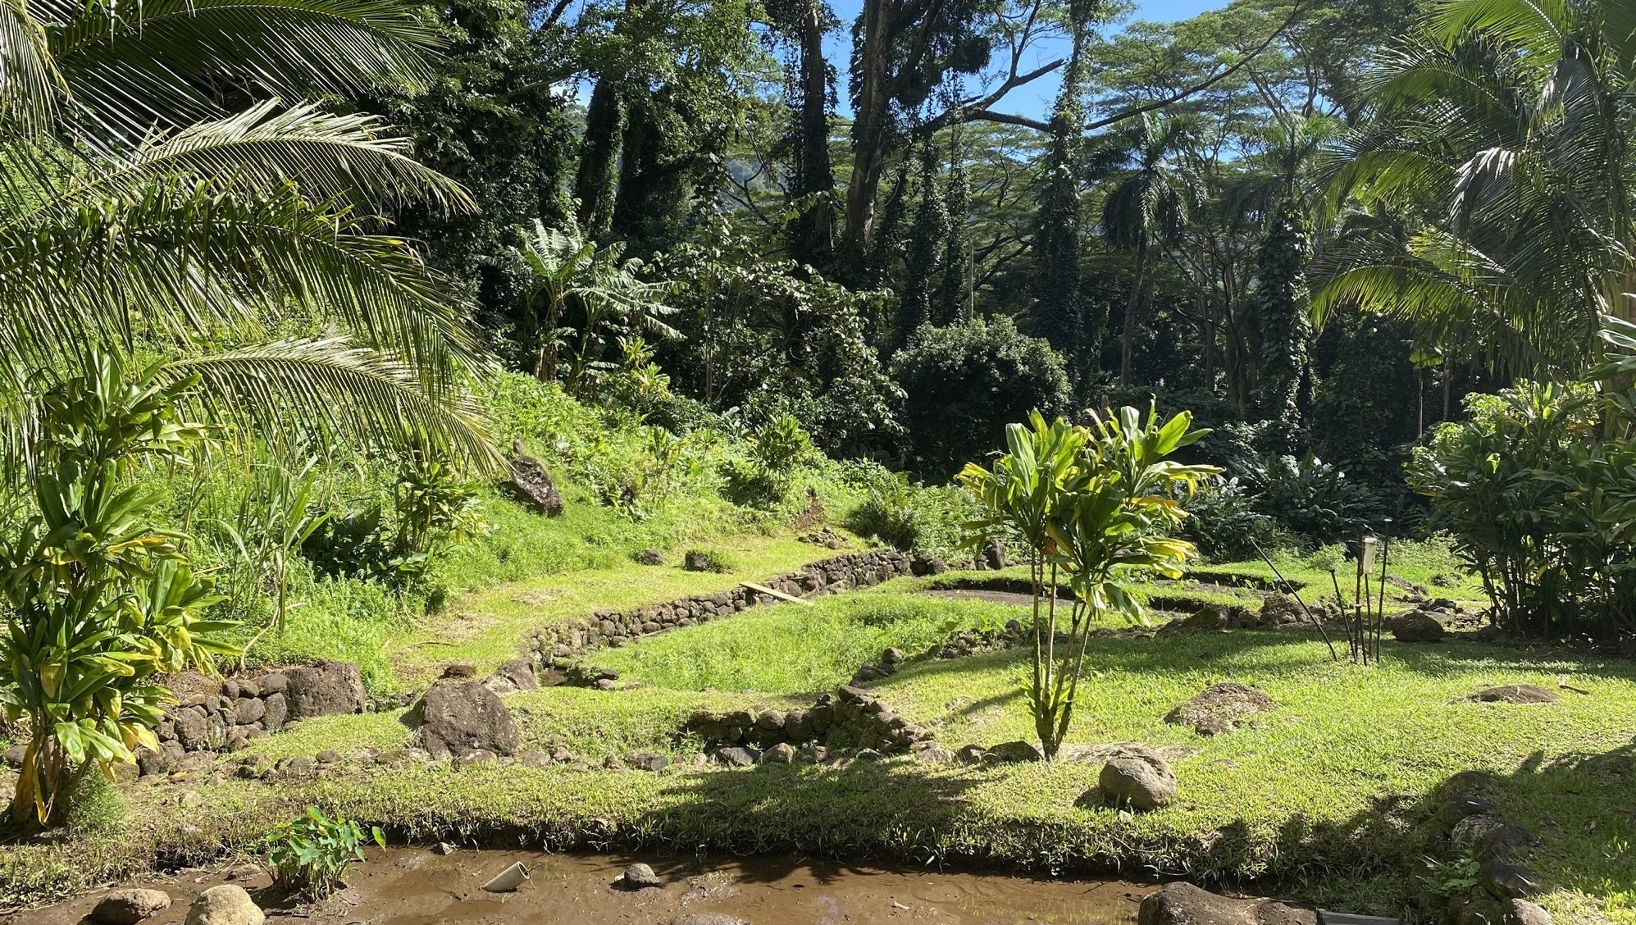
Food Sovereignty
Key Aspects:
The right to have access to healthy and culturally appropriate foods.
The right to access food produced sustainably and ethically.
The right for people to establish their own food and agricultural systems and policies.
According to the National Indian Council on Aging, Food Sovereignty...
Increases relationships (to land, culture, and community).
Decreases food insecurity and rates of diet-related illnesses (diabetes, heart disease, etc.)
Decreases pollutants that would come from shipping, processing, and packaging.
Image Credit:
Hoku Rivera
Notes:
https://www.nicoa.org/the-importance-of-food-sovereignty/

Slide 20
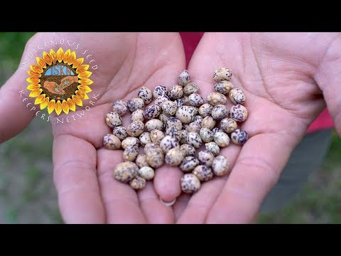
Another Facet Led by Indigenous Communities: Seed Sovereignty!
The Native American Food Sovereignty Alliance established the Indigenous Seed Keepers Network
Notes:
https://youtu.be/IooHPLjXi2g
https://nativefoodalliance.org/our-programs-2/indigenous-seedkeepers-network/

Slide 21
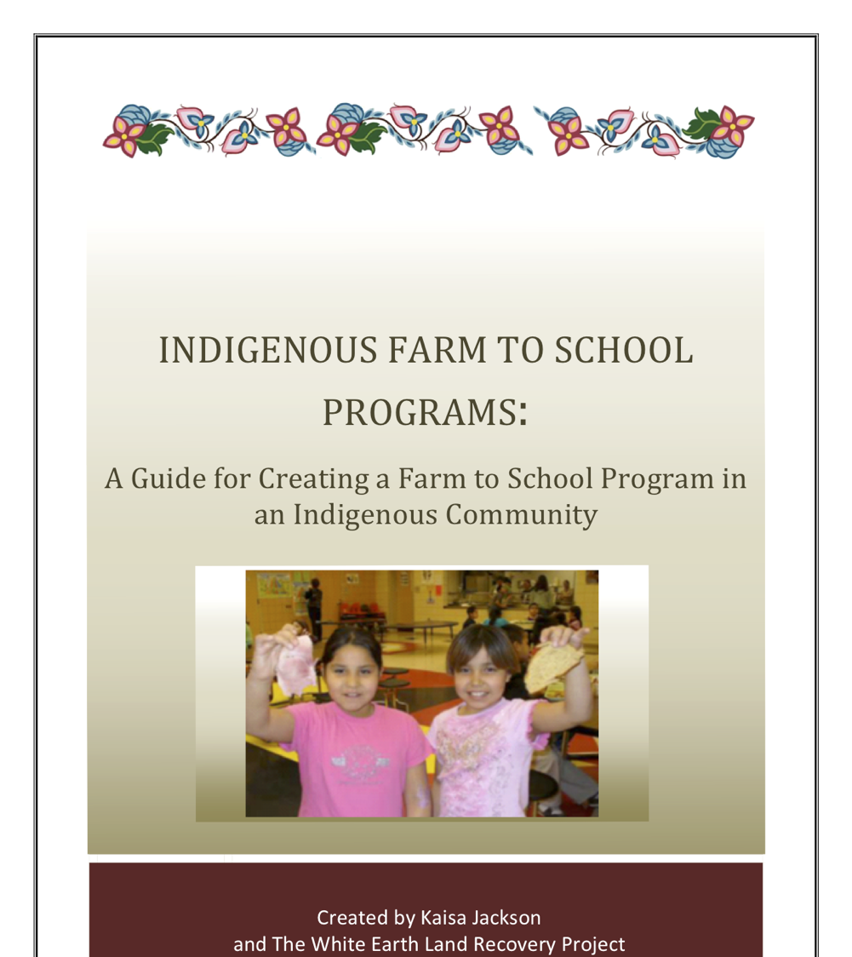
The White Earth Land Recovery Project (WELRP)
View the 2012 Program Guide
here.
WELRP was founded in 1989 and focused on the critical food state of the White Earth Reservation.
Members developed and implemented a Farm to School Program in 2008 that was set to…
Reverse the declining trends in student health,
Positively impact student lifestyle choices, and
Provide access to traditionally and locally grown foods.
Notes:
Use front cover as picture: https://d3n8a8pro7vhmx.cloudfront.net/honorearth/pages/222/attachments/original/1390858099/INDIGENOUS_FARM_TO_SCHOOL_PROGRAMS.pdf?1390858099

Slide 22
The Hāloa Challenge
Kamehameha Schools Kapālama Campus, 2014
Three high school seniors harvested, cooked, prepared, and ate kalo as a substitute to other staple foods for ninety days.
This rose awareness that…
“Hawaiʻi no longer has enough agriculture production to feed its own people – an estimated 85 - 90% of all food is imported into the state” (Lincoln 2014).
There is another way: food sovereignty, backyard cultivation, and other traditional agricultural practices on the islands.
Read a brief summary of the significance of kalo and its cultivation to Kanaka Maoli here.
Image Credit:
Hoku Rivera
Notes:
https://www.hawaiinewsnow.com/story/24659380/becoming-haloa-teens-will-harvest-cultivate-kalo-for-their-meals-for-90-days/
https://keolamagazine.com/agriculture/kalo-farming-on-hawaii-island/

Slide 23
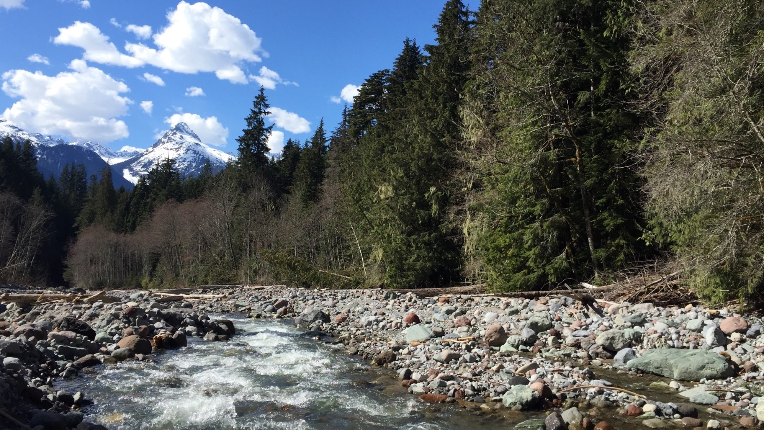
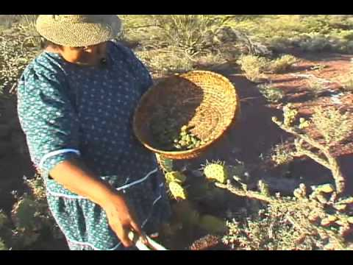
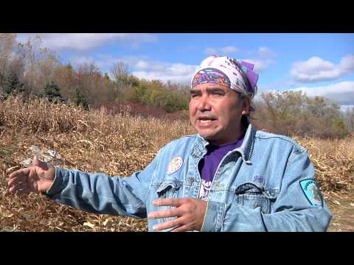
Other Examples of Food Sovereignty
Harvesting Cholla Seeds in Tohono O’odham territory
Traditional Agricultural Practices of the Oneida Nation
Image Credit:
Hoku Rivera

Slide 24
Energy Sovereignty
Energy Sovereignty is the application of Indigenous sovereignty principles and concepts to energy generation and use.
Because energy use is integral to everything from business to education to food production, a community’s dependence on external energy generation directly relates to that community’s independence as a whole.
In light of the debate over renewable energy and fossil fuels, energy use is also an important medium for exercising cultural responsibilities to place and to others, as well as a way to integrate cultural values into the very infrastructure of a community.

Slide 25
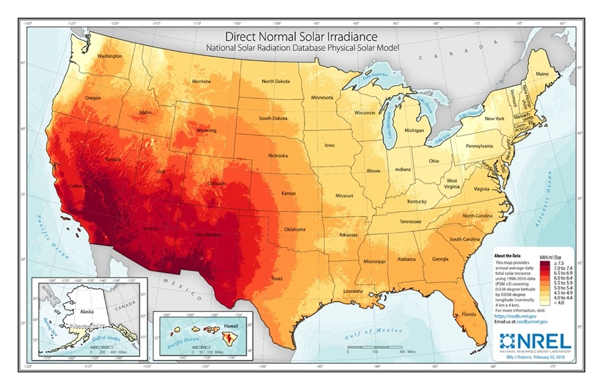
Energy Use on Tribal Lands
While American Indian land only comprises 2% of total US land, the National Renewable Energy Laboratory estimates that Indian lands contain 5% of all renewable energy resource potential. (link)

Slide 26
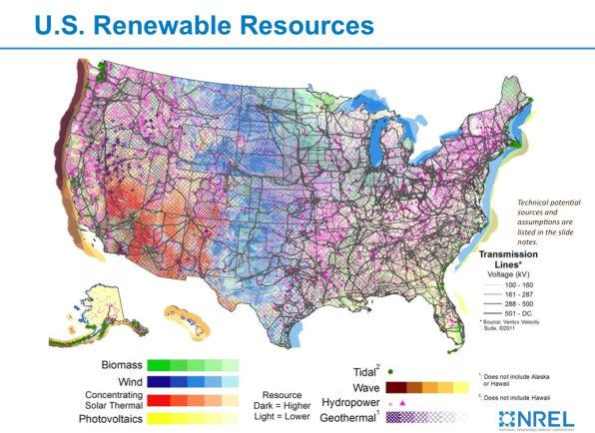
Renewable Energy Potential

Slide 27
Energy and Community Resilience
In addition to promoting cultural values, energy sovereignty (especially that which focuses on renewable energy) promotes resilience in a community economically.
Renewable energy programs create skilled jobs and can be a great source of employment when paired with skills training. Greater economic stability is often directly correlated with an community’s ability to recover from a major disaster.
The comparable independence of renewable energy sources like solar also equips a community to have functioning energy within hours of a disaster, mitigating the immediate impacts to heat, water safety, and telecommunication during the recovery phase.

Slide 28
Blue Lake Rancheria (Video)

Slide 29
Blue Lake Rancheria
In 2017, the Blue Lake Rancheria, a reservation in Northern California, launched its new low-carbon microgrid. In non-disaster times, this microgrid helps to power both governmental offices and Tribal businesses in its 100 acre service area.
In October 2019, in the midst of devastating wildfires, Pacific Gas and Electric (PG&E) made the decision to shut off power to millions of customers. The decision was made to prevent further wildfires from power equipment throwing off sparks and igniting brush. Millions of Californians across 30 counties were impacted.
The Blue Lake Rancheria microgrid went into “island mode”, which allows the microgrid to function on a Tesla battery without risk to electrical workers. During the blackout, they were one of the only places in Northern California with power.

Slide 30
Blue Lake Rancheria (continued)
When COVID-19 hit, there was concern that the shut-down of local businesses would cause an overload for the Blue Lake microgrid. However, thanks to an innovative design for its model-based adaptive controller, the microgrid has continued to function as an invaluable resource to the Tribe. They have used the energy generated to run a pre-packaged meal program for the elderly across a 1,400 square-mile territory.
The microgrid saves the Tribe an estimated $200,000 in energy costs per year.
Notes:
https://new.siemens.com/global/en/company/stories/infrastructure/2020/blue-lake-rancheria-energy-resilience.html
https://www.npr.org/2020/01/11/795248921/california-reservations-solar-microgrid-provides-power-during-utility-shutoffs
https://microgridknowledge.com/blue-lake-rancheria-microgrid-controller-covid-19/

Slide 31
Indigenous Communities through COVID-19
Image Credit:
Anton / Unsplash
Nov. 25, 2020

Slide 32
Tribal Leadership in Action
Mask Mandates
Blackfeet Nation leaders decided to continue mask mandates even after Montana government officials removed the mandate statewide.
Cherokee Nation leadership supported a mask mandate, free drive-thru testing for COVID-19, and well-stocked & staff hospitals since Spring 2020.
Quarantines and Traffic Checkpoints
The Navajo Nation issued a mask mandate and lockdowns in April 2020 to curb infection rates.
The Oglala Sioux and the Cheyenne River Sioux Tribes initiated traffic checkpoints to curb the introduction of COVID-19 to tribal residents. This action shed light on the fracture between tribal governments and state/local governments. (Sept 2020)
Notes:
https://www.greatfallstribune.com/story/news/2021/02/12/montana-removes-mask-mandate-tribes-keep-covid-restrictions/6737944002/
https://www.pbs.org/newshour/health/how-the-cherokee-nation-has-curtailed-the-pandemic
https://www.navajo-nsn.gov/News%20Releases/NNDOH/2021/Jan/NDOH%20Public%20Health%20Emergency%20Order%202021-001%20Dikos%20Ntsaaigii-19.pdf
https://www.postbulletin.com/indigenous-impacts/6641313-South-Dakota-COVID-19-checkpoints-highlight-fractures-strength-in-tribal-relations

Slide 33
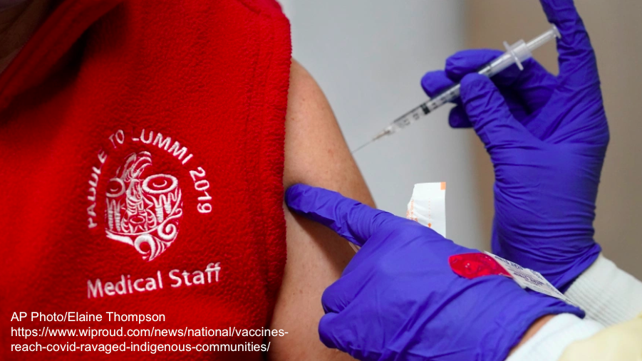
Prioritizing Community & Culture
Protecting Language Keepers
Vaccine Distribution
Lummi Nation opened vaccine clinics, and later began sharing vaccines with the Ferndale School District.
This brought the rate of fully-vaccinated Whatcom County residents aged 16+ to 67 percent!
December 2020: 68,400 vaccine doses reached frontline health workers in tribal communities.
In January 2021, the Standing Rock Sioux Tribe decided to allow those who speak Dakota and Lakota languages to receive the first COVID-19 vaccines.
Tribal Chairman Mike Faith input, “It’s something we have to pass on to our loved ones, our history, our culture, our language. We don’t have it in black and white, we tell stories. That’s why it’s so important” (AP News 2021).
Notes:
https://www.bellinghamherald.com/opinion/op-ed/article249792298.html
https://kgmi.com/news/007700-lummi-data-helps-push-whatcom-to-one-of-states-highest-vaccination-rates/
https://apnews.com/article/health-north-dakota-coronavirus-pandemic-b713d9721e8125887c93f1cbe2ae48f4

Slide 34
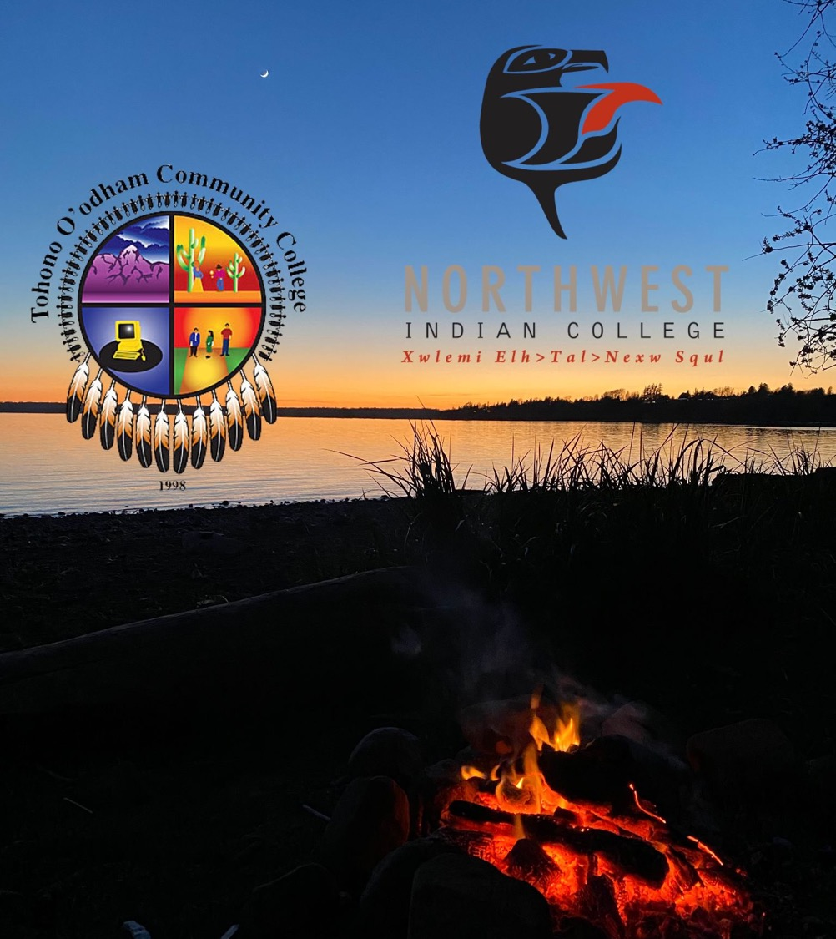
Education
Due to nationwide stay-at-home orders, some Tribal Colleges began offering free or reduced tuition:
Tohono O’odham Community College offered free tuition to tribally-enrolled (and Native Hawaiian) students.
Northwest Indian College offered a 50% tuition waiver to students for Fall 2020 and 2021.
Image Credit:
Hoku Rivera

Slide 35
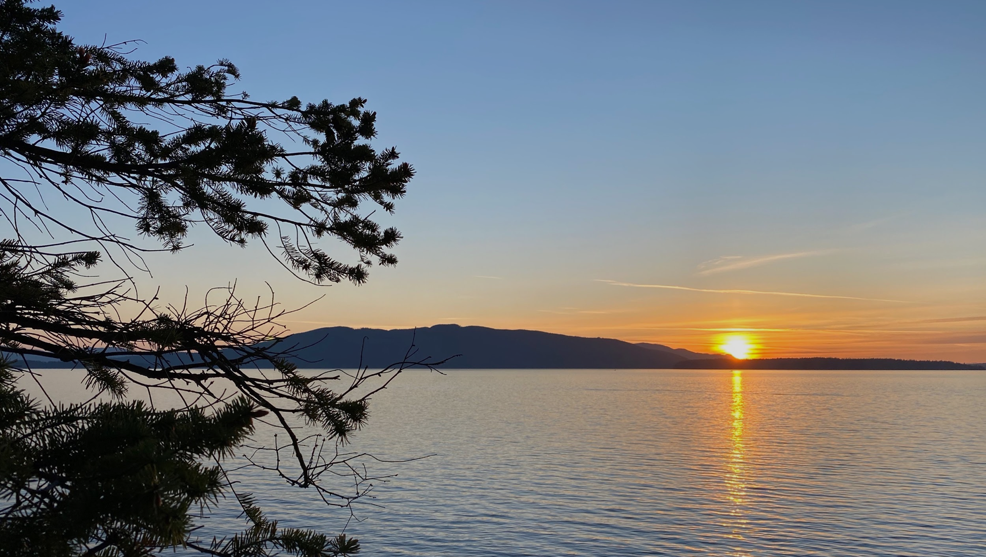
Indigenuity as Community
The Social Distance Powwow (SDP) & SDP Marketplace
Traditions and Arts could still be celebrated even remotely
Indigenous-owned small businesses thrived from the developing communal economics
Connections were rebuilt virtually
Hunting, Farming/Gardening & Trading
With the extra time at home, Indigenous Peoples could spend more time rebuilding their connections to place.
Virtual Spaces
With online platforms, many renewed their interest in language, traditional medicines and practices, and prayer.
E.g.: “E Hoʻopili Mai”
Image Credit:
Hoku Rivera
Notes:
https://www.intheknow.com/post/social-distance-powwow-native-american/
https://www.ksbe.edu/article/ksk-kumu-solatorio-amasses-global-social-media-following-of-his-lelo-hawaii/

Slide 36
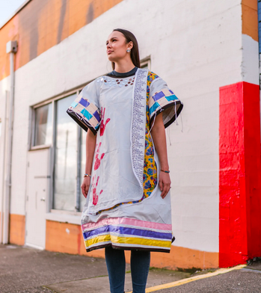
Indigenuity as Resilience
The United States has sent Indigenous Peoples a message of violence and erasure countless times, over multiple centuries.
In the latest message - when the Seattle Indian Health Board received body bags instead of PPE - this Indigenous woman (Abigail Echo-Hawk) repurposed it for healing.
She turned the body bags into a traditional ribbon dress.
Image Credit:
Samuel Fu
Notes:
https://www.vogue.com/article/body-bag-native-ribbon-dress

Slide 37
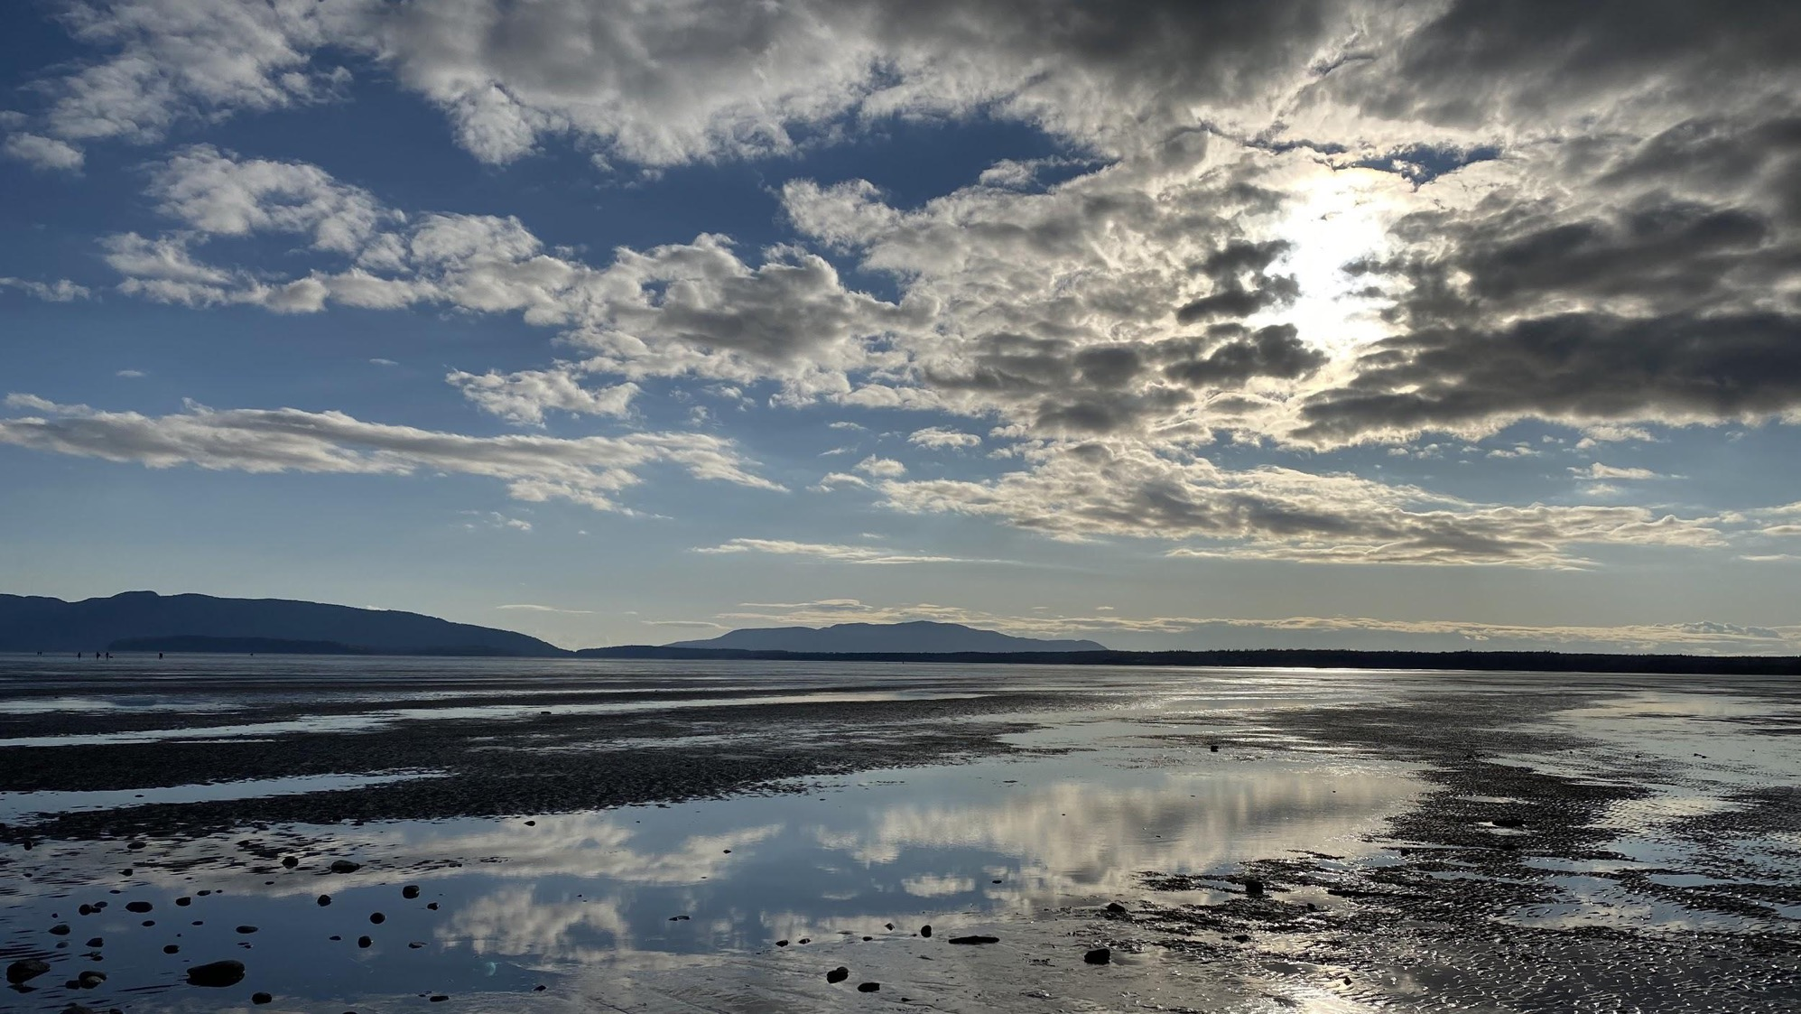
Discussion
What does ‘resilience’ mean to you?
While resilience can be meaningful, how can we create more room for healing within ourselves and our communities?
How has COVID-19 impacted your relationship with place and our non-human relatives?
What fears do you have when it comes to mitigating between tribal communities and public institutions (universities, federal departments, etc.)?
Image Credit:
Hoku Rivera

Slide 38
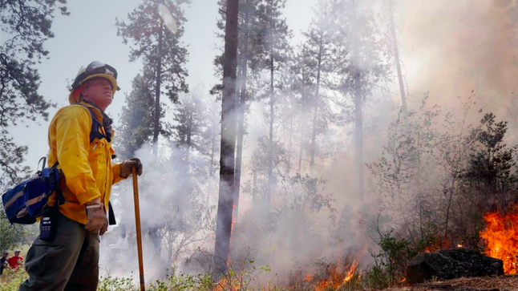
The Role of the Emergency Responder

Slide 39
The Necessity of Relationships
More so than non-Indigenous societies, the importance of relationships in Tribal communities cannot be overstated.
Historical breaches of trust and accountability have permanently colored the interactions between Tribes and non-Tribal entities.
Federal agencies engaging with Tribes need to understand trust as an ongoing process, as well as the disproportionate risk that Tribes carry in these interactions.

Slide 40
Mindful Practices for Relationship Building
Focus on the 7R’s of Indigenous Research:
Respect
Relevance
Reciprocity
Responsibility
Review the full article by Paulette Blanchard & Michelle Montgomery here.
Relatedness
Relationships
Redistribution

Slide 41
Differences in Tribal Protocol
In addition to the differences in Tribal histories and cultural values, it is important to recognize that there may be stark differences in protocol between one community and another. These include appropriate engagement practices and might govern how an outsider makes the initial approach to a community.
These differences have the potential to make or break a successful relationship between agencies and Tribes as they often represent respect.
Boundary organizations might be helpful in navigating these complexities but when in doubt, ask. Allow yourself to be teachable.

Slide 42
Critically Read the Policies Impacting Tribal Sovereignty in Emergency Situations
Treaties
While not “policies,” these documents are the cornerstones for all federal-tribal protocols, including FEMA Policies. Get to know the treaties that apply to the region(s) you serve.
Develop familiarity with these FEMA policies:
FEMA Policy #101-002-02: Consultation
What are the obstacles impacting tribal communities in this document?
FEMA Tribal Policy #305-111-1
This policy recognizes federally-recognized Tribes and Nations
Beware: Many hyperlinked policies in FEMA documents are out of date.
Notes:
https://www.docsteach.org/documents?filter_searchterm=AND%22treaty%22+AND%28%22native+american%22+OR+indian%29&searchType=formula&filterEras=&filterDocTypes=&sortby=date&filter_order=&filter_order_Dir=&rt=5E2Qs3X2zeZf&reset=1

Slide 43
FEMA Tribal Consultation Policy (#101-002-02)
Phase #1: Identify
Determining if an Agency action has tribal implications and thus requires tribal consultation
Phase #2: Notify
Once the need for consultation is identified, FEMA will notify the affected tribal governments.
Phase #3: Input
FEMA will then determine the process for consulting with tribal governments to “exchange information, receive input, and consider the views of tribes on actions that have tribal implications” (3)
Phase #4: Follow-Up
After consultation, FEMA will consider and incorporate the input received into decision-making process. FEMA will then contact tribal officials involved to communicate how consultation was used to inform the final decision.
Notes:
https://www.fema.gov/sites/default/files/2020-07/tribal-consultation-policy_07-03-2019.pdf

Slide 44
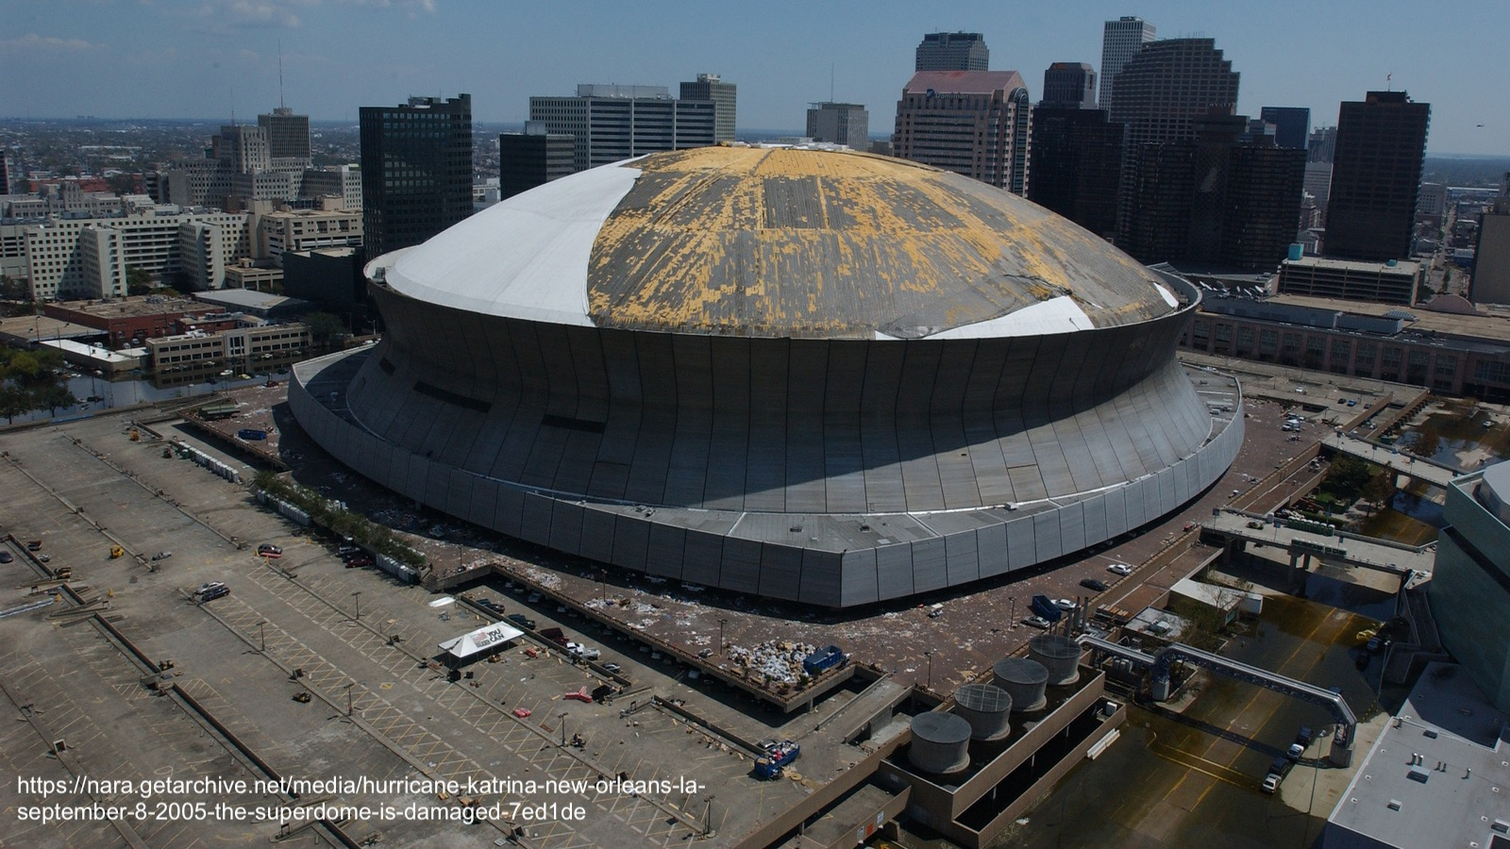
The Obstacles within Policies
”Without a FEMA-approved mitigation plan in place, tribes are not able to receive funding for permanent, non-emergency repairs or long-term mitigation measures, Andrews said. And yet, as of 2018, around 30% of tribal nations had an approved plan” (Herrera 2019).
When a plan is in place, full coverage of aid by FEMA is not a guarantee:
Spring 2013: Standing Rock Sioux Tribe faced severe flooding; FEMA granted <$240k
Elliot Ward (Tribal Emergency Manager) reported it wasn’t enough AND the tribe had to use more money to fix the repairs.
2015: Wildfires destroyed 24 homes and 20% of the land in the Colville Reservation
Individual Assistance requests were denied by FEMA, and reimbursements were delayed.

Slide 45
Government-to-Government Needs
Approved mitigation plans must be created for all tribes and nations.
Federal recognition is a Colonial-based barrier that works against Indigenous communities.
Urban Native Populations must be accounted for in disaster situations.
Progress has been made on that front, with the first meeting ever between FEMA and Urban Indian Organizations leaders having taken place in May 2020.
Treaty rights must be considered when creating mitigation plans
Tribal treaties have specific rights to the resources that make communities resilient after disasters: water rights; hunting, fishing, and gathering rights; resource rights; and environmental rights (NARF).
Notes:
https://www.ncuih.org/videos?article_id=436
https://www.narf.org/our-work/protection-tribal-natural-resources/

Slide 46
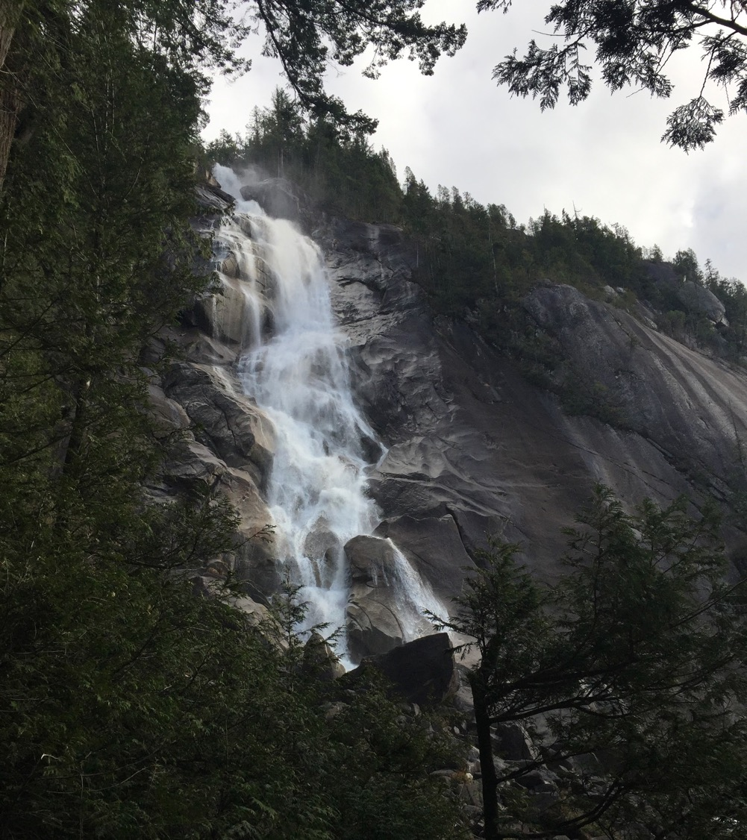
Alu Like
To work in unity with each other
Image Credit:
Hoku Rivera

