Slide 1
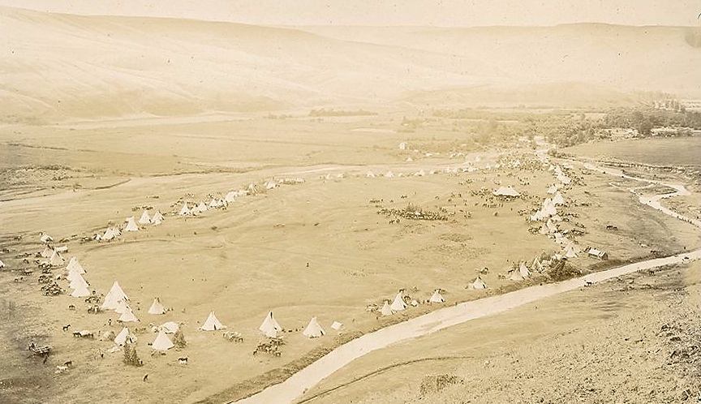
MODULE 1 Place-Based Identities: Nimiipuu
Notes:
Aerial view of large encampment of tipis. "Indian Encampment. Lapwai July 4th, 97.“ (Plateau Peoples’ Web Portal, 2018)
Citation: Plateau Peoples’ Web Portal. (2018). Indian Encampment. Lapwai July 4th, 97. [Image]. Indian Encampment. Lapwai July 4th, 97 | Plateau Peoples' Web Portal. http://plateauportal.libraries.wsu.edu/digital-heritage/indian-encampment-lapwai-july-4th-97

Slide 2
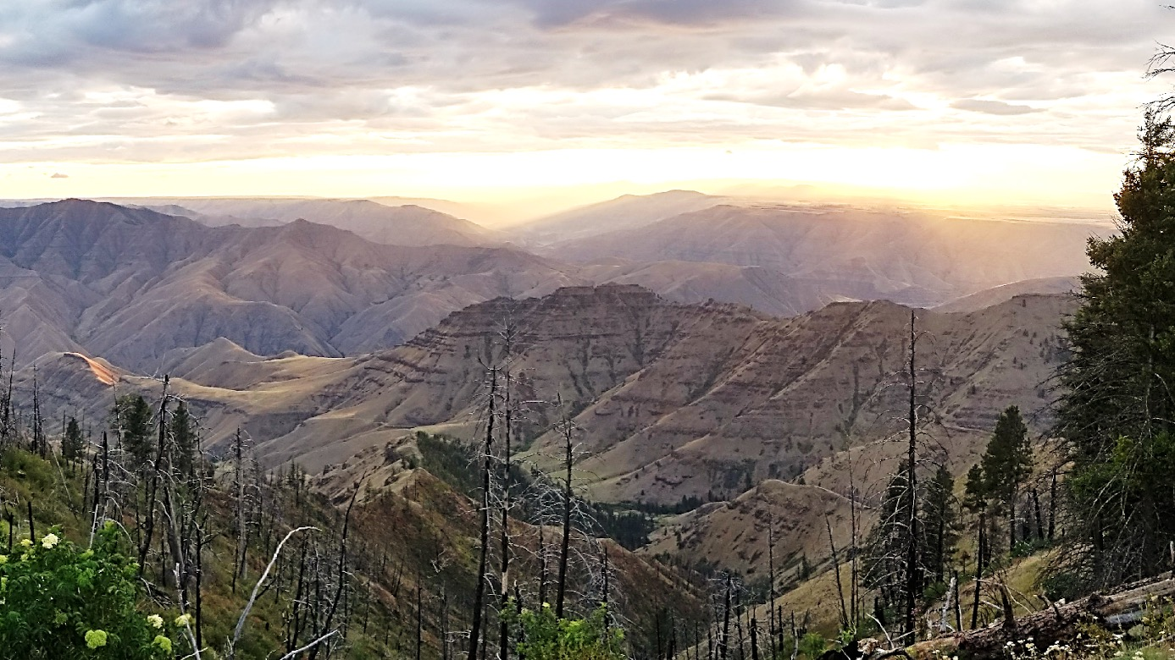
Module Objectives
Gain appreciation of the Nimiipuu worldview.
Describe values, relationships, balance, and responsibility of Nimiipuu with their homelands.
Consider Nimiipuu values, relationships, balance, and responsibility in emergency management.
Notes:
Image caption: Snake River breaks, Idaho.
Image courtesy of Sapóoq'is Wíit’as Ciarra S. Greene (2018).

Slide 3
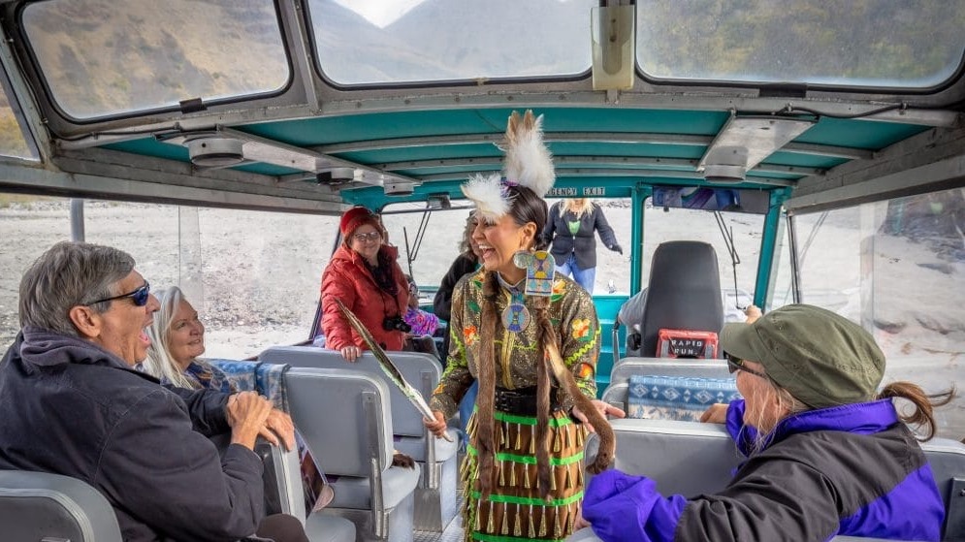
Outline
Exploration Activity: An activity assigned at the beginning of the module where students view videos of the Nimiipuu and take detailed notes addressing themes of place, identity, colonization, and resilience.
Opening Discussion: A class discussion where students share their video notes based on the themes and common values are identified.
Module Content: Informational content offers insight into the place, identity, colonization, and resilience of the Nimiipuu.
Holistic Understandings : Assigned as homework, a written response addressing the values of the Nimiipuu and critical needs in considering emergency management.
Notes:
Image caption: Stacia Morfin, owner of Nez Perce Tourism, invites guests to experience the place of the Nimiipuu through stories, songs, and cultural exhibitions/demonstrations.
Image courtesy of Nez Perce Tourism, LLC (2020).

Slide 4
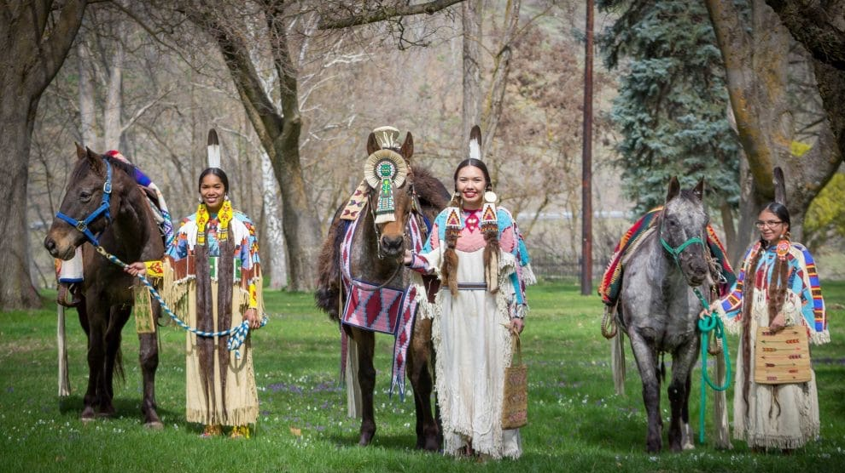
EXPLORATION ACTIVITY: The Nimiipuu worldview is difficult to communicate through text alone. To hear the language and see the people and places, provides insight into the Nimiipuu worldview. To truly understand though, is to speak the language, have a reciprocal relationship with place, know the stories, and honor the responsibility of protecting and healing place.
Notes:
An activity assigned at the beginning of the module where students view videos of the Nimiipuu and take detailed notes addressing themes of place, identity, colonization, and resilience.
Image caption: Young Nimiipuu women and horses dressed in traditional regalia on the banks of the Clearwater River.
Image courtesy of Nez Perce Tourism, LLC (2020).

Slide 5
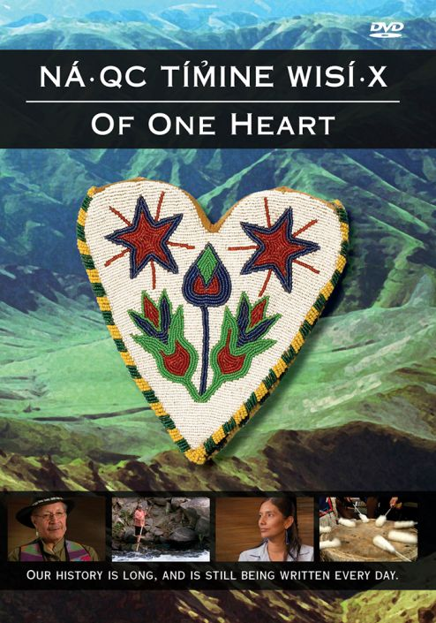
DIRECTIONS: Watch one or more of the following videos about the Nimiipuu. Each of the videos communicate aspects of the Nimiipuu worldview. The opening discussion for this module will be based on the videos. During the video, complete Cornell Notes.
Video List Option 1: Nimiipuu (22:31) Option 2: Closing the Circle #1 (12:52) and #2 (12:02) Option 3: Wisdom sits in places: Angel Sobotta at TEDxLCSC (19:32) Option 4: Surviving Lewis & Clark: The Nimiipuu Story (27:42)
Themes
The homelands of the Nimiipuu (including the landscape, climate, specific/sacred places) Values of the Nimiipuu Examples of Nimiipuu relationships with light, spirit, air, water, and earth Forms of colonization experienced by the Nimiipuu (Reference Module 1 -3) The impact of capitalism, imperialism, and federal law and policy experienced by the Nimiipuu
Notes:
An activity assigned at the beginning of the module where students view videos of the Nimiipuu and take detailed notes addressing themes of place, identity, colonization, and resilience.
Video List:
Nimiipuu
http://youtu.be/aTSNXhhqvOs
Closing the Circle #1
http://youtu.be/NVIKuPlA0cw
Closing the Circle #2
http://youtu.be/AxwrQhMEOoU
Wisdom sits in places: The Nimiipuu land: Angel Sobotta at TEDxLCSC
http://youtu.be/7WuaUXLqRTg
Surviving Lewis & Clark: The Nimiipuu Story
http://www.archaeologychannel.org/video-guide-summary/155-surviving-lewis-a-clark-the-nimiipuu-story?fbclid=IwAR13ChrzqLSTmQEG6wcJl76xIwy-tHJEvBhSzbWb5E2WkxG22_xRDqASUHI
Image: Cover of DVD featuring the Nimiipuu (Nez Perce) people. Of One Heart shares perspectives of a people whose contemporary way of life is firmly rooted in tribal tradition. Of One Heart introduces the rich heritage of the Nimiipuu, whose stories are preserved and interpreted at 38 sites comprising Nez Perce National Historical Park in Idaho, Montana, Washington and Oregon. The DVD can be purchased at http://www.discovernw.org/nez-perce-of-one-heart-dvd.html

Slide 6
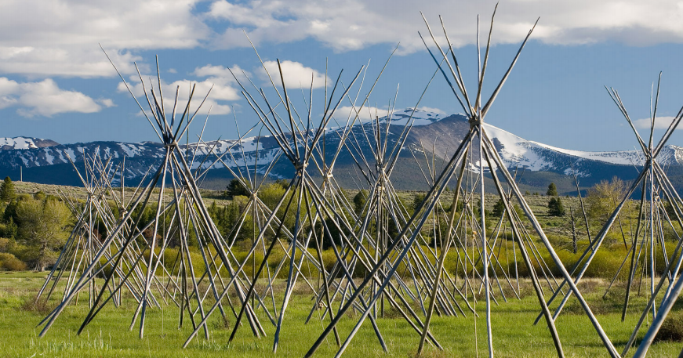
Opening Discussion:
Read the excerpts from the book Noon Nee Mee Poo (We, the Nez Perces)
Students share video notes based on the themes
Identify common values as a class
Image courtesy of Nez Perce Tourism, LLC
Notes:
A class discussion where students share their video notes based on the themes and common values are identified.
Image: Big Hole National Battlefield, the location of a surprise attack by the U.S. Army on members of the Nez Perce Tribe in western Montana. The skeleton tipis symbolize where the Nez Perce were asleep at the time of the attack. (Photo by Alan Majchrowicz Photography)
Image citation: Nez Perce Wallowa Homeland. (August 10, 2020). 143 Years, Remembering the Battle at Big Hole — Nez Perce Wallowa Homeland. http://www.wallowanezperce.org/news/2020/8/10/143-years-remembering-the-battle-at-big-hole

Slide 7
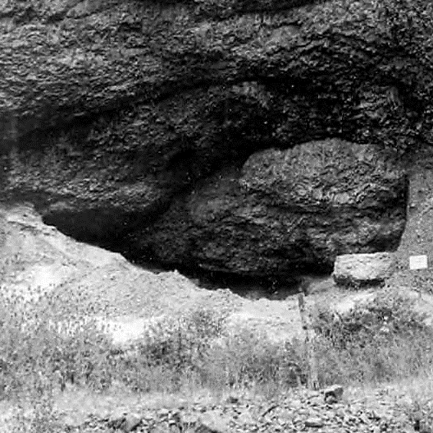
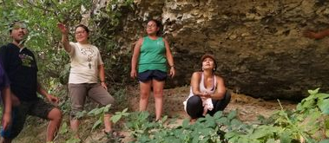
The Weis Rockshelter dates back more than 8,000 years with evidence as soon as 600 years ago. The site was backfilled after archaeologists excavated it in 1962.
Image below: Nimiipuu adults sharing knowledge at the Weis Rockshelter near the Salmon River, Idaho.
Right image: The site before backfilling. National Park Service, 1963
Notes:
Task: Read aloud the excerpts from the book Noon Nee Mee Poo (We, the Nez Perces)
“This is the history of the Nez Perce Nation, whose aboriginal domain was located in the northcentral part of Idaho, southeastern Washington, and northeastern Oregon, land comprised of approximately thirteen million acres of land. From time immemorial, they were identified as the Tsoop-nit-palu, which means ‘the walking people.’ The people were also known as the Nee-me-poo (We, the people).
Upon the arrival of the Lewis and Clark expedition in 1805, through a so-called interpreter, they were given the name of Nez Perce, a French translation meaning pierced nose. This is somewhat ambiguous, as it was a known fact that the Nee-me-poo tribe, as a whole, did not practice piercing their noses and wearing ornaments, like many authors have described. However, in the early days, other tribes were known to have pierced their noses. These people lived on the lower Columbia River and in other parts of the Northwest.
The Nez Perces were considered to be a noble and intelligent people. Basically a peaceful nation, this book will tell of Nez Perce skirmishes with other tribes and federal troops where Nez Perces were able to demonstrate superior skills and knowledge of warfare.
The book relates the many hardships, social and economic depressions, broken treaties, federal-tribal relationships, and the struggle to obtain the white man’s education. It will also describe living habits, customs, and cultural values of the Nez Perces. A new age will also be seen, an age which portrays the Nez Perce people regaining their place in an upward movement for the advancement of their social and economic well-being. Thus, we present the Nee-me-poo.
The Indian must learn that the entire history of man shows that pride is in fact a virtue and self-pity the deadliest of sins. His own history shows that he fought the white man valiantly, and – in accordance with his own, equally valid standards of warfare – cruelly. History shows that he lost, as he had to lose, but that he faught, like a man, like a true American. He owes nothing for having fought. The owing comes from his acceptance of the degradation imposed on him afterward, for the fact that the white man made a willing artifact of him for the solace of the white man's troubled soul. He has become something to possess, fought over by the missionaries on the one hand and the universities on the other. For this misuse, the white man owes him a chance to make his own choice once more, good or bad. Nez Perces used to be a strong people, breeders and traders of the horses by which the Plains Indians became the fierce Warriors the white man feared. The Nez Perces still raise horses and cattle with the limited land based remaining. They have their water, their rich forests to produce timber, their grazing land, their wheat farms to feed the city dwellers, their quarries to yield minerals needed by the white man's technology, their art to delight the outsider, and most of all, their country, into which they can admit the white men as visitor, to see an experience for a little while a life and a land he destroyed for himself” (Slickpoo et al., 1973, p. iii - iv)
“…Our homeland is located in present day North Central Idaho among some of the greatest hunting and fishing grounds of the nation. Elk, dear, bear, mountain goats and sheep, moose , and cougar have roamed the forests and cliffs from time immemorial and the fast, clear streams and alpine lakes are filled with fighting fish. Some of the most rugged terrain is beyond reach of all but the boldest adventures. The deep canyon country of the Salmon and Snake rivers is guarded by the Seven Devils. In this region, in which even packhorses often failed to find footing, are the Imnaha, the Grande Ronde, Joseph Creek, and Hell’s Canyon, the latter more than 2,000 feet deeper than the Grand Canyon of Arizona.
We call ourselves Ne-mee-poo, which means the ‘real people’, or ‘we the people.’ The names given to us by outsiders usually are based on habit or traits they attributed to us. We are called ‘dark brown’ by our Sahaptin neighbors to the west because we are supposed to have darker skin than other tribes in our area. But we ourselves call our neighbors Sukuy Sukuy, which also means ‘dark brown skin’, especially those who lived in low, arid areas, including the Columbia River. People to the south call us ‘people under the tule,’ apparently referring to our type of dwelling or sometimes ‘khouse eaters’ because of our liking for the edible root, khouse . It is not certain where the Blackfoot Indians derive their name for us which means ‘dark blue or dark green.’” (Slickpoo et al., 1973, p. 1)
“…Blue earth Indians and blue mud Indians may refer to the color and material of our face paint.
Archaeologists now tell us that we have been living in America upwards of 20,000 to 30,000 years period many of the earlier guesses as to our origin have been based either upon biblical stories or upon tales contained in classical literature. American Indians have been suspected of being descendants of Egyptians, Phoenicians, Greeks, Romans, Chinese, Japanese, Welsh, Irish, or people who made their way from a lost continent of Atlantis or Mu. Some people have even suggested that we are the descendants of lost tribes of Israel.
Archaeology has shown that Indians have been here a long time. They have found human bones and artifacts at Marmes Cave on the edge of Nez Perce territory dating from the last stages of the great ice age. Within the present Nez Perce territory, humans inhabited the Weis Rockshelter site from about 5,400 BC to 1,400 AD. Here, there are indications of volcanic ash deposits from Mt. Mazama, whose terrible explosion covered the northwest. The Weis Rockshelter is located in Nee-pe-ha (presently called Graves Creek near Cottonwood, Idaho.
Some of our legends may describe this earlier age. For example, elderly Nez Perces relate the time when the Tah-seeh was hunted in the area. The Tah-seeh was a huge, hairy animal resembling the musk ox, which may have been around here during the last days of the ice age. Others describe giant elk of the size that fed the Marmes man. There is some connection too between the present-day elk (female) which is called Tah-seeh.
Some of our elders also relate traditional stories of huge birds that could pick up and fly away with a human being. These huge birds were called Khoo-sa. Maybe they were the huge condors that once flew in Nez Perce country.
Anthropologists say that we speak a language related to many other Penutian languages of the Northwest, California, and possibly even Mexico. The many centuries necessary for our ancestors have spread so far shows that we have existed as long as any other culture. We are proud of ancient history which our own traditions have preserved and which science is helping to reveal.” (Slickpoo et al., 1973, p. 5)
Citation: Slickpoo, A. P., Walker, D. E., & Nez Perce Tribe of Idaho. (1973). Noon nee-me-poo (We, the Nez Perces): Culture and history of the Nez Perces. Lapwai, Idaho: Nez Perce Tribe of Idaho.
Color image courtesy of Sapóoq'is Wíit’as (Ciarra S. Greene).
Right image: Nez Perce National Historical Park. 1963. Weis Rock Shelter. [Image]. http://content.libraries.wsu.edu/digital/collection/npsnezperce/id/2430/

Slide 8
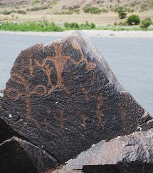
SUMMARY
Homelands stretch across North Central Idaho into Washington state and Oregon
History dates back thousands of years
Relationships with sacred places and with plants, animals, and non-human beings
Knowledge passed down from generation to generation orally, before a written language was practiced
Impacts of colonization
Notes:
The excerpt describes the Nimiipuu homelands as stretching across northcentral Idaho into Washington state and Oregon, made up of mountains, rivers, canyons, prairies, and forests. A history that dates back thousands of years is apparent in the landscape and within the culture. The Nimiipuu value their sacred homelands. They have relationships with sacred places and with plants, animals, and non-human beings; these understandings have been passed down from generation to generation orally, before a written language was practiced. There are multiple facets of colonization expressed, including reduction of accessible territory to practice cultural lifeways of hunting, fishing, gathering; removal of land means removal of sacred, living and giving places. Further imposition of colonial frameworks about and onto the Nimiipuu included misnaming them (i.e. pierced noses – Nez Perce), forced assimilation through missionaries, academics, politics, and the economy which led to changes in the homelands of the Nimiipuu still present today.
Tasks: Students share video notes based on the themes
Tasks: Identify common values as a class
Image: Nimiipuu petroglyphs dating back 4,500 years at Buffalo Eddy, Snake River at the Washington/Idaho border. National Park Service, 2020
Image citation: National Park Service. (2002). What meanings do you see etched into the Snake River stone? [Image]. Bufallo Eddy History – Nez Perce National Historical Park. http://www.nps.gov/nepe/learn/historyculture/buffalo-eddy.htm

Slide 9
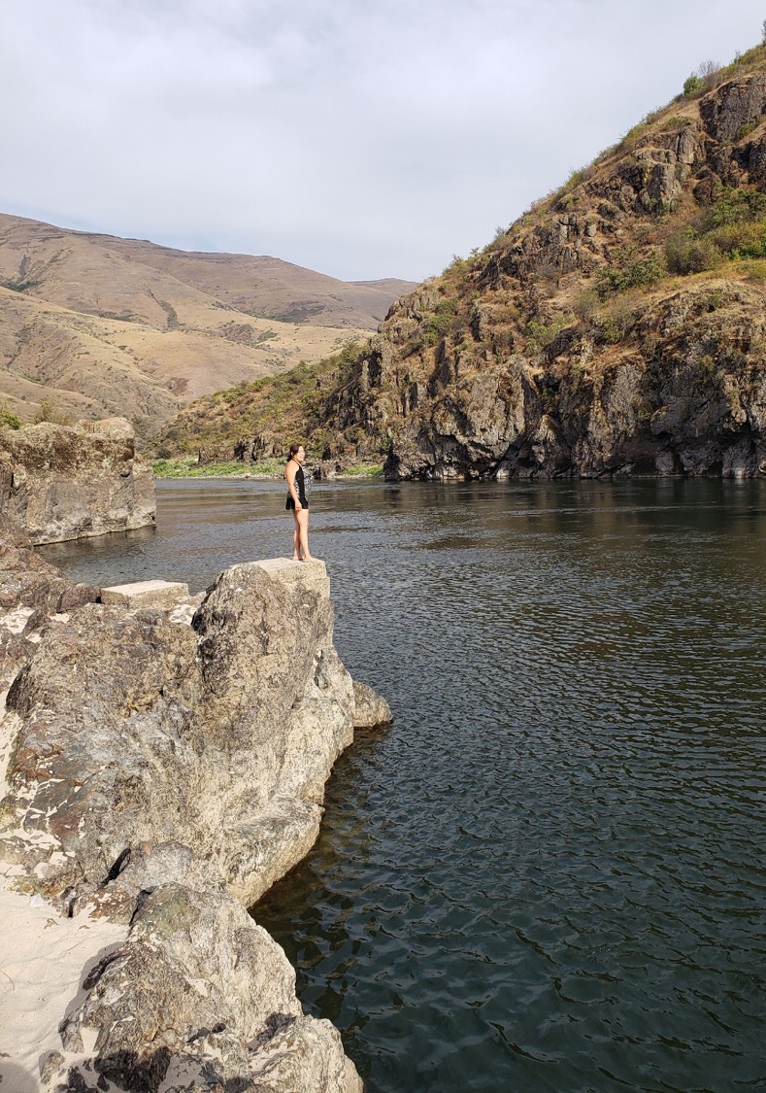
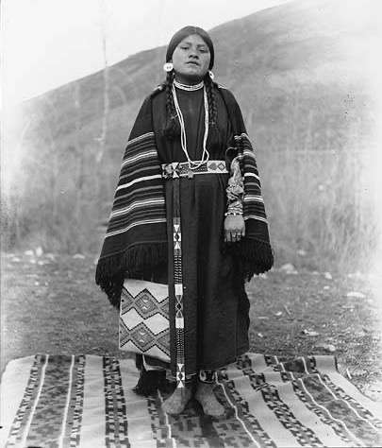
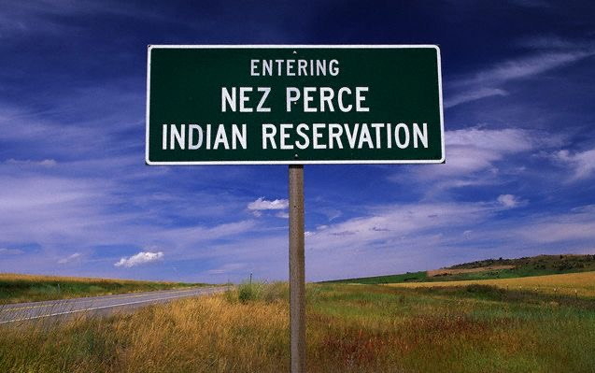
Nimiipuu Worldview
Place
Story
Identity
Seasonal Round
Changing Landscapes
Critical Needs
Notes:
Left image: “Entering Nez Perce Reservation” sign at the southeast end of the present-day reservation. (Sohm, 2006)
Center image: Nez Perce woman named Lizzie Cayuse, ca. 1903. Young woman stands on blanket outside. She wears dress over long sleeved shirt. Her hair is braided and she wears earrings, necklaces, bracelets, three rings on her left hand, beaded belt, moccasins, and blanket around her shoulders. She holds a cornhusk bag. (University Libraries – University of Washington)
Right image: Nimiipuu woman standing along the rocky canyon of the Salmon River on a hot August day. A place where Nimiipuu swam, fished, and traveled for thousands of years.
Left image citation: Sohm, J. (2006). Nez Perce Reservation highway entrance sign. [Image] http://serc.carleton.edu/download/images/6068/_1139622185.jpg
Center image citation: Edward H. Latham Collection. (1903). Nez Perce woman named Lizzie Cayuse, ca. 1903. [Photograph] http://digitalcollections.lib.washington.edu/digital/collection/loc/id/1573
Right image citation: Image courtesy of Nimiipuu’neewit: Lifeways of Our Homelands (2019)

Slide 10
Place: The video excerpt from ná·qc tım̉íne wısí·x: Of One Heart describes the Nimiipuu homelands and relationship to place. Watch the video at: http://vimeo.com/151098037
Notes:
Video citation: Grayzel, Lindsey. [lindseygrayzel]. (2016, January 7). "ná·qc tım̉íne wısí·x: Of One Heart" – Excerpt [Video]. Vimeo. http://vimeo.com/151098037

Slide 11
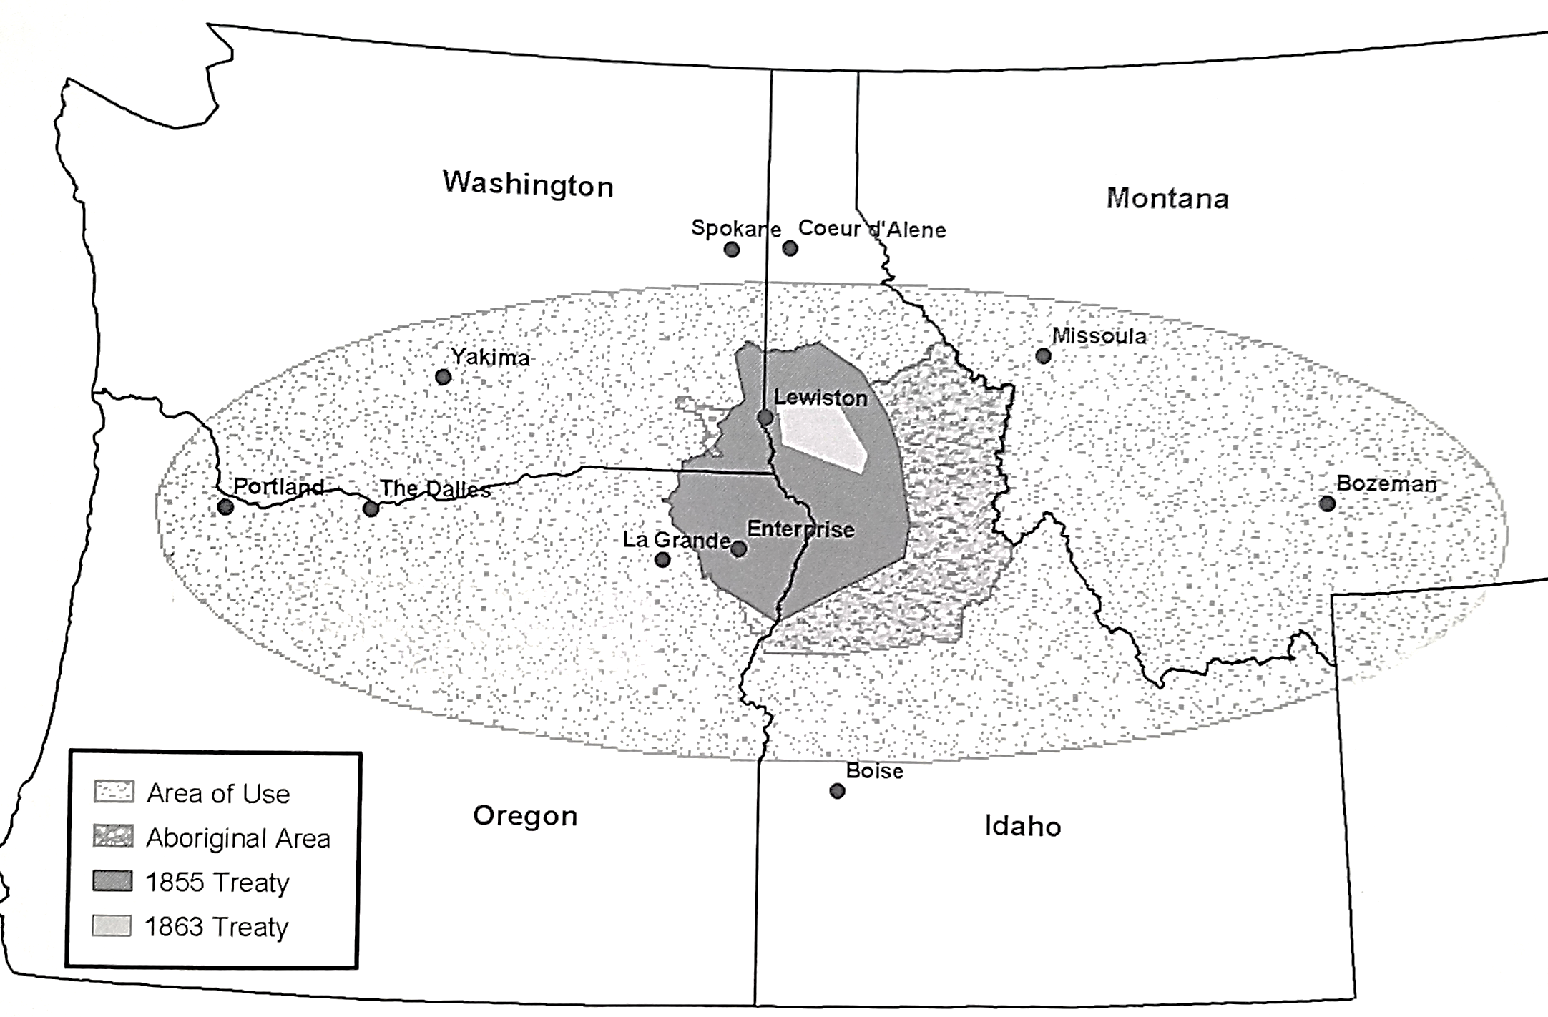
Territory of the Nez Perce Tribe and Land Diminishment since the Treaty of 1855.
(Nez Perce Tribe of Idaho, 2003, p. xiii)
Notes:
Read the excerpt from the book Noon Nee Mee Poo (We, the Nez Perces):
“We also had friendly relations with many of our neighbors in the Northwest, Great Basin, and Plains. Early white explorers observed our ancestors regularly in such places as southern Oregon and Idaho. They were also seen in the Willamette Valley, the western Great Plains, at the confluences of the Spokane and Little Spokane, the Snake and Columbia, the Deschutes and Columbia, the John Day and Columbia, the Yakima and Columbia rivers; and at principle fisheries such as those found at Celilo, Kettle Falls, Willamette, and Spokane Falls. The Nez Perces were probably the most traveled tribe of the Northwest, and with their neighbors, the Cayuse, were the military masters of the Plateau and strong contenders for dominance in the western Plains and the Plateau region.
Our ancestors were the only direct link between The Dalles-Celilo region and the northern Plains, and our importance as traders is well known. We and other Plateau tribes held annual trade fairs at The Dalles and Celilo Falls, the Yakima Valley, and at Walla-Walla. An early white explorer described one of our trade fairs as follows:
‘We had scarcely advanced three miles when a camp of the true Mameluke style presented itself; a camp of which we could see the beginning but not the end! It could not have contained less than 3,000 men exclusive of women and children and treble that number of horses. It was a grand and imposing sight in the wilderness, covering more than six miles in every direction. Councils, root gatherings, hunting, dancing, drumming, yelling, and thousand other things which I cannot mention, were going on around us.’” (Slickpoo et. al., 1973, p. 24)
Citation: Slickpoo, A. P., Walker, D. E., & Nez Perce Tribe of Idaho. (1973). Noon nee-me-poo (We, the Nez Perces): Culture and history of the Nez Perces. Lapwai, Idaho: Nez Perce Tribe of Idaho.
The place of the Nimiipuu was not a wilderness, but a well-maintained ecosystem. This includes an inherent relationship with the land, the earth and spirituality that Western science does not capture in their approach through integrated resource management.
Image citation: Nez Perce Tribe of Idaho. Environmental Restoration & Waste Management Dept. (2003). Treaties: Nez Perce perspectives. [Lewiston, Idaho]: Confluence Press.

Slide 12
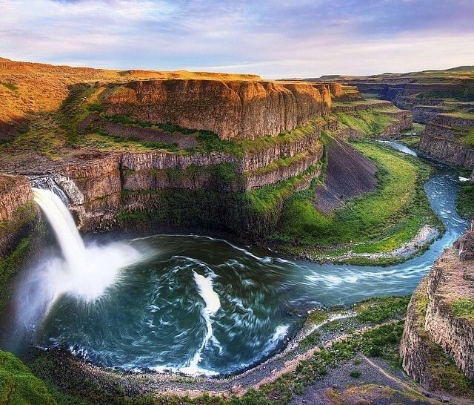
Story: Stories describe place, interactions, characteristics, and values and have been passed down orally for thousands of years.
“The earth is part of my body… I belong to the land out of which I came. The earth is my mother.”
-Too-Hool-Hool-Zute
Notes:
“The following Nez Perce creation story explains the origins of other geological features as well as the important reciprocal relationships the Creator established between the animals and human beings.
A Meeting Between Creator and the Animals
On one of the slopes of the Clearwater River near Lewiston, Idaho, there are a lot of rounded stones going up one of the draws. As you look along the ridgeline there are also other rocks of all different sizes and forms, but most of them are very large. Some of these are referred to by the Nez Perce as the “large animals.” They are the remains of the large animals before there were human beings. The Nez Perces have always known that at one time there were large animals that inhabited this country because we find large bones in the ground between Clarkston and Pasco. The creator called all of these large animals together telling them that there was going to be a great change, and he said that some of them probably wouldn't survive. Many of the animals were late to the meeting that the creator had called and as a result were turned to stone. So creator called all the large animal people together and said there was going to be a great change and that he wanted all of the animals to qualify themselves for a new kind of human being that would be coming as a result of this great change. Creator wanted to know hello what was going to be qualified to help the these new human beings when they came because those human beings were going to be naked, they were going to have a hard time making a living. The Creator said, ‘I want each one of you to come forward and be qualified to help these new human beings when they come.’ So all the animals had to come up and be qualified.
The Nez Perce people could describe every animal including the birds, fish is, and insects that they knew of with this story. This is one story that they could relate for days and days to the young people and tell them how they used these species to survive.
So Deer, he comes out and says, ‘I want to have horns that come up and branch out, and I want to have big ears so I can hear well, and I want a little short tail with a black tip on it. These no human beings when they come can use my horn to make arrows and Flint knives, and they can use my hide for clothing to keep warm, and they can use my hooves to make rattles to sing their songs with.’ So Creator said, ‘You act the way you want to act, and that’s the way you will be,” and that deer is what we call mule deer today.
Well, another deer came forward and said, ‘I don’t want to be like that one. I want to have horns that come up a different way and then branch out. I don’t like large ears and I want a tail that’s longer,’ and so he described himself how he wanted to be, and he also said that the new human beings could use his body parts and also his brains to help them tan the hikes and make them soft and white. That deer was called Blacktail deer. The Creator said, ‘Okay, you are qualified to help these new human beings when they come.’
Another deer came forward and said… Then Moose came forward and said… Then Elk came forward and said…Then Eagle came forward…Then Crow came forward…Then Bee came forward… Spider came forward…Salmon and Steelhead came forward… Sockeye Salmon came forward…Trout came forward…Eel [lamprey] came out…
The last animal to be qualified was Coyote. Coyotes came out, and he couldn’t get qualified. He tried to be qualified to do something, but he couldn’t even talk. When Coyote talks, it sounds like two or three coyotes talking at the same time. So he couldn’t get qualified, and finally Creator said that he would take pity on him. He said, ‘Because you can’t get qualified I’ll give you special powers. When these new human being come, you will have all the faults and all the traits that this new human being will have. That’s what you will be able to do, but I’ll give you some special powers beyond that. You will be able to transform and change yourself, and you will be able to get out of bad situations in order to save yourself, and you will be able to get out of bad situations in order to save yourself. You will also be able to teach these new human beings many things.’ Creator said, ‘I’ll make you qualified but you’ll get to be gray. You won’t have any others colors.’ That’s the way Coyotes was created, and that’s how Coyote became qualified to help new human beings.
About this time Grizzly Bear spoke up and said, ‘What are we going to do about day and night? I want six months of night and sic month of day.’ Chipmunk perked up and said, ‘We can’t have that. I want one day and one night.’ So Chipmunk and Grizzly Bear started to argue…Finally, Creator told the two of them to go off to have their argument, and he told them that whoever won the argument would determine the way the new world would be created. So Grizzly Bear and Chipmunk went off and continued arguing.
After a long time, Grizzly Bear started to get tired, and he was trying not to go to sleep but Chipmunk was still going strong. Finally, Grizzly Bear got so tired that we went to sleep. Chipmunk yelled, ‘I won, I won, there will be one day and one night when those new human being come.’ Creator replied, ‘That’s the way it will be from now on, one day and one night.’ Soon, Grizzly Bear awoke and found out from the other animals that he had lost the argument. This made him angry and he started chasing Chipmunk. As Chipmunk was trying to get away, Grizzly Bear put out his claws and scratched Chipmunk on the back, and that is why today the Chipmunk has black and white stripes on his back.
-Allen Pinkham (Nez Perce)” (Landeen and Pinkham, 1999, p. 4-8)
Citation: Landeen, D., & Pinkham, A. (1999). Salmon and his people: fish and fishing in Nez Percé culture. Confluence Press.
Image: Palouse Falls on the homelands of the Nimiipuu. Ice Age Floods Institute
Image citation: Ice Age Floods Institute. (2016). Snake River-Palouse Falls Bus Tour. http://i.pinimg.com/736x/f4/64/a7/f464a73b5ed67ea3f80752b2071a5478.jpg

Slide 13
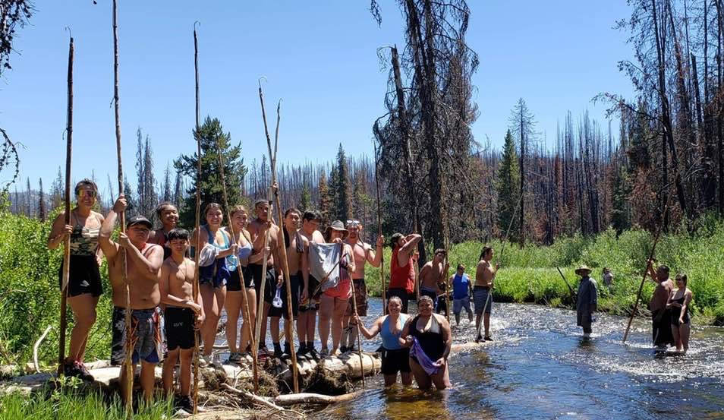
Identity: Nimiipuu identity is linked through time and space through place, community, and values that persist today. Continuing relationships with place is imperative in sustaining the Nimiipuu culture.
Notes:
Read the following quotes from Nimiipuu people of the past and present that describe who they are and their worldview…
Image caption: The Secesh River in central Idaho is one of the furthest inland runs of natural salmon still active today. The Greene family of Lapwai are one of the last families to annually fish the high-elevation river using gaff poles as their ancestors did for thousands of years. This is a place the family is known for maintaining a connection to, exercising their inherent rights to fish and gather in their usual and accustom areas.
Image courtesy of Sapóoq'is Wíit’as Ciarra S. Greene (2018).

Slide 14
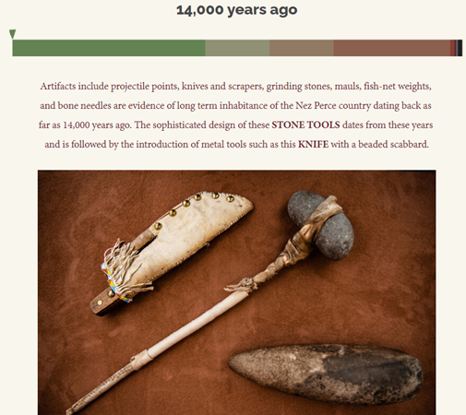
“…historically [we] did not use gill nets. They used to make a lot of hooks out of [Indian hemp]. We would hold it, braid it, and it couldn’t break. We would peel the bark off of it. Sam Watters made hooks like this… You had to roll it a lot to make them. We also made antler and bone hooks.
-Lyman Scott”
Notes:
Image citation: Nez Perce Wallowa Homeland. (n.d.). Our Creation Story. http://www.wallowanezperce.org/our-creation-story
Quote: Landeen and Pinkam, 1999, p. 94
Citation: Landeen, D., & Pinkham, A. (1999). Salmon and his people: fish and fishing in Nez Percé culture. Confluence Press.

Slide 15
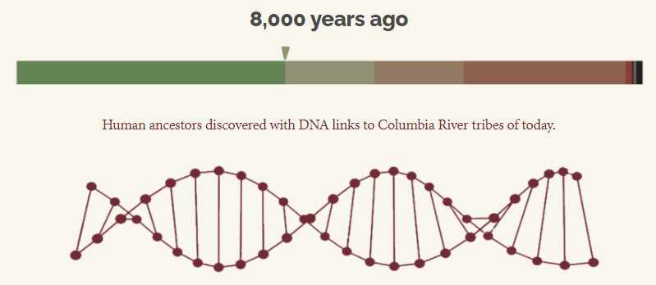
“Our traditional relationship with the earth was more than just reverence for the land. It was knowing that every living things had been placed here by the Creator and that we were part of a sacred relationship… entrusted with the care and protection of our Mother Earth. We could not stand apart from our environment.
– Elsie Maynard”
Notes:
Image citation: Nez Perce Wallowa Homeland. (n.d.). Our Creation Story. http://www.wallowanezperce.org/our-creation-story
Quote: Landeen and Pinkam, 1999, p. 52
Citation: Landeen, D., & Pinkham, A. (1999). Salmon and his people: fish and fishing in Nez Percé culture. Confluence Press.

Slide 16
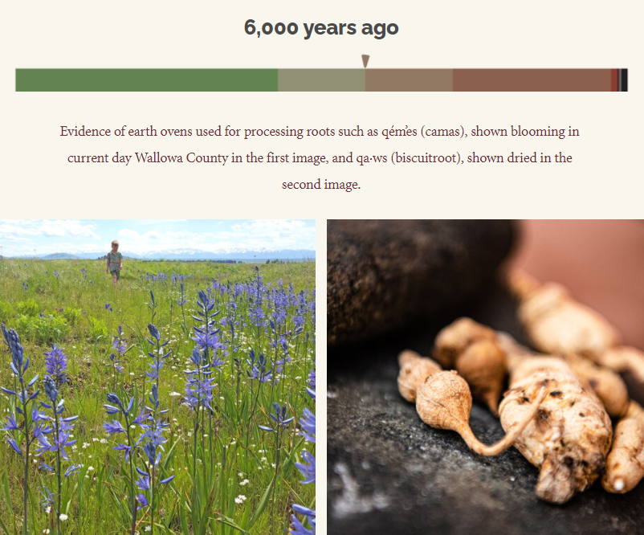
“We didn’t make the skies bring rain, we didn’t make the roots grow, we didn’t make the salmon run. When it was time for the salmon to run, we moved down to the rivers, and when it was time for the foods and medicines to grow, we turned into the mountains. We moved in reference to the landscape and to the resources that nature provided to us.
-Jaime Pinkham”
Notes:
Image citation: Nez Perce Wallowa Homeland. (n.d.). Our Creation Story. http://www.wallowanezperce.org/our-creation-story
Quote: Nez Perce Tribe of Idaho, 2003, p. 70
Citation: Nez Perce Tribe of Idaho. Environmental Restoration & Waste Management Dept. (2003). Treaties: Nez Perce perspectives. [Lewiston, Idaho]: Confluence Press.

Slide 17
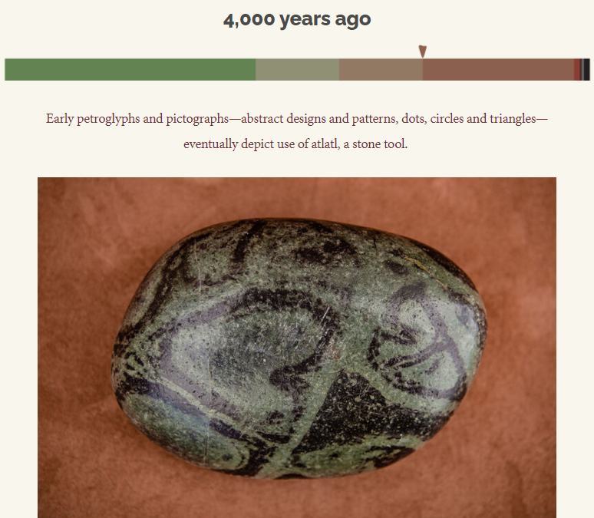
“I want you to understand that there was another aspect of life already here when the non-Indian people came to this country. It was a good life. Sure, we had our difficulties before the white man came, but they were difficulties that had more to do with the battling of elements. In our stories we would learn how to survive the harsh conditions that could be imposed by the elements.
-Allen Pinkham”
Notes:
Image citation: Nez Perce Wallowa Homeland. (n.d.). Our Creation Story. http://www.wallowanezperce.org/our-creation-story
Quote: Nez Perce Tribe of Idaho, 2003, p. 4
Citation: Nez Perce Tribe of Idaho. Environmental Restoration & Waste Management Dept. (2003). Treaties: Nez Perce perspectives. [Lewiston, Idaho]: Confluence Press.

Slide 18
Notes:
Image citation: Nez Perce Wallowa Homeland. (n.d.). Our Creation Story. http://www.wallowanezperce.org/our-creation-story

Slide 19
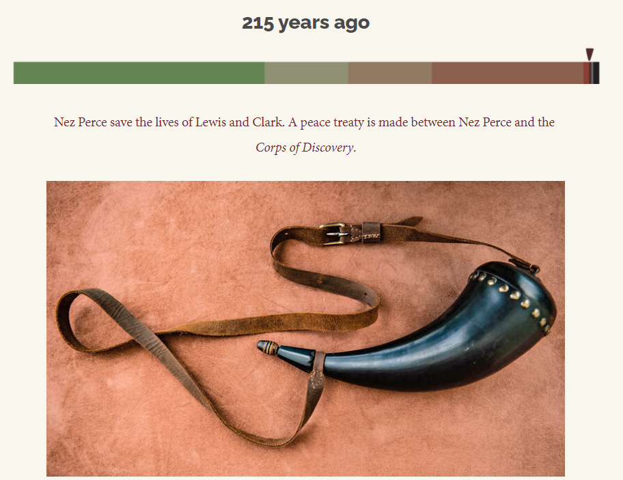
“For all intents and purposes the first official agreement between the Nez Perce and the government of the United States occurred in 1805 with the Lewis and Clark expedition. Lewis and Clark were official representatives of the United States and entered into a ‘peace and friendship’ agreement with the Nez Perce and other tribes. The Nez Perce took this agreement very seriously and often referred to it in their subsequent negotiations with the federal government.”
(Nez Perce Tribe of Idaho, 2003, p. 20)
Notes:
Image citation: Nez Perce Wallowa Homeland. (n.d.). Our Creation Story. http://www.wallowanezperce.org/our-creation-story
Quote citation: Nez Perce Tribe of Idaho. Environmental Restoration & Waste Management Dept. (2003). Treaties: Nez Perce perspectives. [Lewiston, Idaho]: Confluence Press.

Slide 20
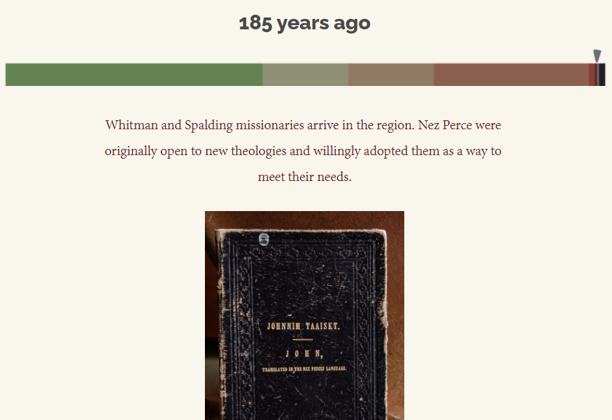
“We do not want churches because they will teach us to quarrel about God, as the Catholics and Protestants do. We do not want that. We may quarrel with men about things on earth, but we never quarrel about the Great Spirit.
-Chief Joseph”
Notes:
Image citation: Nez Perce Wallowa Homeland. (n.d.). Our Creation Story. http://www.wallowanezperce.org/our-creation-story
Quote: Nez Perce Tribe of Idaho, 2003, p. 12
Quote citation: Nez Perce Tribe of Idaho. Environmental Restoration & Waste Management Dept. (2003). Treaties: Nez Perce perspectives. [Lewiston, Idaho]: Confluence Press.

Slide 21
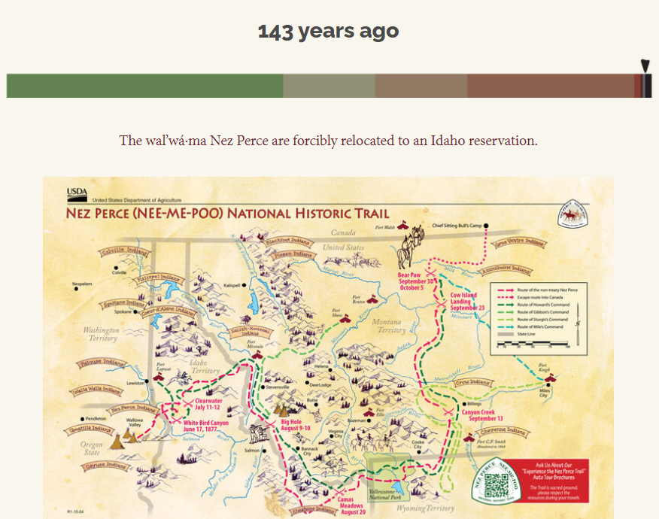
“Even when I was a boy we got into the habit of hiding our fishing gear because of the fear of being hassled by the local law enforcement officials. It was always a touch and go situation… Many times we used to fish at night even when we were gaffing for suckers so we could avoid being harassed.
-Wilfred Scott”
Notes:
Image citation: Nez Perce Wallowa Homeland. (n.d.). Our Creation Story. http://www.wallowanezperce.org/our-creation-story
Quote: Landeen and Pinkam, 1999, p. 114
Citation: Landeen, D., & Pinkham, A. (1999). Salmon and his people: fish and fishing in Nez Percé culture. Confluence Press.

Slide 22
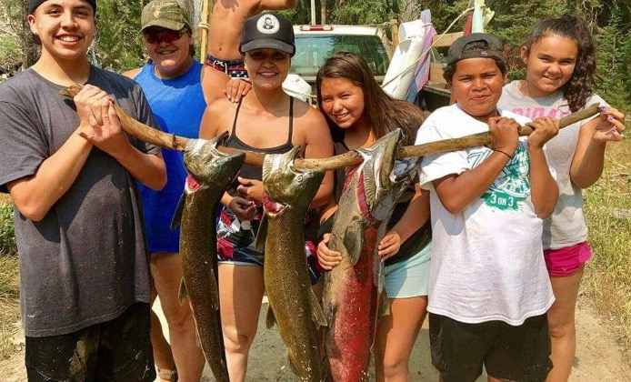
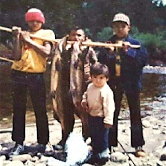
“Our animal legends have a lot more truth to them than many think and there are a lot of lessons we can learn from our brothers and sisters who live on the land, in the air and water. It is important to observe animals and pay close attention to them and do things that will preserve them. If we lose the animals because of pollutions which we have made, we will be next. – Leroy Seth (Nez Perce)” (Landeen and Pinkam, 1999, p. 1)
“We learn a lot of lesson from watching animals. The salmon are one of our best teachers. We learn from them that we have to do certain things by the seasons. We watch the salmon as smolts going to the ocean and observe them returning home. We see the many obstacles that they have to overcome. We see them fulfill the circle of life, just as we must do. If the salmon aren’t here, the circle becomes broken and we all suffer. – Leroy Seth (Nez Perce)” (Landeen and Pinkam, 1999, p. 3)
Notes:
Citation: Landeen, D., & Pinkham, A. (1999). Salmon and his people: fish and fishing in Nez Percé culture. Confluence Press.
Images courtesy of Sapóoq'is Wíit’as Ciarra S. Greene (left 1970’s, right 2017).

Slide 23
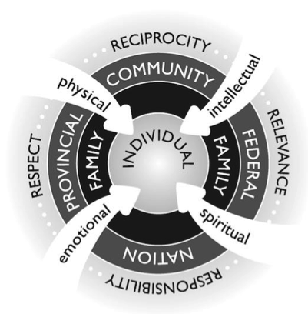
“While there is great diversity among Indigenous Peoples, there are also some commonalities in Indigenous worldviews and ways of being. Indigenous worldviews see the whole person (physical, emotional, spiritual, and intellectual) as interconnected to land and in relationship to others (family, communities, nations). This is called a holistic or wholistic view…”
(Cull et al., 2018)
Notes:
Image: Pidgeon intentionally uses the “w” in holistic for the Indigenous wholistic framework to reference the whole person. Absolon (2009) and Archibald et al. (1995) also intentionally use the term “wholistic.”
Image and quote citation: Cull, I., Hancock, R., McKeown, S., Pidgeon, M., & Vedan, A. (2018). Indigenous Ways of Knowing and Being. Bccampus. Retrieved from http://opentextbc.ca/indigenizationfrontlineworkers/chapter/indigenous-ways-of-knowing-and-being/#footnote-47-2

Slide 24
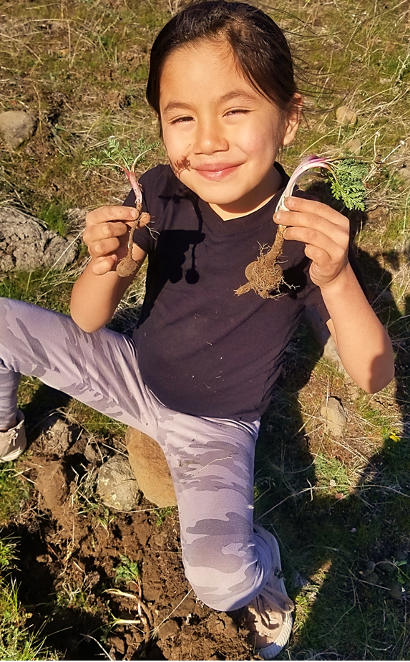
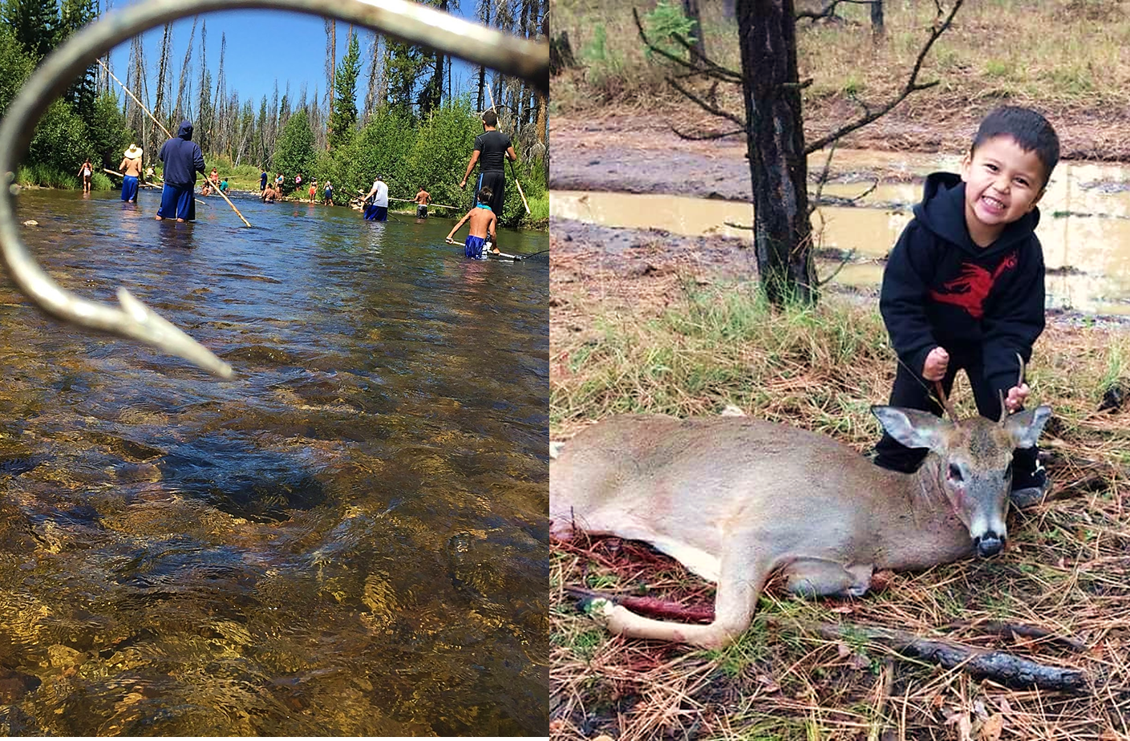
Seasonal Round: The life cycle of the Nimiipuu correlate to the daily rhythms and seasons of the land.
“Every activity and cultural practice fitted into a ‘seasonal cycle or round.’ There was a pattern to this movement. It was a purposeful journey rather than random wandering. Families and bands traveled to their usual and accustomed places for hunting, fishing, and harvesting roots and plants.”
(National Park Service)
Notes:
Slide quote citation: National Park Service. (n.d.). Nez Perce museum collections: Seasonal Round. http://www.nps.gov/museum/exhibits/nepe/seasonal_round.html
Images courtesy of Sapóoq'is Wíit’as Ciarra S. Greene (left 2020, middle and right 2017).

Slide 25
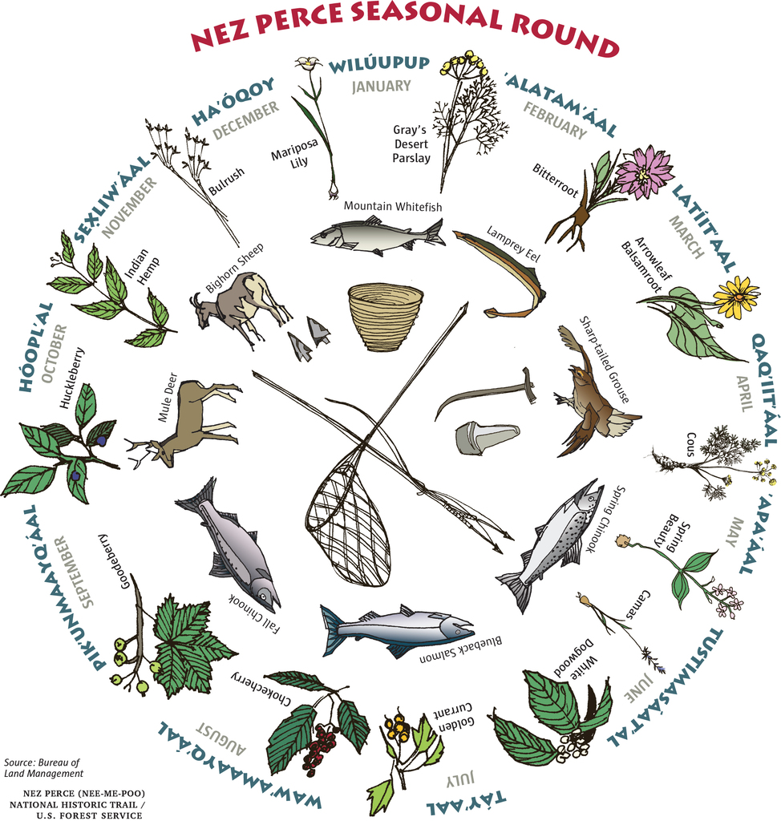
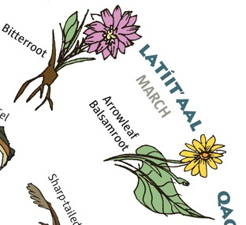
0
Latíita’aal is commonly associated to the month of March, but the word latíita’aal translates to “flowering season” and comes from the root word latí, the verb, “to bloom.”
Language carries deep knowledge of place, time, and values.
Notes:
Read aloud the excerpt from the National Park Service:
“[the Nimiipuu] used the seasons of the year as a means to keep track of time and to guide the major activities & celebrations in their culture. This is often referred to as “the seasonal cycle” or the “seasonal round”… They did not use a 12 month calendar or watches like we use today. The length of a particular season would vary from year to year depending on; when cold or warm weather arrived, how dry or wet it was, when plants matured, when fish ran, etc. Having lived on dried foods all winter, spring was a time to gather the early greens and roots growing in the low river valleys that made good winter home sites. The men began fishing as soon as the run of spring Chinook started up the river. The snow would be starting to melt out of the mountains and as the run of salmon ended the bands would begin moving to higher elevations. Woman and younger children concentrated on harvesting whatever plants were in season and ripe. Woman cooked the foods and preserved extra by drying it. Nimiipuu women also were in charge of the home. They gathered the materials needed to make it, prepared them, made it, put the home up, took it down and moved it as needed. Large game would become more accessible for hunting by the men as the snow retreated through the spring and summer. Men were also ready at all times to protect their family and band if the need arose.
Bands began to move toward the end of spring, and through the summer they would often meet other Nez Perce bands. It was a good time for socializing with friends and relatives you might not have seen for a year. Through the summer, as some of the bands stayed in the mountains to continue gathering and hunting, others would return to the rivers to fish the summer run of Chinook. As fall approached, gathering foods and supplies for winter became the primary concern. Everything needed to make winter clothes, new tools, and other items would be collected during the fall.
Winter brought with it a return to the deep, warmer river valleys where the rivers and streams provided needed water and wood for fuel. Winter was a quieter time; a time to stay at home, to make tools and other items, pass on the ancient stories and conduct ceremonies.”
Image source: National Park Service. (n.d.). Teaching Museum Collections: The Nez Perce Seasonal Round. http://www.nps.gov/museum/tmc/NEPE/GenderRoles/GenderRoles.pdf

Slide 26
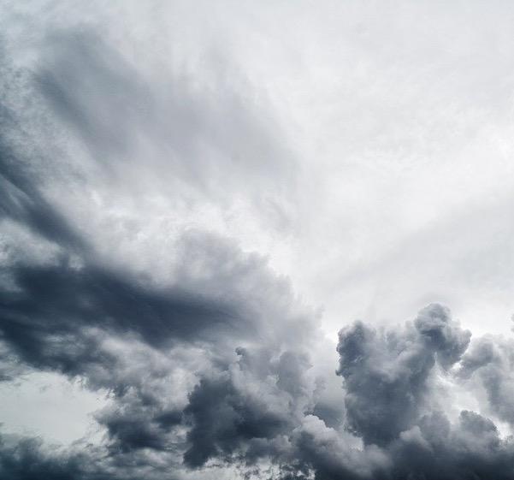
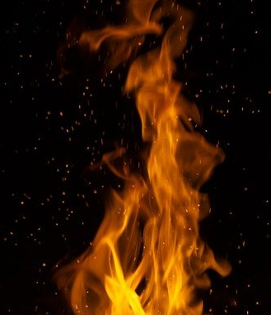
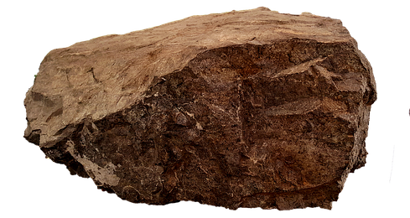
Elements: The elements – spirit, air, fire, land, water– are intricately connected and the knowledge is embedded in Nimiipuu stories, language, and values.

Slide 27
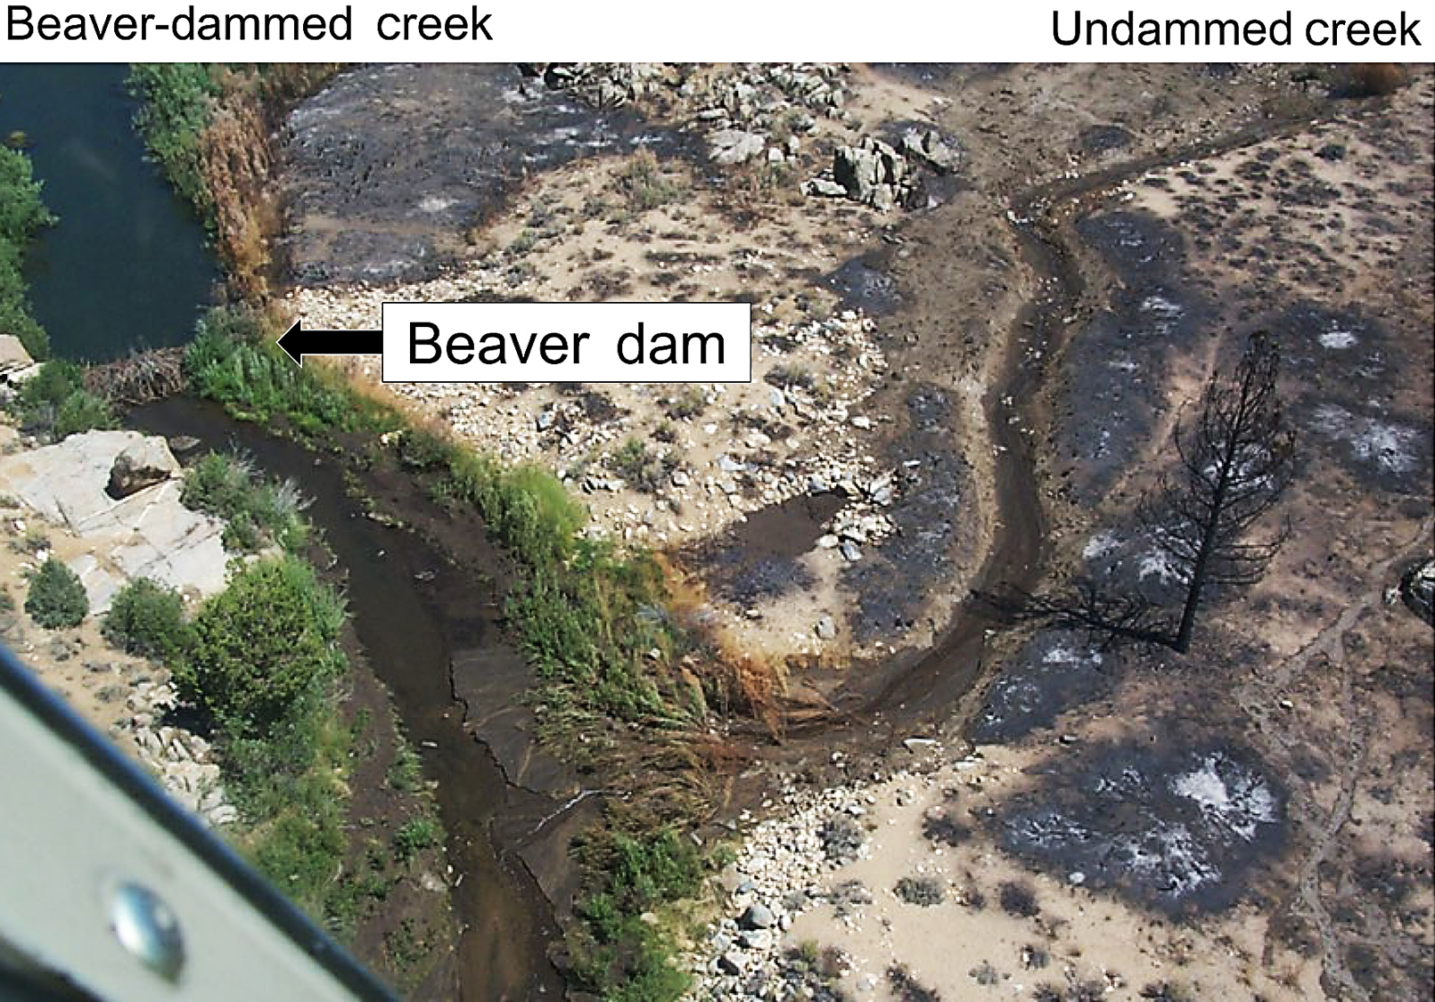
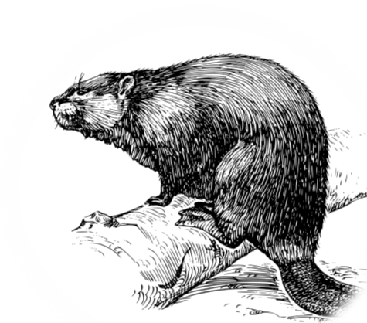
Beavers and the intricate balance and role of the elements
Notes:
Read How Beaver stole Fire from the Pines and consider the elements:
“Once, before there were any people in the world, the different animals and trees lived and moved about and talked together just like human beings. At this time the pine-trees had the secret of fire, and guarded it jealously from the rest of the world, so that, no matter how cold it was, nobody could get any fire to warm himself by, unless he was a pine. At the length an unusually cold season came, and all the animals were in danger of freezing to death because they could get no fire; but all plans to find out their secret from the pines were in vain, until Beaver hit upon one which proved successful.
At a certain place on the Grande Ronde River, in Idaho, the pines were about to hold a great council. They built a large fire at which to warm themselves, after coming out of the icy water from bathing, and had posted sentinels round about to keep off all the animals and other intruders, who might steal their fire secret. But Beaver had hidden under the bank near the fire before the sentinels had been posted, and so escaped their notice. After a while, a live coal rolled down the bank close by Beaver, which he seized and hid in his breast, and then ran away as fast as he could. The pines immediately raised the hue and cry, and started after him. Whenever he was hard pressed, Beaver darted from side to side, and dodged his pursuers, and when he had a good start he kept a straight course. Hence the Grande Ronde River is very tortuous in some parts of its course and then straight for some distance, because it preserves the direction Beaver took in his flight.
After running a long time, the pines grew tired and decided to abandon the chase. So most of them halted in a body on the river banks, where they remain in great numbers to this day, and form a growth so dense that hunters can hardly get through it. A few, however, kept on after Beaver, but they finally gave out one after another, and they also remain scattered at intervals along the banks of the river in the places where they stopped.
There was one cedar running with the foremost pines, and although he despaired of capturing Beaver, he said to the few pines still in the chase, "Although we cannot catch Beaver, I will keep on to the top of the hill yonder, and see how far he is ahead." So he ran to the top of the hill, and saw Beaver far ahead, just diving into Big Snake River where the Grande Ronde enters it, so that further pursuit was out of the question. He saw Beaver dart across Big Snake River and give fire to some willows on the opposite bank, and recross farther on and give fire to the birches, and so on to certain other kinds of wood. Since then, all who have wanted fire have got it from these particular woods, because they have fire in them and give it up more readily than other kinds when rubbed together in the ancient way.
Cedar still stands all alone on the very top of the hill where he stopped in the chase after Beaver, near the junction of the Grande Ronde and Big Snake rivers. He is very old; so old that his top is dead, but he still stands as a proof of the truth of the story. That the chase was a very long one is shown by there being no cedars within a hundred miles upstream from where he stands. The old people point him out to the children as they pass by, and say, " See, there is old Cedar standing in the very spot where he stopped chasing Beaver."
Citation: Packard, R. (1891). Notes on the Mythology and Religion of the Nez Perces. The Journal of American Folklore, 4(15), 327-329. doi:10.2307/533388
Task: From the story and the slide image, describe the intricate balance and role of the elements exhibited.
Image caption: Adjacent creeks with and without beaver damming during a wildfire demonstrates vegetation near beaver ponds stayed green while other nearby riparian vegetation burned.
Image citation: Fairfax, E., & Whittle, A. (2020). Smokey the Beaver: beaver‐dammed riparian corridors stay green during wildfire throughout the western United States. Ecological Applications, 30(8). doi: 10.1002/eap.2225

Slide 28
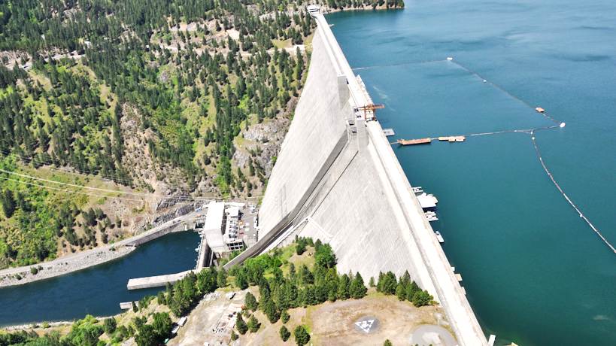
“The earth was created by the assistance of the sun, and it should be left as it was… The country was made without lines of demarcation, and it is no man’s business to divide it…Understand me fully with reference to my affection for the land. I never said the land was mine to do with as I choose. The one who has the right to dispose of it is the one who has created it. –Chief Joseph”
Changing Landscapes: The homelands of the Nimiipuu have drastically changed since colonization. The mountains, rivers, canyons, prairies, and forests had always been stewarded through the reciprocal relationship the Nimiipuu have held with their homelands, the plants, animals, and elements. Since colonization, their homelands have been detrimentally transformed from modernizing forces (industrialization, population and demographic changes, globalization, and modern socioeconomic and sociopolitical forces).
Notes:
Image citation: United States Army Corps of Engineers. (n.d.). Walla Walla District – Dworshak Dam and Reservoir. http://www.nww.usace.army.mil/Locations/District-Locks-and-Dams/Dworshak-Dam-and-Reservoir/
Quote citation: Nez Perce Tribe of Idaho. Environmental Restoration & Waste Management Dept. (2003). Treaties: Nez Perce perspectives. [Lewiston, Idaho]: Confluence Press.

Slide 29
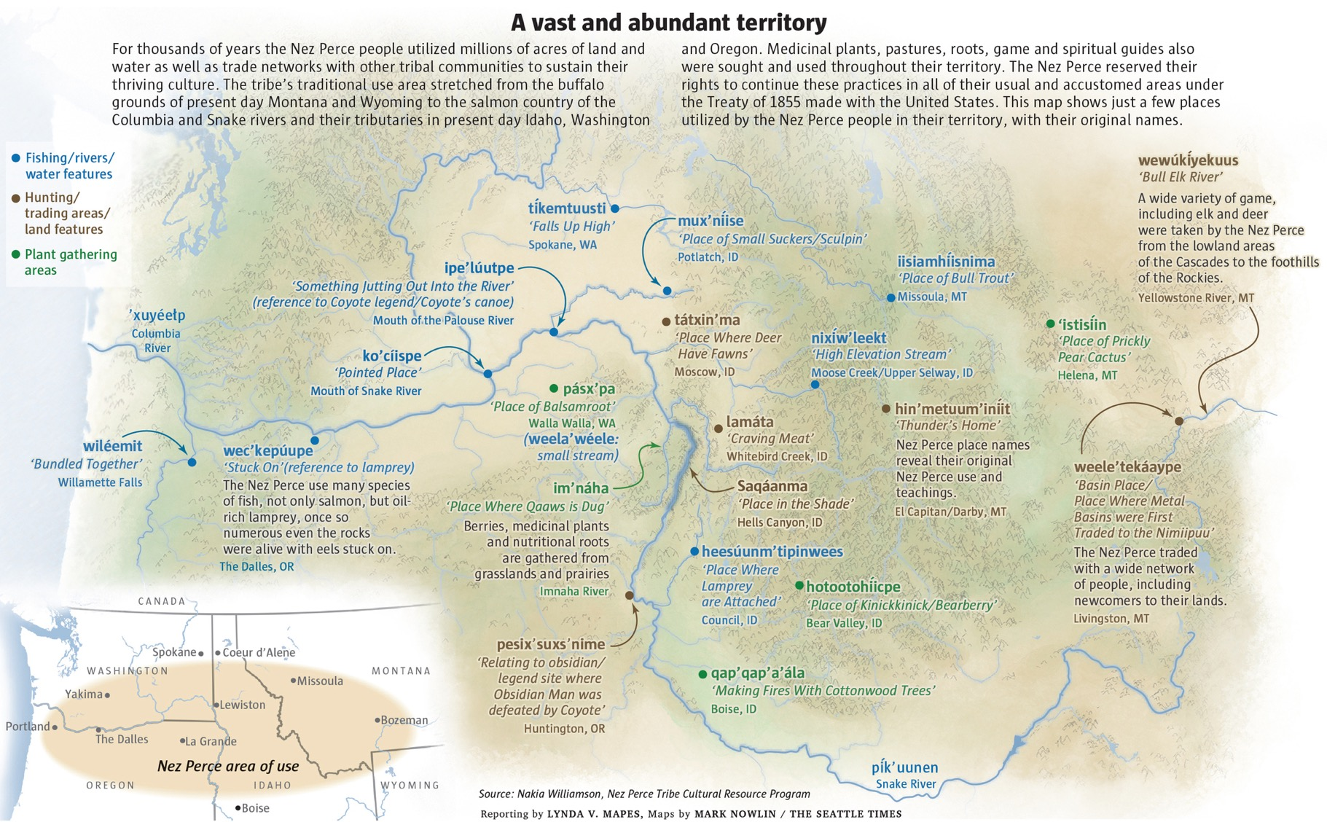
Notes:
The inherent relationship to place, the generations of experiences with the homelands still exists today, but too has been transformed.
Image source: Nakia Williamson, Nez Perce Tribe Cultural Resources Program, 2020

Slide 30
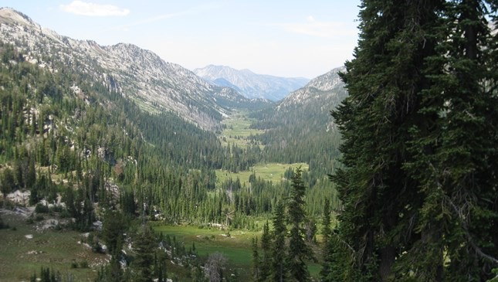
“Article III of the Nez Perce Treaty of 1855 reserves the Tribe’s fishing rights and goes on to reserve ‘privilege of hunting, gathering roots and berries, and pasturing their horses and cattle upon open and unclaimed land.’”
“The United States’ trust obligation includes a substantive duty to consult with ta tribe in decision-making to avoid adverse impacts on treaty resources and a duty to protect tribal treaty-reserved rights ‘and the resources on which those rights depend’ (Klamath Tribes v. U.S., 1996)”
Notes:
Quotes citation: Nez Perce Tribe of Idaho. Environmental Restoration & Waste Management Dept. (2003). Treaties: Nez Perce perspectives. [Lewiston, Idaho]: Confluence Press.

Slide 31
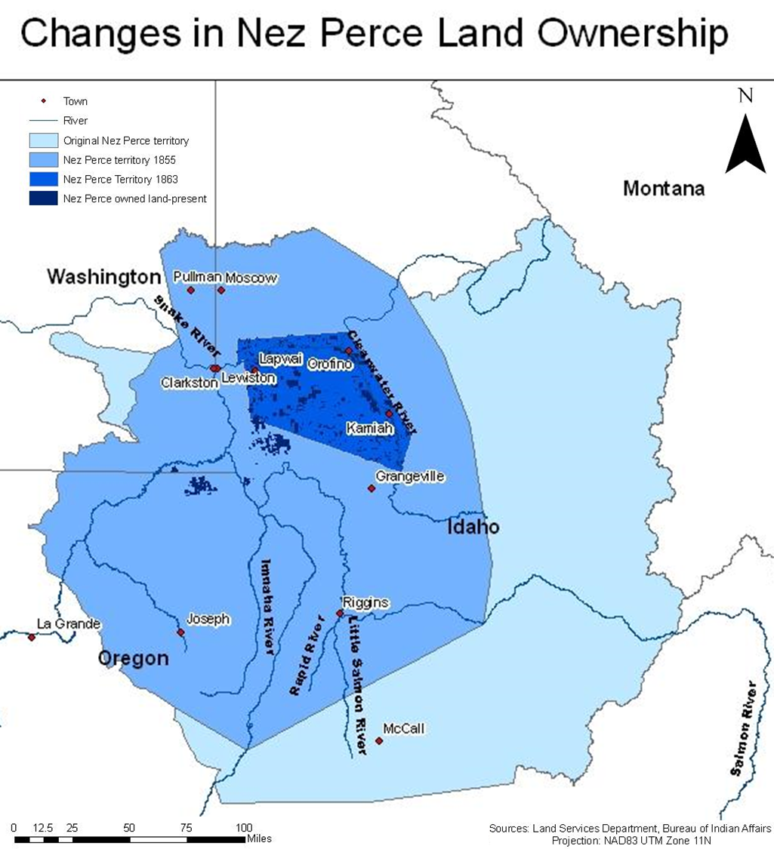
Although land ownership was never a Nimiipuu perspective, access to nimiiipuu’neewit (pronounced nee-mee-poo now-it, Nez Perce lifeways) is critical for the survival of the people, their culture, and the landscapes.
The two cannot be separated.
Notes:
Image citation: Bureau of Indian Affairs - Land Services Department (2010). Changes in Nez Perce Land Ownership. Taylor Lundee’s Geography 390 Blog. http://geoglundeen.blogspot.com/2010/03/map-3-nez-perce.html

Slide 32
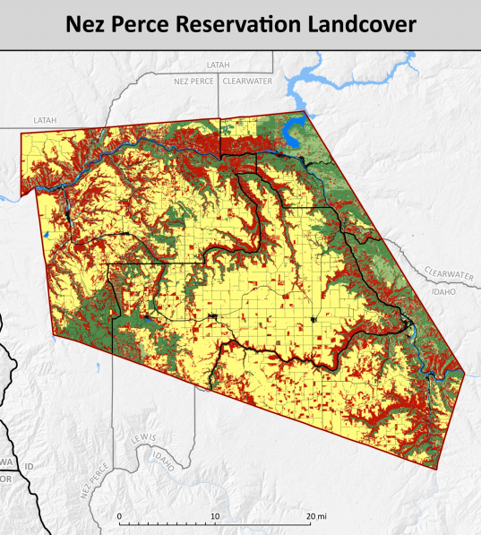
“The allotment era is marked by the enthusiastic zeal of Christian and eastern philanthropic influences, both of which purported to be sympathetic to the plight of the great ‘red man’ but both of which were nevertheless essentially patriarchal and culturally arrogant in their attitude of knowing ‘what was best’ for us. These people fervently wanted the Indian people on reservations to adopt non-Indian ways. They encouraged this process by developing a system for individual ownership of lands, and in 1887 Congress passed the Dawes Allotment Act, ostensibly to teach Indians how to farm using European methods but also by providing individual Indian with an allotment of land.” (Nez Perce Tribe of Idaho, 2003, p. 50)
Notes:
Quote citation: Barbier, N. (2013). Conflicting stakes and governance relating to the co-management of salmon in the Columbia river basin (USA). VertigO-la revue électronique en sciences de l'environnement, 13(3).
Image citation: Nez Perce Tribe GIS Department. (2008). Large dams on the Columbia, Snake and Clearwater rivers. http://journals.openedition.org/vertigo/14586

Slide 33
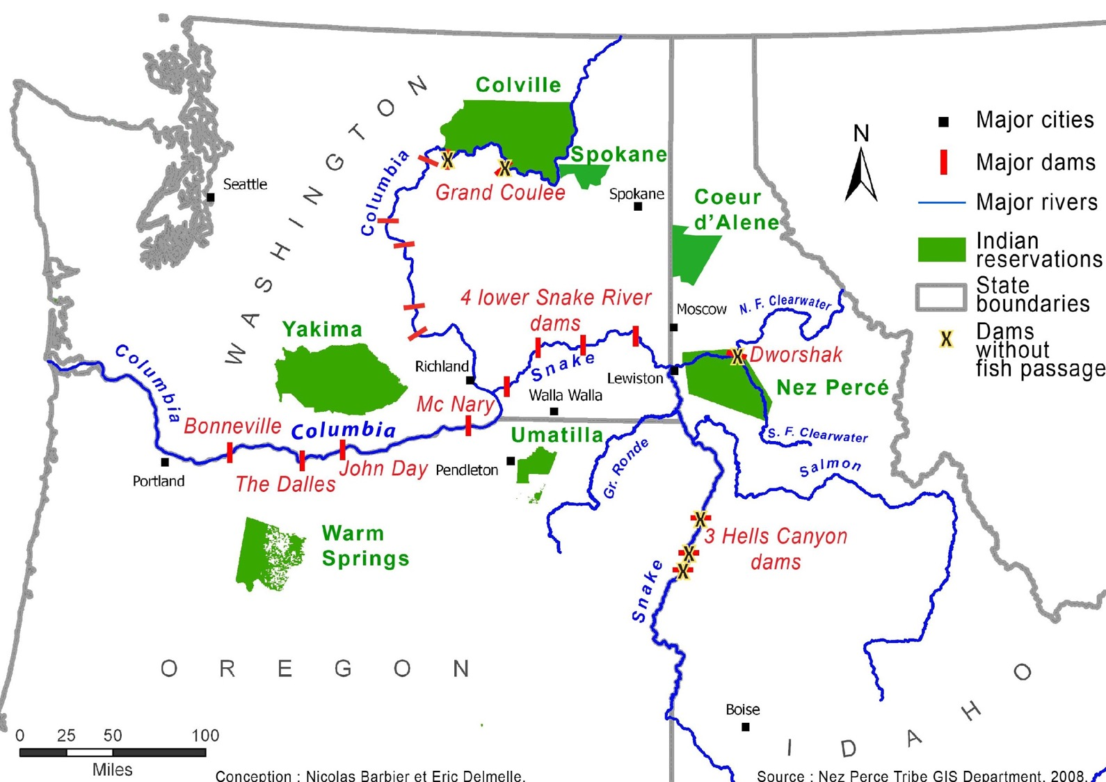
“The regional challenge is tremendous. It is about restoring salmon populations whose returns at the mouth of the Columbia River declined from eleven to sixteen million in the 19th century (Taylor, 2009) to less than 2.5 million at the beginning of the 21st century (Fish Passage Center, 2013).”
Notes:
“During the era of large-dam construction in the American West, the Pacific Northwest River Basins Commission designated the lower Snake River watershed as Region Six--an area the Nez Perces have called home since time immemorial (figure 1). The archaeological record demonstrates the antiquity of human occupation in Region Six with evidence that Aboriginal peoples have been living in the regions of the Snake, Clearwater, and Salmon rivers for at least eleven thousand years. (1) For countless generations, Nez Perce subsistence centered on the bountiful supply of anadromous fish whose "populations first reached levels of eighteenth- and nineteenth-century abundance around 5,000 years ago." (2) As a result, a complex "salmon culture" developed throughout the Columbia and lower Snake River watersheds as Indigenous groups utilized small-scale economic systems focused on the consumption and trade of anadromous fish. In the last two centuries, however, this mode of subsistence drastically changed, and now the Columbia and lower Snake River watersheds only vaguely resemble the wildly evolving character of its ancient and recent past.
Throughout the Columbia and Snake River watersheds, a complex system of earthen and concrete dams dramatically impedes anadromous fish from completing their 40- to 50-million-year-old quest to reproduce and survive. (3) In particular, the lower Snake River dams were constructed to provide Region Six with sources of subsidized electricity and economic security and to facilitate the shipment of agricultural commodities by barge to the centralized ports at the mouth of the Columbia River in Portland, Oregon. The dams and the agricultural economy they support, generate tremendous costs to the environment by radically altering one of the world's most prolific cold-river watersheds. This alteration disproportionately benefits specific elements within the global market economy and encourages increased production of surplus agriculture commodities and other land based enterprises throughout Region Six.
A framework for understanding this culture history lies within the constructs of social power and culture scale. (4) Social power operates at an incrementally higher level in Euroamerican society than in an egalitarian Aboriginal society. For example, collective individuals and institutions steamrolled the Nez Perces and conquered their aboriginal homeland. The scale at which Euroamerican society has evolved since Lewis and Clark can be expressed exponentially, because the impetus to tame the 13-million-acre sphere of Nez Perce traditional territory deliberately crossed several scale thresholds. The contemporary Nez Perces struggle against an enormous non-Native power structure has increased since the Nez Perces were first removed and relocated to a reservation system during the mid-1800s. Currently, the Nez Perces face an overwhelming Euroamerican presence throughout their reservation, the adjacent counties, and Region Six. Large-scale agriculture is the major economic practice on the Nez Perce reservation, but, ironically, there is not one Nez Perce who farms in either Nez Perce or Clearwater counties. The farming economy is dominated by Euroamerican individuals, families, and corporations who have systematically benefited from government policies and the operation of new forms of power and scale.”
Citation: Benedict J. Colombi. (2005). Dammed in Region Six: The Nez Perce Tribe, Agricultural Development, and the Inequality of Scale. American Indian Quarterly, 29(3/4), 560-589. Retrieved March 3, 2021, from http://www.jstor.org/stable/4138991
Slide quote citation: Barbier, N. (2013). Conflicting stakes and governance relating to the co-management of salmon in the Columbia river basin (USA). VertigO-la revue électronique en sciences de l'environnement, 13(3).
Image citation: Nez Perce Tribe GIS Department. (2008). Large dams on the Columbia, Snake and Clearwater rivers. http://journals.openedition.org/vertigo/14586

Slide 34
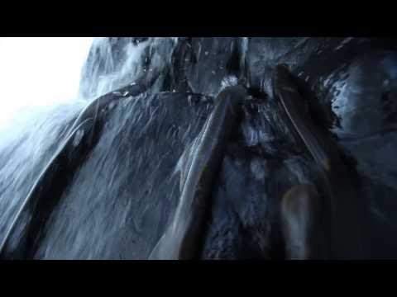
Notes:
“Pacific lamprey have been on earth for around 450 million years but in the past 50 years, they've been pushed to near extinction in the Columbia River Basin. Lamprey have been a part of the cultures of the tribes in the Pacific Northwest since time immemorial and in this video they share their feelings on this amazing creature as well as what they are doing to help keep them from going extinct.”
Video and quote citation: Columbia River Inter-Tribal Fish Commission. (2012, November 5). Why Pacific Lamprey Matter to Columbia Basin Tribes [Video]. YouTube. http://youtu.be/RIsRfSoCvXA

Slide 35
Notes:
“Tai Simpson works in anti-racism education and community organizing. She calls on her non-native audience to embody “old ways” when voting, teaching, and living in the world. Tai is a warrior and storyteller working in anti-racism education and community organizing. She is a direct descendant of Chief Redheart of the Nez Perce tribe and a tireless advocate for social justice. Tai is well-loved and supported by a four-legged, amber-eyed "Gunner." She enjoys sunshine, dogs, and wine. This talk was given at a TEDx event using the TED conference format but independently organized by a local community.”
Video and description citation: TEDx Talks. (2019, May 31). Indigenous storytelling as a political lens | Tai Simpson | TEDxBoise [Video]. YouTube. http://youtu.be/T5RhEStF_bQ

Slide 36
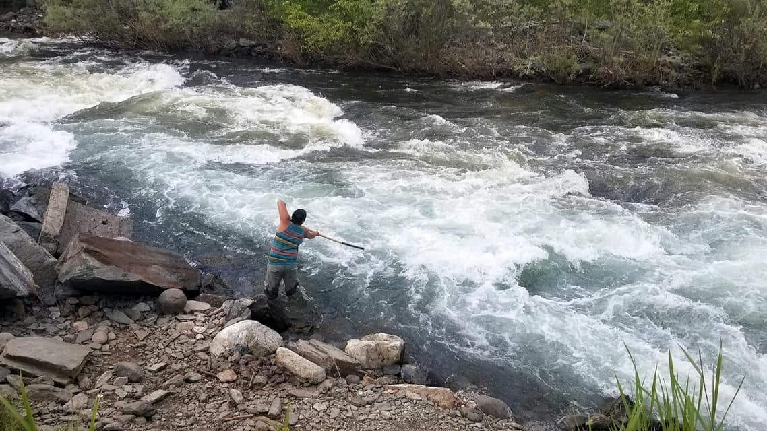
“One of the limitations of Western Science is its inability to recognize the traditional environmental knowledge the American Indians have been passing down to each other in their oral histories for millennia… oral tradition is still very much alive among the Nez Perce people. Western scientists however, are unable to recognize this traditional environmental wisdom because it also contains spiritual and cultural aspects fundamental to the religion religious beliefs of many Native Americans, and these beliefs and values are simply impossible to quantify using the scientific method…”
“Sometimes I try to get people to compare plant and animal species with their own body parts. For instance, the buffalo could be a finger, the passenger pigeon another finger, the peregrine falcon another finger; the wrist could be the sockeye salmon. If you relate these body part to theses species, how many would you eliminate before you would say, ‘Stop.’ You can get along pretty well if you lose a finger, but if you keep doing that, when is it enough? I learned this philosophy from my elders. Even Joseph himself said, ‘I am of the earth.’ Well, if you consider yourself part of the earth, you won’t sacrifice those body parts. – Allen Pinkham (Nez Perce)” (Landeen and Pinkam, 1999, p. 8)
Notes:
Image courtesy of Sapóoq'is Wíit’as Ciarra S. Greene (2020).
Citation: Landeen, D., & Pinkham, A. (1999). Salmon and his people: fish and fishing in Nez Percé culture. Confluence Press.

Slide 37
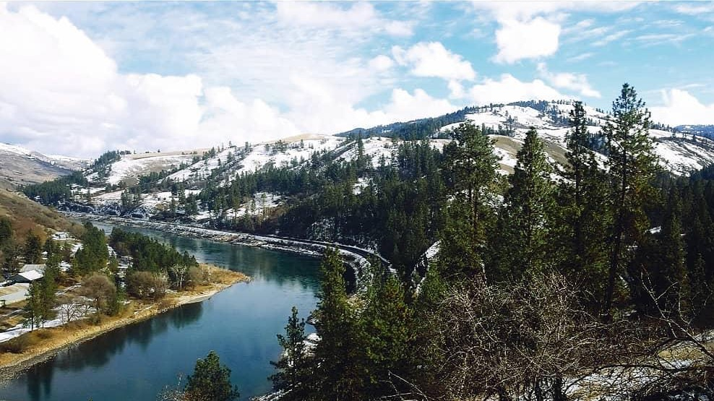
Holistic Understandings: Reflect on the Nimiipuu worldview (values, relationships, balance, and responsibility) and describe considerations for emergency management/response on Nimiipuu homelands.
Notes:
Assigned as homework, students write a reflection on the Nimiipuu worldview (values, relationships, balance, and responsibility) and describe considerations for emergency management/response on Nimiipuu homelands.
Image courtesy of Sapóoq'is Wíit’as Ciarra S. Greene (2019).

