Slide 1
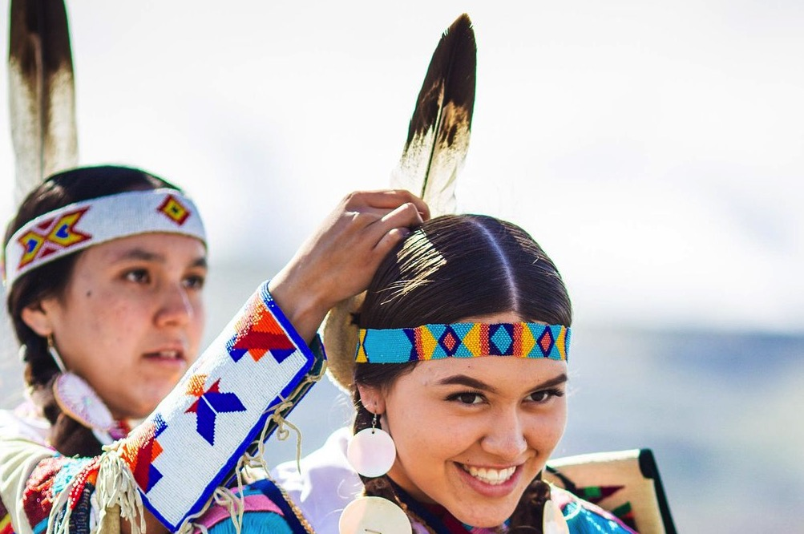
MODULE 5 Preparation and Adaptation: Nimiipuu
Notes:
Image caption: Chief Joseph Foundation Princesses assist each other in getting dressed in their traditional buckskin regalia and eagle feathers. (Nez Perce Tourism, 2018)
Image courtesy of Nez Perce Tourism, 2018.

Slide 2
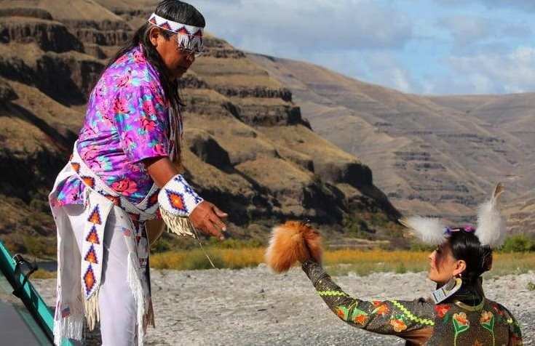
Module Objectives
Gain appreciation of the historical and modern contexts of the elements in considering hazards (climate change, floods, wildfires, and disease).
Identify Nimiipuu cultural values in preparation and adaptation to hazards (emergency management/response).
Consider the role of FEMA and/or agency representatives in honoring Nimiipuu values, relationships, balance and responsibility in preparation and adaptation to hazards.
Notes:
Image caption: Nimiipuu woman, Stacia Morfin, dressed in a modern jingle dress is passing Nimiipuu man, Maurice Wilson a fox pelt.
Image courtesy of Sapóoq'is Wíit’as Ciarra S. Greene (2018).

Slide 3
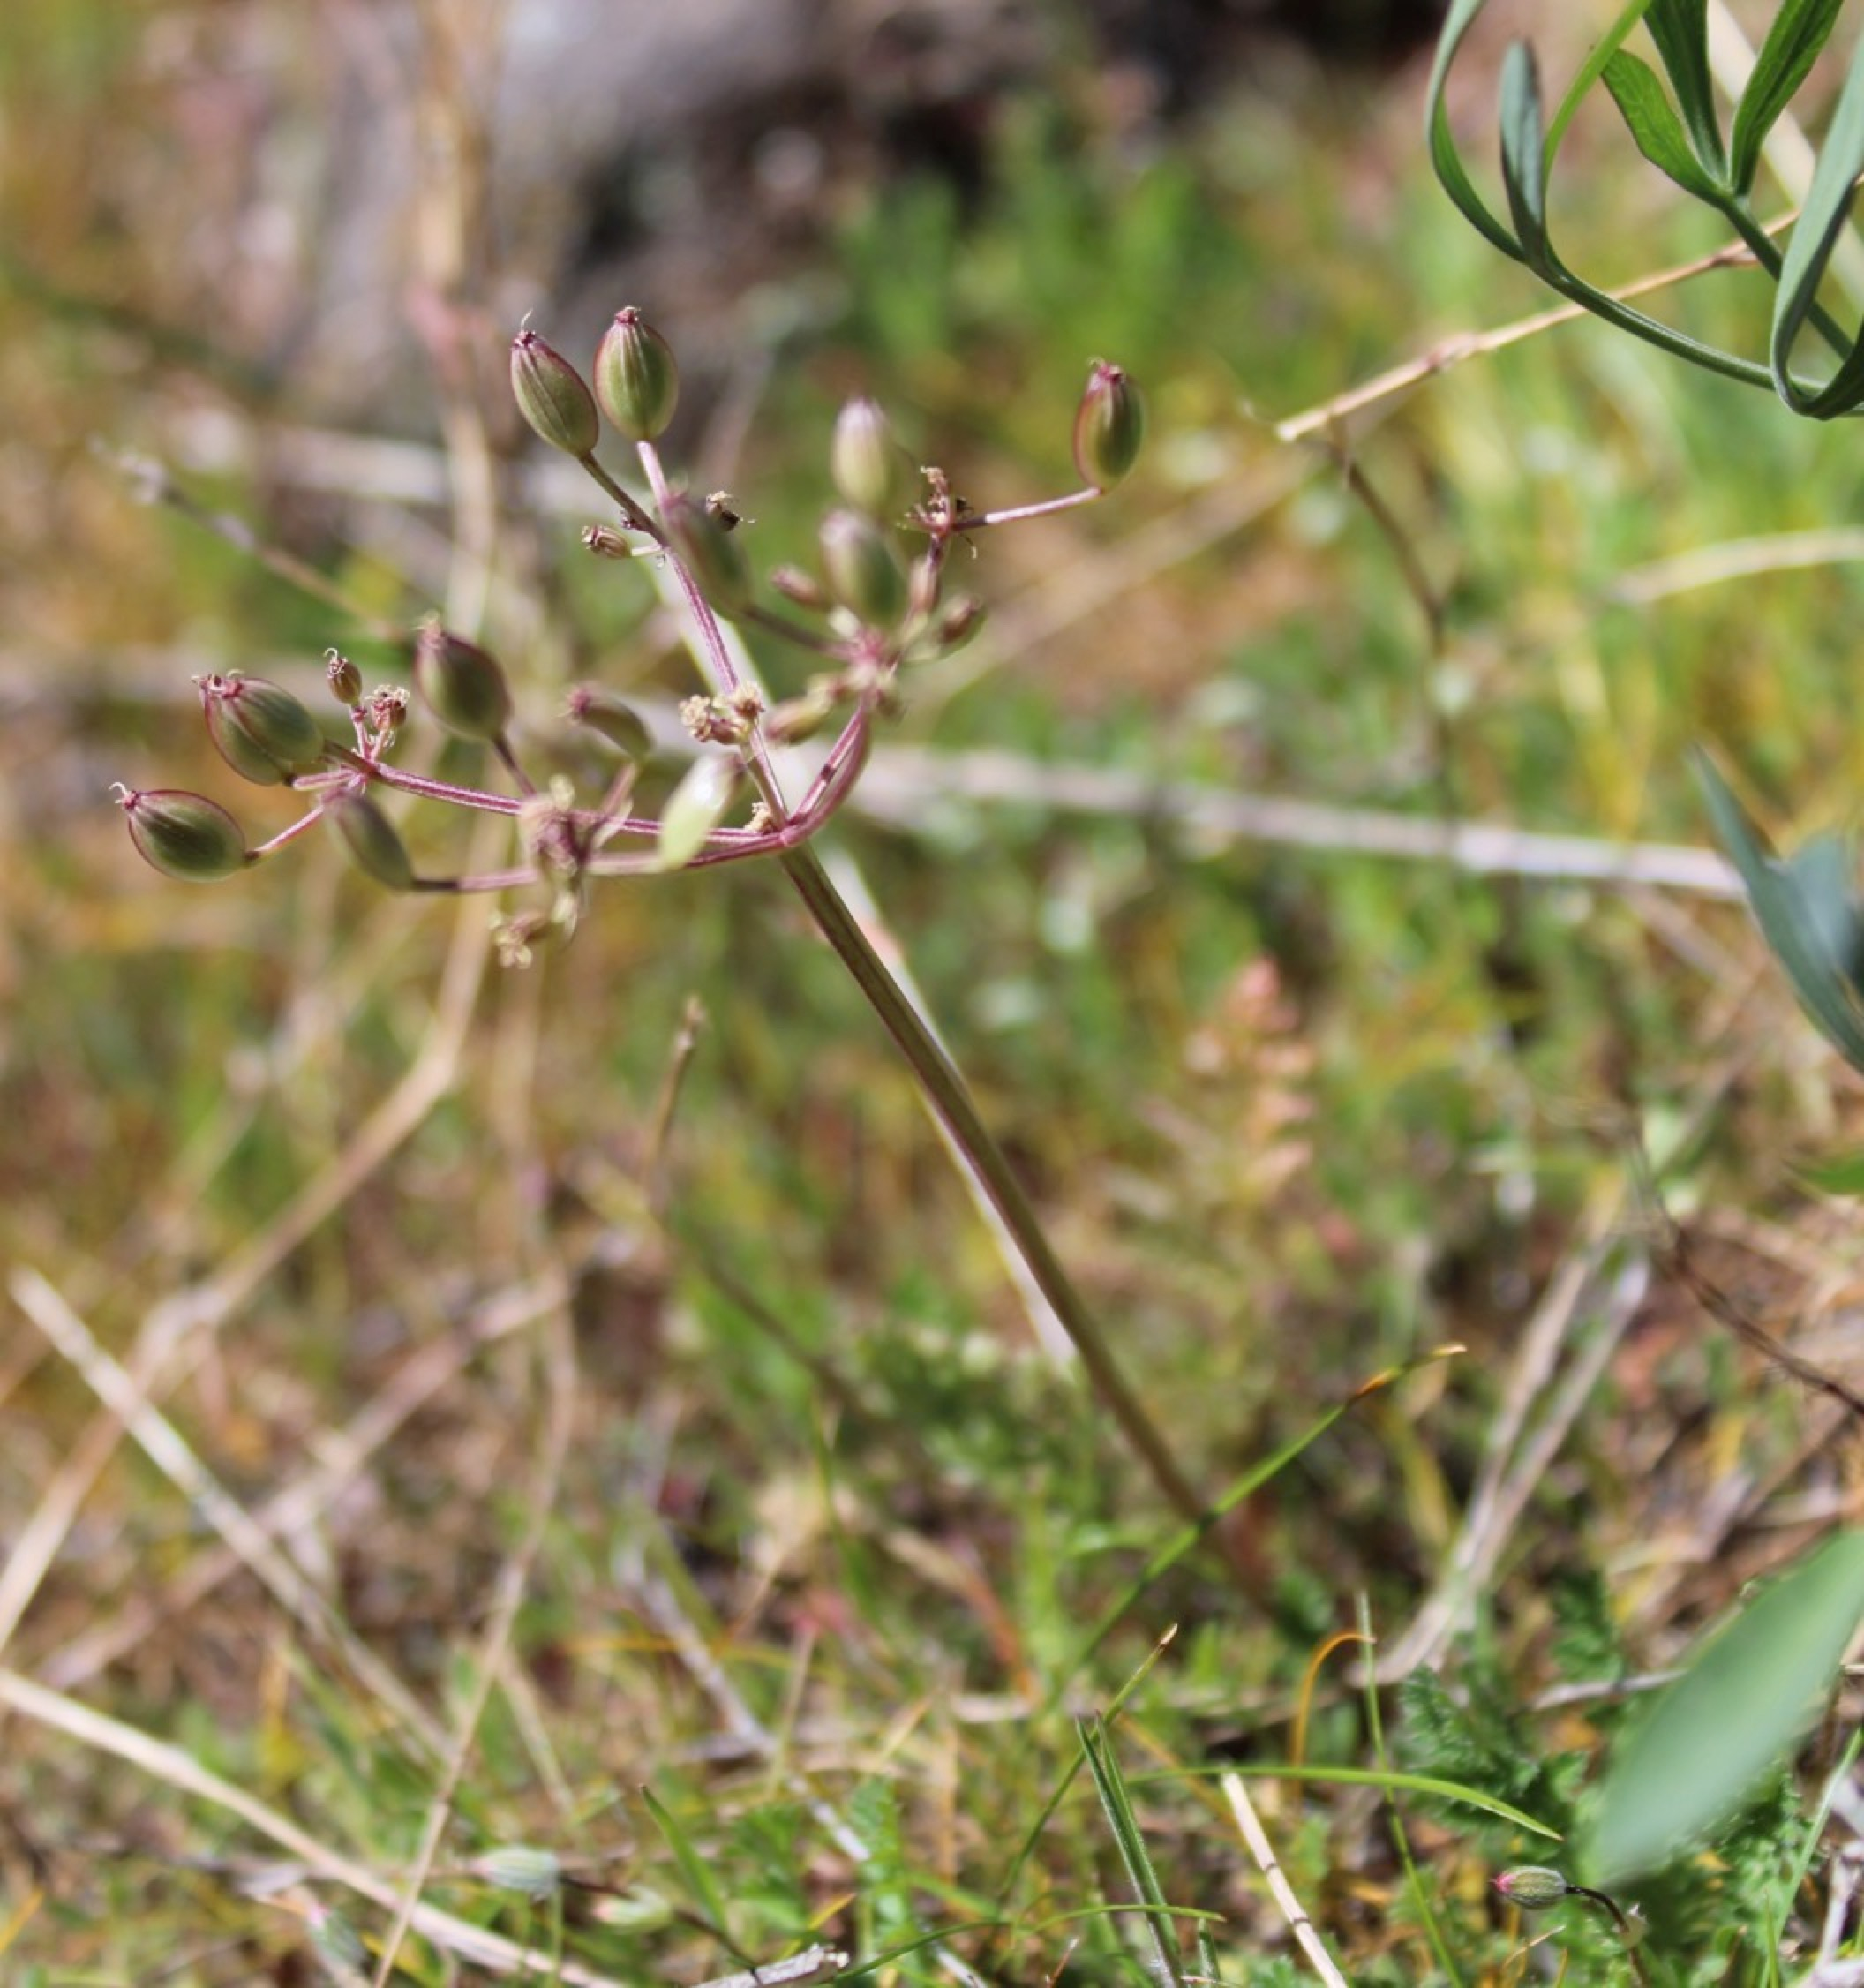
Outline
Exploration Activity: An activity assigned at the beginning of the module where students view a video by the Nimiipuu and take detailed notes addressing themes of historic and modern relationships with the elements in considering hazards and cultural values.
Opening Discussion: A class discussion where students share their video notes based on the elements and cultural values.
Module Content: Informational content offers insight into the historic and modern relationships with the elements in considering hazards and cultural values.
Holistic Understandings : Assigned as homework, students write a reflection on the role of FEMA and/or agency representatives in honoring Nimiipuu values, relationships, balance and responsibility in preparation and adaptation to hazards.
Notes:
Image caption: Plant relative of the Nimiipuu.
Image courtesy of Sapóoq'is Wíit’as (Ciarra S. Greene).

Slide 4
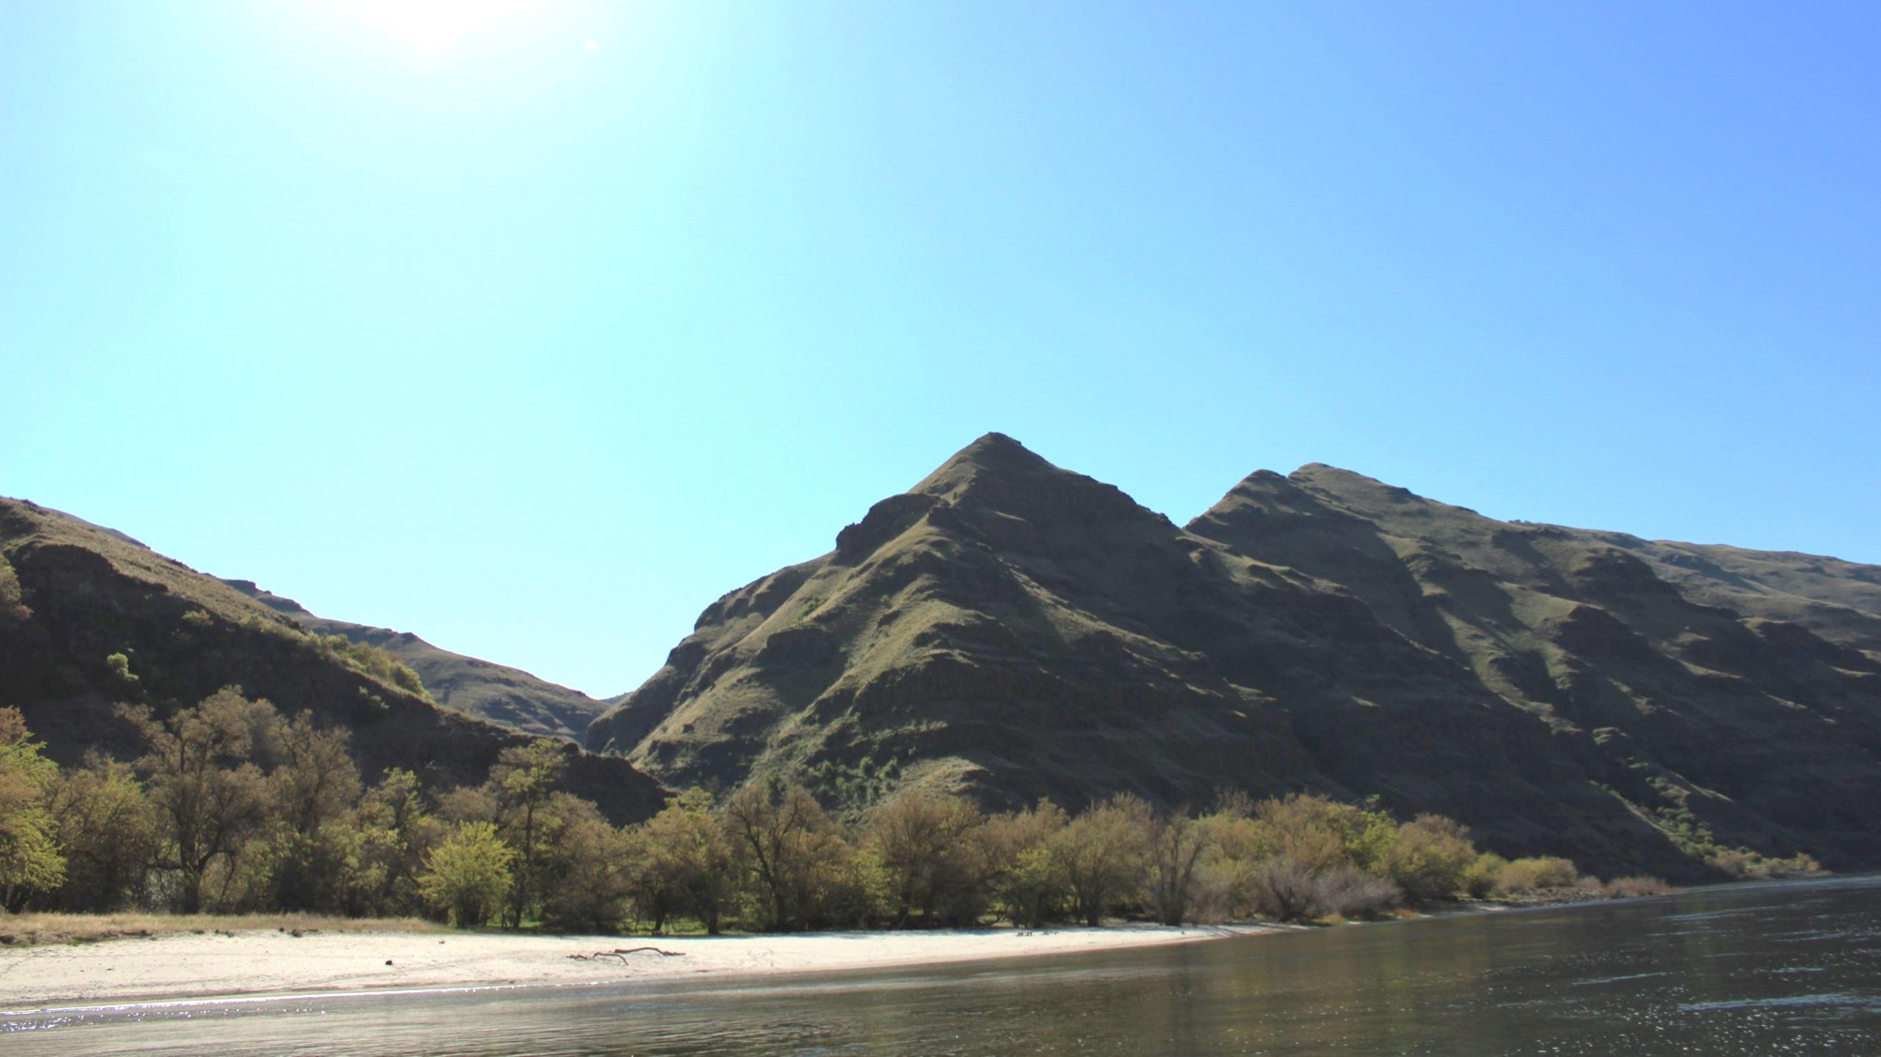
EXPLORATION ACTIVITY: As a sovereign nation, the Nez Perce Tribe perpetuates the resilience of the Nimiipuu in their preparation and adaptation to modern hazards. This module describes the historical and modern contexts of climate change, floods, wildfires, and disease.
Notes:
An activity assigned at the beginning of the module where students view videos of the Nimiipuu and take detailed notes addressing historical and modern contexts of climate change and the elements.
Image caption: An ancient village site along the Snake River, located in Hells Canyon, Idaho/Washington.
Image courtesy of Nez Perce Tourism, LLC (2020).

Slide 5
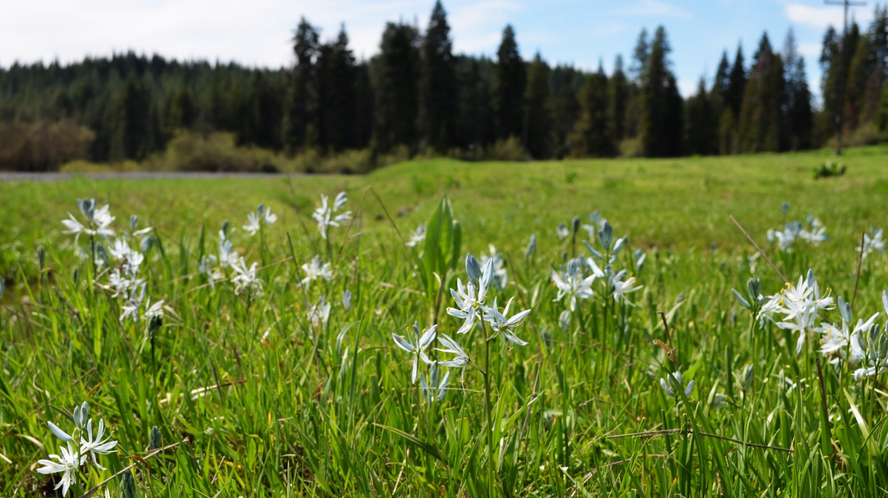
DIRECTIONS: Students watch the video and read the article about climate change and the Nimiipuu. This video and article should be reviewed before class. For both the video and article, complete Cornell Notes (template on the next page) while considering:
Descriptions of the historical and modern contexts of climate change with examples/quotes
Examples for each of the elements – spirit, air, fire, and land
Summary of the video and article.
Resource List:
Video: Blues to Bitteroots Coalition: Seasonal Round Trail Project: http://youtu.be/csMozN-pDvU
Article: Nez Perce Tribe: Clearwater River Subbasin Climate Change Adaptation Plan: http://www7.nau.edu/itep/main/tcc/docs/tribes/tribes_NezPerce_Clearwater.pdf
Notes:
An activity assigned at the beginning of the module where students view videos of the Nimiipuu and take detailed notes addressing themes of place, identity, colonization, and resilience.
Video List:
Nimiipuu
http://youtu.be/aTSNXhhqvOs
Closing the Circle #1
http://youtu.be/NVIKuPlA0cw
Closing the Circle #2
http://youtu.be/AxwrQhMEOoU
Wisdom sits in places: The Nimiipuu land: Angel Sobotta at TEDxLCSC
http://youtu.be/7WuaUXLqRTg
Surviving Lewis & Clark: The Nimiipuu Story
http://www.archaeologychannel.org/video-guide-summary/155-surviving-lewis-a-clark-the-nimiipuu-story?fbclid=IwAR13ChrzqLSTmQEG6wcJl76xIwy-tHJEvBhSzbWb5E2WkxG22_xRDqASUHI
Image: Cover of DVD featuring the Nimiipuu (Nez Perce) people. Of One Heart shares perspectives of a people whose contemporary way of life is firmly rooted in tribal tradition. Of One Heart introduces the rich heritage of the Nimiipuu, whose stories are preserved and interpreted at 38 sites comprising Nez Perce National Historical Park in Idaho, Montana, Washington and Oregon. The DVD can be purchased at http://www.discovernw.org/nez-perce-of-one-heart-dvd.html

Slide 6
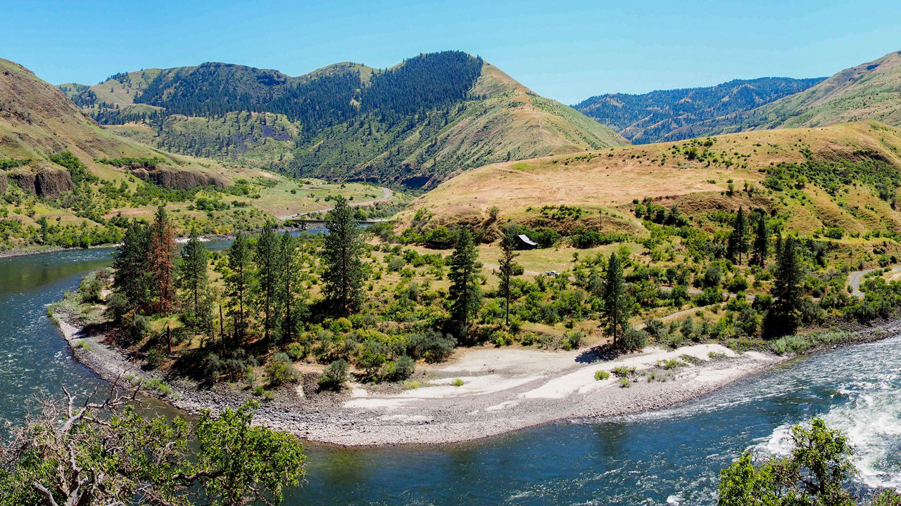
Opening Discussion:
Read the article about Nipéhe, an ancient village of the Nimiipuu and archaeological site of the earliest evidence of humans in North America to date.
Students share video notes based on the themes
Identify common values as a class
Notes:
The Nimiipuu have inhabited their homelands since time immemorial (beyond the reach of human memory). Archaeologists have dated the Nimiipuu back over 16,500 years when they uncovered 189 stone artifacts and bones of extinct animals at Nipéhe (now known as Cooper’s Ferry near Cottonwood, Idaho). (Baker, 2019)
Read the article about Nipéhe, an ancient village of the Nimiipuu and archaeological site of the earliest evidence of humans in North America to date. Read the article which is included as a PDF in the module materials. (Baker, 2019)
Read the article which is included as a PDF in the module materials. (Baker, 2019)
Article: Baker, Eric. (2019, August 31). Digging up history. Lewiston Morning Tribune. http://lmtribune.com/northwest/digging-up-history/article_46f12938-f6c8-5b62-8dc5-b8c763b3442c.html
Image: The Cooper’s Ferry site located in Idaho’s lower Salmon River canyon. White arrow points to the site. Image credit: Davis et al, doi: 10.1126/science.aax9830.
Image citation: Loren G. Davis et al. 2019. Late Upper Paleolithic occupation at Cooper’s Ferry, Idaho, USA, ~16,000 years ago. Science 365 (6456): 891-897; doi: 10.1126/science.aax9830

Slide 7
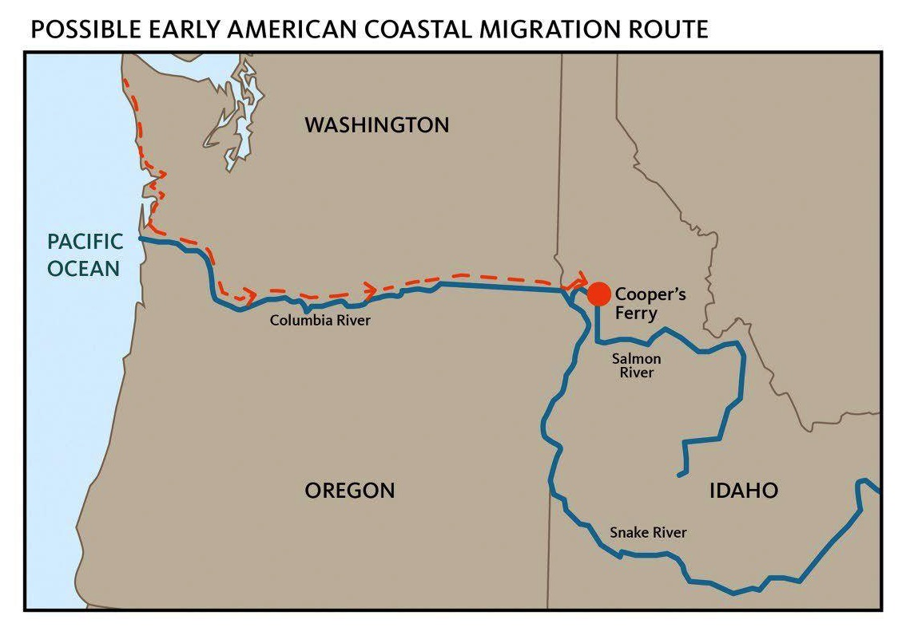
Notes:
Task: Read aloud the article about Nipéhe, an ancient village of the Nimiipuu and archaeological site of the earliest evidence of humans in North America to date. Read the article which is included as a PDF in the module materials. (Baker, 2019)
Article: Baker, Eric. (2019, August 31). Digging up history. Lewiston Morning Tribune. http://lmtribune.com/northwest/digging-up-history/article_46f12938-f6c8-5b62-8dc5-b8c763b3442c.html
As the article states, “We know we have been here for a very long time… If anything [the archaeological findings are] a testament to the long relationship that our people fostered, that has endured a lot of cataclysmic activities - floods and all kinds of other activities - that have happened on this landscape that our people have witnessed… [Nakia Williamson, Nez Perce Tribe Cultural Resource Program Director].”
Thousands of years inhabiting the landscape, means that the Nimiipuu have held ancient relationships with mammoths and other extinct plant and animal relatives, endured dynamic regional floods (Bonneville and Missoula floods), and in 200 years witnessed the conversion of diverse grassland prairies to monoculture agricultural fields, maintained forests to fire-suppressed or clearcut timberland, the decimation of wetlands and intensely channeled waterways. Among these changes to the homelands overtime, complex problems of climate change and disease are equally apparent in the community.
Image citation: Baker, Eric. (2019, August 31). Digging up history. Lewiston Morning Tribune. http://lmtribune.com/northwest/digging-up-history/article_46f12938-f6c8-5b62-8dc5-b8c763b3442c.html

Slide 8
Historical Context: Begin this module by watching Grandmother Tessie Williams – People of the Seventh Fire: https://youtu.be/mxyYORlFohQ
Notes:
As a sovereign nation, the Nez Perce Tribe perpetuates the resilience of the Nimiipuu in their preparation and adaptation to modern hazards. This module describes the historical and modern contexts of climate change, floods, wildfires, and disease.

Slide 9
Notes:
Watch Continuity of Operations Planning for Tribal Governments: https://youtu.be/dm476MnqpRY and reflect on the preparation and adaptation of the Nimiipuu in relationship with their homelands.

Slide 10
Opening Discussion:
The homelands of the Nimiipuu (including the landscape, climate, specific/sacred places)
Summary of the video
Summary of the article
Descriptions of the historical contexts of climate change with examples/quotes
Description of the modern context of climate change (examples/quotes)
Examples for each of the elements – spirit, air, fire, land, and water
Task: As a class, develop a list of values prevalent in Nimiiipuu culture.
Notes:
Image: Huckleberries are a relative of the Nimiipuu and are being seriously threatened by climate change.
Image citation: By Bruno.karklis – Own work, CC BY 4.0, https://commons.wikimedia.org/w/index.php?curid=71361345

Slide 11
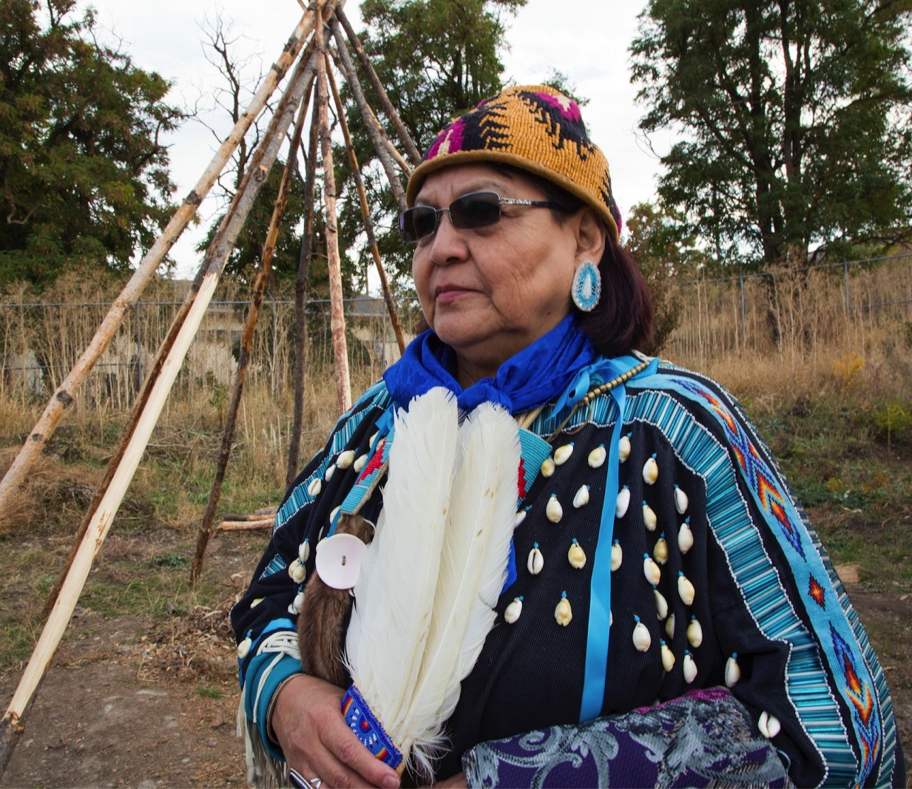
“Tamálwit is the law that binds us to and makes us accountable to this land” – Nakia Williamson, Nez Perce, 2018
Notes:
“Tamálwit is the law that binds us to and makes us accountable to this land” – Nakia Williamson, Nez Perce, 2018. (Tamá·lwit, 2021)
“... the Nez Perce land and the Nez Perce people [are] inseparable, a part of the vast area stretching between the winding waters of the Wallowas and the highest crests of the Bitterroots. [They shared] a common language and culture, the Nez Perce moved within this region enjoying what the land provided -- roots and berries, fish and game, shelter and clothing and fuel -- and derived from it both a sustainable economy and a rich spirituality. Strong families formed villages, and villages the tribe, the Nez Perce people were in harmony -- with their land, with their people, with their Creator.” -- Reflections on the Nez Perce National Historic Trail, Chief Joseph Band of the Nez Perce – 1999 (Nimiipuum Wetes, 2021)

Slide 12
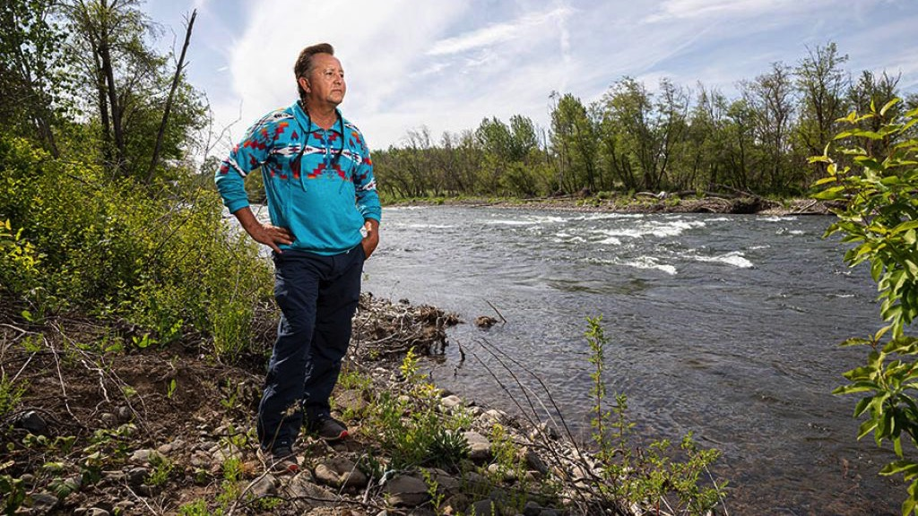
“Indigenous people have fundamental values that all of us need to understand, evaluate, and embrace to restore our global balance and perpetuate human kind.”
-Don Sampson, 2015
Notes:
In reference to the observations of Don Sampson (Chief of the Walla Walla Tribe and member of the Confederated Tribes of the Umatilla Indian Reservation) upon arriving at the 2015 Paris Climate Accord “Indigenous people from around the world to represent their livelihoods, their cultures, their homelands, and ultimately their fight for their survival. I heard them speak passionately about their beliefs and their sacred obligations for the earth and all life. Indigenous people have fundamental values that all of us need to understand, evaluate, and embrace to restore our global balance and perpetuate human kind.” Ancient sacred truths and laws given to us at the beginning of creation.
Respect for the land, respect for the water, Mother Earth and all of creation. Tamálwit, the great law, value
Everything is interrelated and inter-reliant, we are all one family.
Reciprocity - the practice of exchanging things for a mutual benefit. Everything we do to the earth we do to ourselves. We do not have the right to exploit resources.
Image caption: Don Sampson, Chief of the Walla Walla Tribe and member of the Confederated Tribes of the Umatilla Indian Reservation looks upon a sacred river on the Columbia River Plateau.
Image citation: Cunningham, N. (2021). Oregon Business - The Salmon and the Snake. Retrieved 3 July 2021, from https://www.oregonbusiness.com/article/energy-environment/item/19323-the-salmon-and-the-snake

Slide 13
Notes:
This is an activity designed for an example of each element – spirit, air, fire, land, and water – to be identified by students based on Don’s description of climate and energy throughout Indigenous communities nationwide.
Listen to the presentation offered by Don Sampson: climate hope, clean energy determination and a just transition: http://youtu.be/SiDV6TYz7Jc
Climate change was previously explored in the opening discussion and additional information will be reviewed in this section of the module. After reviewing the climate change section, flooding, wildfires, and disease will be introduced. Review each of the section introductions, then assign students one of the remaining three hazard to investigate (watch video and read article). After time exploring the content, ask students to provide a synopsis and insight:
Summary of the video
Summary of the article
Descriptions of the historical contexts of climate change with examples/quotes
Description of the modern context of climate change (examples/quotes)
Examples for each of the elements – spirit, air, fire, land, and water

Slide 14
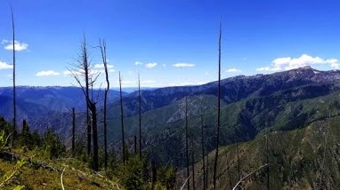
Climate Change
Notes:
The Nimiipuu are aware of climate imbalances on their homeland because of their attune relationships with the land - specifically to food and medicinal sources. Parts of Nimiipuu culture have evolved with the relationships on the landscape such as the language, Nimiipuutimpt, and stories which explain the intimately shared relationships the people have to the land and everything which survives in harmony with it.
Image courtesy of Sapóoq'is Wíit’as Ciarra S. Greene (2018).

Slide 15
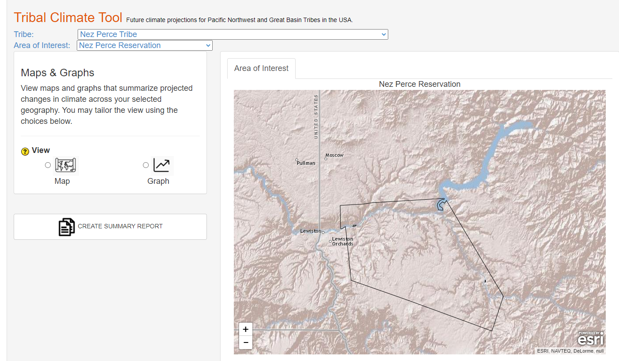
Notes:
Visit the Tribal Climate Tool of the Pacific Northwest and Great Basin Tribes.
This tool is designed to help tribes in the Pacific Northwest and Great Basin, understand how the climate is expected to change in places that they care about. It provides maps, graphs, tables and descriptions of projected changes.
The areas of interest (e.g., ceded areas, watersheds) included in this tool reflect results of outreach to Northwest and Great Basin tribes, as well as tribally-relevant areas in the public domain (e.g., reservations). These areas are shown for educational purposes only and are not intended to be legally binding.
Link: https://climate.northwestknowledge.net/NWTOOLBOX/tribalProjections.php
Consider: What is the true extent of the Climate Crisis for Nez Perce People?
Image courtesy of Sapóoq'is Wíit’as Ciarra S. Greene (2018).

Slide 16
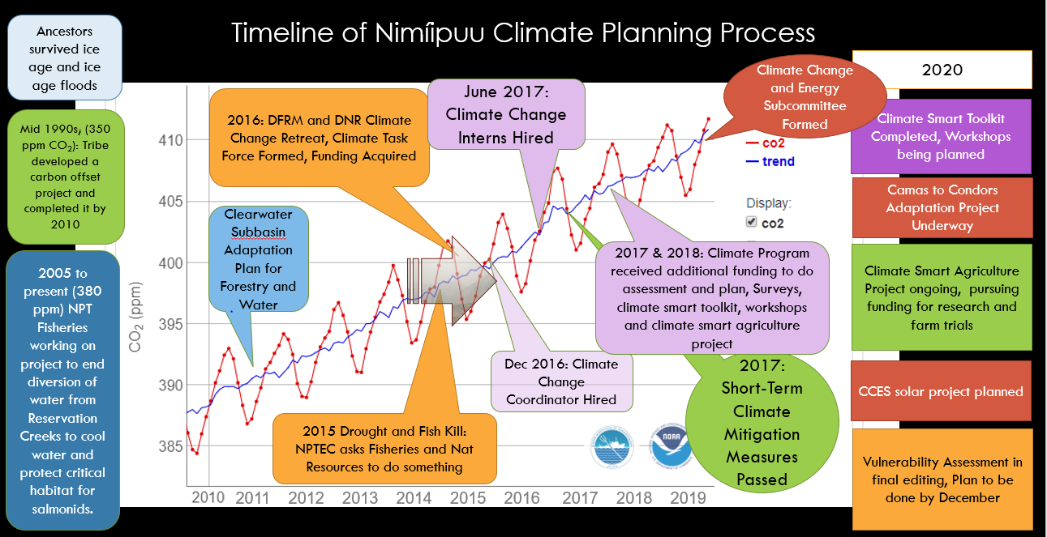
Notes:
The timeline provides insight into Nimiipuu climate planning process, which extends back to the ice age (or even further). Review the timeline starting at the top left and read each informational text box. The column on the right side of the timeline, labeled “2020” provides modern and current approaches the of Nez Perce Tribe Climate Change Program.
Image courtesy of the Nez Perce Tribe Climate Change Program, 2020.

Slide 17
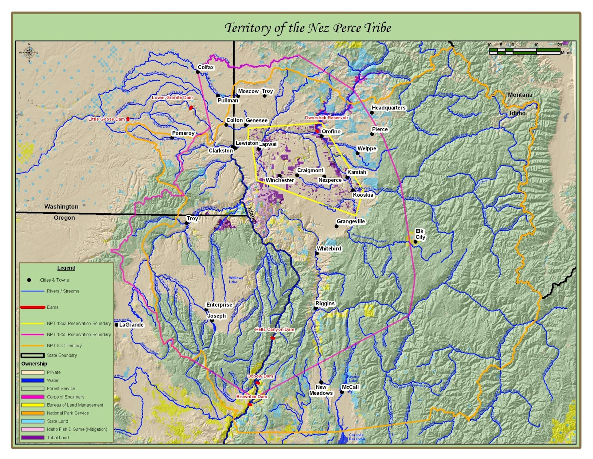
Notes:
Some of the most significant changes to the homeland of the autonomous bands of Nez Perce people are shown on Slide 17. Growing conflict compelled the Nez Perce and the United States to negotiate a treaty in 1855. The basis of the negotiation was land taken by the U.S. for its citizens in exchange for recognition of inherent rights, sovereignty and homeland. Since this treaty negotiation garnered the greatest support from the autonomous bands of Nez Perce a vast majority of them signed. Another result of the contract was the autonomous bands of Nez Perce people are a federally recognized tribe. The Nez Perce reserved a portion of their homeland which became known as the Nez Perce Indian Reservation and is outlined on the map in magenta. Only eight years later, the United States would return for another treaty negotiation. This time the U.S. negotiators utilized an unjust and immoral strategy. Seeking to establish a significantly reduced reservation, the U.S. negotiators focused on acquiring the support and signatures of those autonomous band leaders whose land would lie within the boundary of the new significantly reduced reservation. Nez Perce Treaty of 1863 (yellow), and the Nez Perce Indian Claims Commission Territory (orange).
These territories include areas of cultural significance to the Nimiipuu, and in the context of climate change, the seasonal gradient of significant seasonal food gathering, hunting, and fishing sites. The food which is honored first in Plateau ceremonies is Kuus, or water. The watersheds represented in this figure are a part of the Columbia River which is among the most heavily dammed river system in the world. Without healthy open waterways, we restrict the natural travel of migratory fish which sustain cultural life-ways. These anadromous species include steelhead, salmon, and lamprey. (move this paragraph below diagram)
To gather their foods, hunt, or fish is a cultural practice, and so intimately connected to spirituality that for the Nez Perce, these things are not one without the other. We draw physical sustenance from these foods, and they are nourishing in many more ways. Their relationships with these foods are like the shared relationships between each plant and each season. The relationships also express connections between plants and people because it is family who teach you about the locations of these foods as well as how to prepare them and put them away for sustenance in the winter months.
Image courtesy of the Nez Perce Tribe Climate Change Program, 2020.

Slide 18
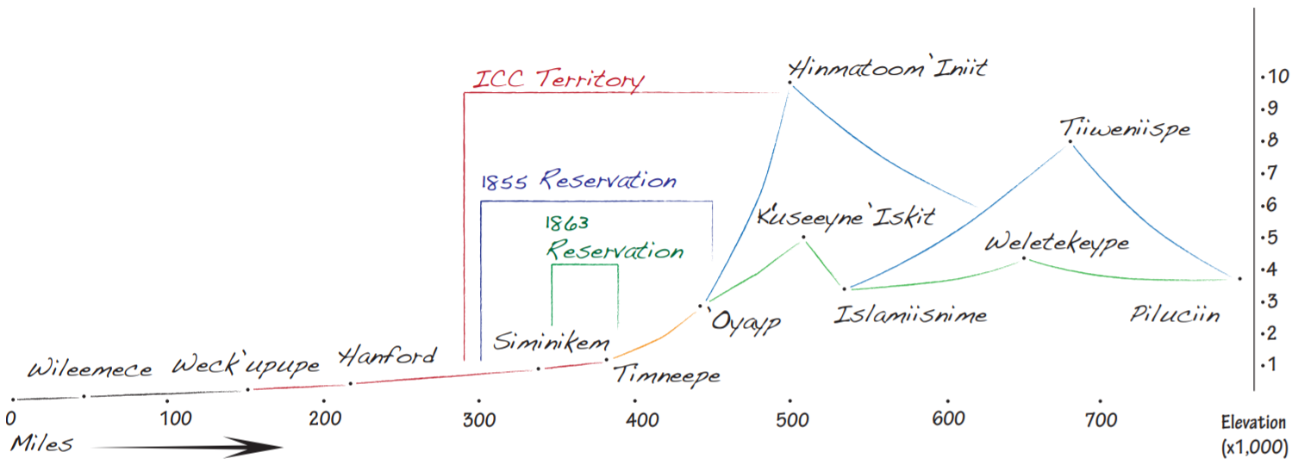
Notes:
Nez Perce people are known to follow a transhumance pattern of nomadism, which means they are at specific locations when resources are available and they keep to this seasonal round annually. They are moving camp to gather, hunt, and fish with the seasonal availability of foods as temperatures allow movements.
On Slide 18, is the silhouette of Nez Perce Tribe reservation and Usual and Accustomed Areas defined by elevation and distance of significant cultural sites. The entirety of this graph represents Nez Perce homeland. Smaller fractions of this area include ICC Territory, NPT Reservation in 1855, and NPT reservation 1863 - which lead into the Nez Perce War. The following are translations of these cultural sites: Wileemece (Willamette Falls), Weck’upupe (Something sticking on the sides/lamprey eels/ The Dalles, Oregon), Hanford Nuclear Reservation (contaminated cultural landscape/superfund site), Simiinikem (the place where the Clearwater and Snake rivers come together/ Lewiston, Idaho), Tim’neepe (The heart place/ Kamiah, Idaho), Oyayp (where the Nez Perce rescued Lewis and Clark/ Weipe, Idaho), K’useeyne Iskit (expedition trail/ for extended journey/ Lolo Trail, Idaho), Hinmatoom Iniit (El Capitan in the Bitterroot Mountains/ highest point in Nez Perce Country), Islamiisnime (Dolly Varden/Bull trout place/ Missoula, Montana), Weletekeype (where the water looks like a pan/ Livingston, Montana), Tiiweniispe (the fart place/ Yellowstone National Park), Piluciin (gooseberry place/ Crow Indian Reservation).
Image courtesy of the Nez Perce Tribe Climate Change Program, 2020.

Slide 19
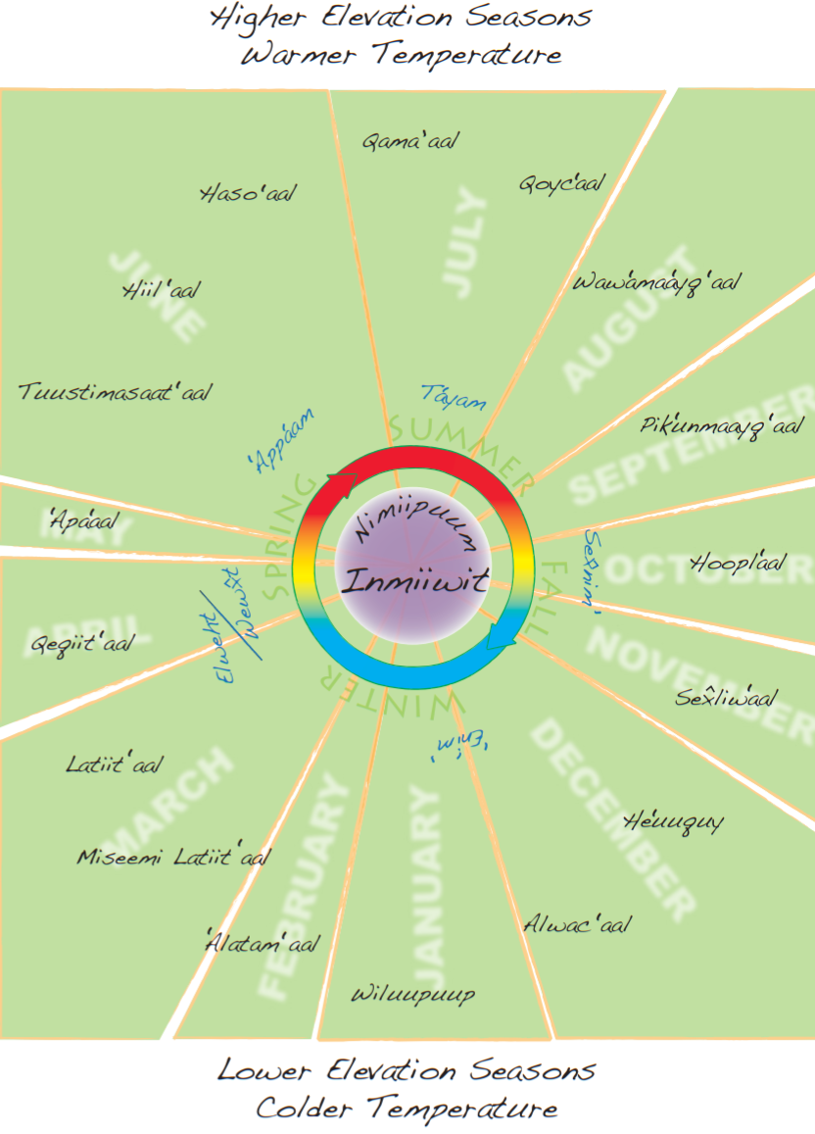
Notes:
Slide 19 is an image representing the Nez Perce Tribe, Seasonal Round Calendar showing 17 recognized seasons by cultural food gatherers, hunters, and fishers. This calendar is overlayed with the common calendar months and the 4 seasons (Spring, Summer, Fall, and Winter) to demonstrate contrasting perspectives. The Nez Perce, among other plateau tribes, had to know the seasonal availability of many foods. The availability of foods indicated when to move camp to the next gathering site or to begin gathering the next food in season.
Today, cultural food gatherers, fishers, and hunters express experiencing earlier seasons, shorter gathering windows, and less quality and quantity of foods. For the Nimiipuu, the seasonal round is everything for cultural survival. The foods are unable to adapt quickly enough to the changing climate, risking endangerment and even worse, extinction. This loss is not only to their foods and diverse ecosystems, but loss of culture, loss of language, and the loss of what makes their people Nimiipuu.
All 5 elements go hand in hand: not one without the other (spirit, air, fire, land, and water).
Image courtesy of the Nez Perce Tribe Climate Change Program, 2020.

Slide 20
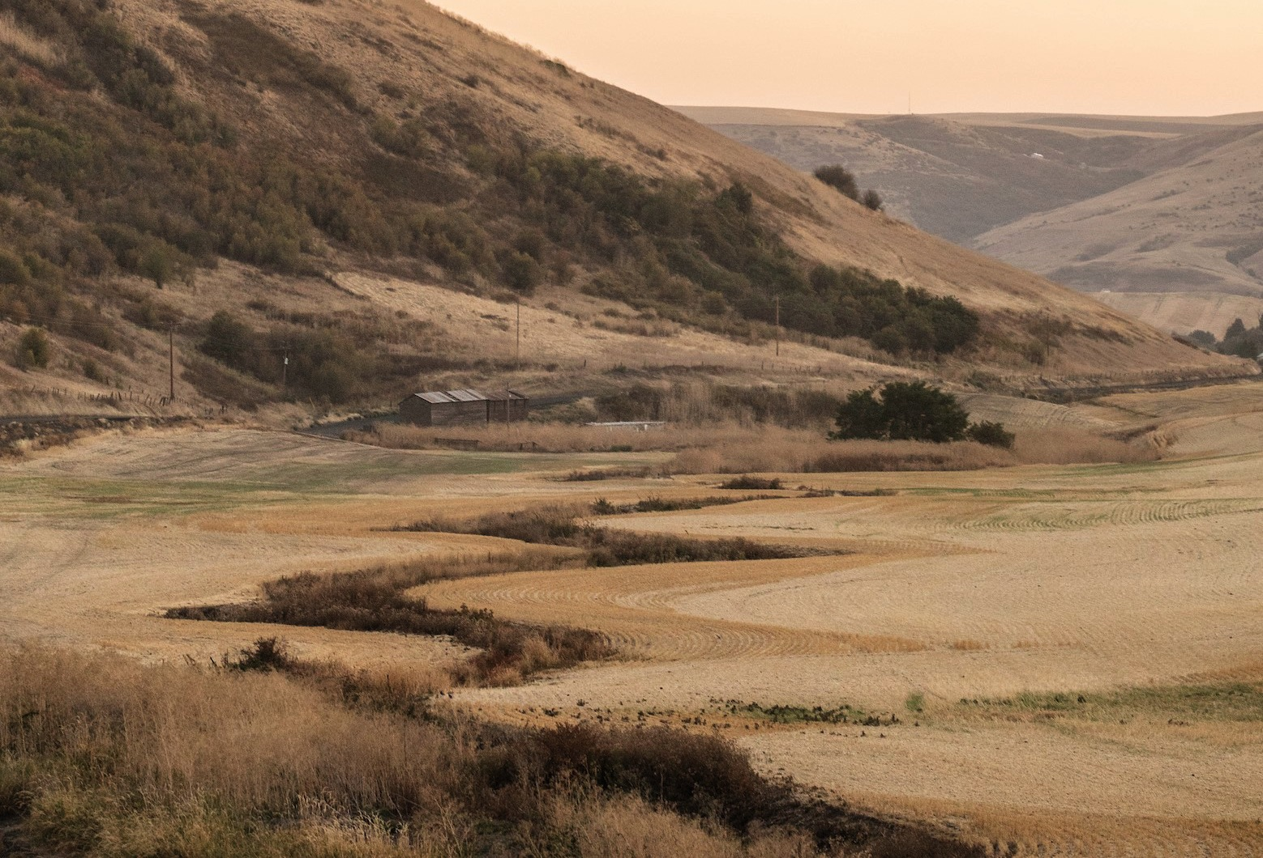
Resources to Review:
Video(s):
Facing Climate Change: Plateau Tribes: https://vimeo.com/36951241
Roots of Tradition: http://vimeo.com/183056539
Article (Poster): Building a Collaborative Tribal Climate Adaptation Program PA41F-1167 via the Integration of Cultural Values and Perspectives: https://www.essoar.org/doi/pdf/10.1002/essoar.10501476.1
Notes:
Image: A wetland and creek on the Nez Perce Reservation is dried up in the late summer months and after the agricultural fields have been harvested.
Image courtesy of the Nez Perce Tribe Climate Change Program, 2020.

Slide 21
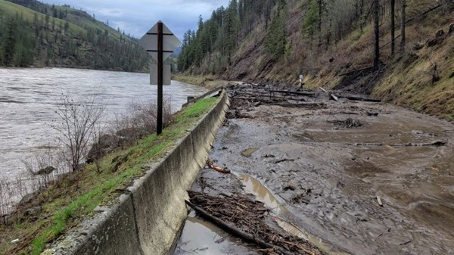
Floods
Notes:
After reviewing the climate change section, flooding, wildfires, and disease will be introduced. Review each of the section introductions, then assign students one of the remaining three hazard to investigate (watch video and read article). After time exploring the content, ask students to provide a synopsis and insight:
Summary of the video(s)
Summary of the article(s)
Descriptions of the historical contexts of climate change with examples/quotes
Description of the modern context of climate change (examples/quotes)
Examples for each of the elements – spirit, air, fire, land, and water
Floods occur naturally and can happen almost anywhere. They may not even be near a body of water, although river and coastal flooding are two of the most common types. Heavy rains, poor drainage, and even nearby construction projects can cause risk for flood damage... Floods are unpredictable. Because flood risk is always changing, communities have used tools to understand their risk and take actions to protect their families, homes and today, businesses.
Historic floods have left scars across the Nimiipuu homelands. Today, modern floods threaten towns, ravage aquatic spawning habitats, and happen infrequently. The historic stories tell of massive, regional floods from the Ice Age where connection to the elements guided the preparation of the Nimiipuu. Their experiences today wield stories of emergency preparation and response in partnership with local, regional, and federal agencies.
Watch the Idaho Public Television film “The Floods” (https://www.pbs.org/video/floods-hp8otm/) as an introduction to the Missoula Floods, which occurred 13,000 – 15,00 years ago across the homelands of the Nimiipuu. Recall that the Nimiipuu have been archaeologically dated back at least 16,000 years (Science, 2019), thus their presence during the floods and the stories of the floods are congruent.
Additionally, read the partial abstract from Gail Woodside’s 2008 Thesis, “Comparing Native Oral History and Scientific Research to Produce Historical Evidence of native Occupation During and After the Missoula Floods”.
“The Missoula Floods occurred approximately fifteen thousand to thirteen thousand years ago during the last ice age. The floods occurred when waters held back by a finger of the Purcell Ice Lobe gave way allowing water which covered present day Missoula, Montana to inundate areas of Idaho, Washington, and Oregon. The flooding moved mass amounts of silt and aggregates on its way to the sea. The flooding also carved out and deepened the Columbia Gorge and caused slack water areas or temporary lakes to form when narrow channels backed up the flooding currents.
Native American oral history tells about the flooding and the deep formation of the Columbia River, though some scientists feel that human occupation of the areas ravaged by the floods had not taken place. Native historians hold information regarding Tribal occupation of the areas flooded as well as information regarding survivability by noting techniques of survival and as well as significant peaks used as resting places until flood water subsided. Anthropological dating of the ancient Native people does point to human occupation of these lands with findings of human feces in caves found in Oregon dating approximately fifteen thousand years ago, although occupation by current tribes may not have occurred until later.”
Image caption: Highway 12 between Orofino and Kamiah reveal the first mudslide closing the road, followed by more than additional ten areas that have been blocked or had water on the roadway.
Image courtesy of Idaho Department of Transportation, 2019

Slide 22
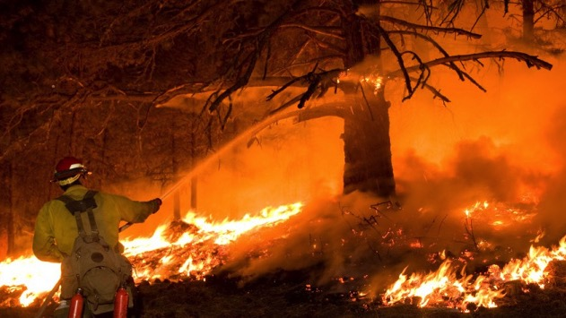
Wildfires
Notes:
The longstanding relationship of Nimiipuu and fire extends back thousands of years. Many legends contain references to fire, but also include ecological information pertinent to understanding holistically the Nimiipuu homelands.
Read the story and analysis of the traditional ecological knowledge of “How Beaver Stole Fire from the Pines”: https://talkingstories.uoregon.edu/2020/09/10/how-beaver-stole-fire-from-the-pines/
Story
Once, before there were any people in the world, the different animals and trees lived and moved about and talked together just like human beings. At this time the pine-trees had the secret of fire, and guarded it jealously from the rest of the world, so that, no matter how cold it was, nobody could get any fire to warm himself by, unless he was a pine. At length an unusually cold season came, and all the animals were in danger of freezing to death because they could get no fire; but all plans to find out their secret from the pines were in vain, until Beaver hit upon one which proved successful.
At a certain place on Grande Ronde River, in Idaho, the pines were about to hold a great council. They had built a large fire at which to warm themselves, after coming out of the icy water from bathing, and had posted sentinels round about to keep off all the animals and other intruders, who might steal their fire secret.
But Beaver had hidden under the bank near the fire before the sentinels had been posted, and so escaped their notice. After a while, a live coal rolled down the bank close by Beaver, which he seized and hid in his breast, and then ran away as fast as he could. The pines immediately raised the hue and cry, and started after him. Whenever he was hard pressed, Beaver darted from side to side, and dodged his pursuers, and when he had a good start he kept a straight course. Hence the Grande Ronde River is very tortuous in some parts of its course and then straight for some distance, because it preserves the direction Beaver took in his flight.
After running a long time, the pines grew tired and decided to abandon the chase. So most of them halted in a body on the river banks, where they remain in great numbers to this day, and form a growth so dense that hunters can hardly get through it. A few, however, kept on after Beaver, but they finally gave out one after another, and they also remain scattered at intervals along the banks of the river in the places where they stopped.
There was one cedar running with the foremost pines, and although he despaired of capturing Beaver, he said to the few pines still in the chase, “Although we cannot catch Beaver, I will keep on to the top of the hill yonder, and see how far he is ahead.” So he ran to the top of the hill, and saw Beaver far ahead, just diving into Big Snake River where the Grande Ronde enters it, so that further pursuit was out of the question. He saw Beaver dart across Big Snake River and give fire to some willows on the opposite bank, and recross farther on and give fire to the birches, and so on to certain other kinds of wood. Since then, all who have wanted fire have got it from these particular woods, because they have fire in them and give it up more readily than other kinds when rubbed together in the ancient way.
Cedar still stands all alone on the very top of the hill where he stopped in the chase after Beaver, near the junction of the Grande Ronde and Big Snake rivers. He is very old; so old that his top is dead, but he still stands as proof of the truth of the story. That the chase was a very long one is shown by there being no cedars within a hundred miles upstream from where he stands. The old people point him out to the children as they pass by, and say, “See, there is old Cedar standing in the very spot where he stopped chasing Beaver.”
Traditional Ecological Knowledge
Zoology - This story contains information about beaver behavior and habitat. It tells us that beavers live along rivers, particularly where willow, birch, and pine grow, and that they hide under river banks. It also identifies two specific rivers (or their tributaries) where beaver can be found–the Grande Ronde and the Snake. Although not explicitly stated, the references to willow, birch, and pine imply that these trees are important to beavers in some way–perhaps for food or for building dams. Because Beaver is sometimes on land and sometimes in the water, the story indicates that beavers are both terrestrial and aquatic. When Cedar sees Beaver dive into the Snake River and cross to the other side, this tells us that beavers are strong swimmers. The description of Beaver’s flight suggests that beavers dart from side to side when closely pursued by predators, but travel in a straight line when they have a good lead.
This information is useful for locating, tracking, and hunting beaver. The information about beaver habitat tells hunters where to look for beaver or signs of their presence (such as tracks, dams, or gnawed branches). The information that beavers dart from side to side could be useful for tracking and pursuing them. The information that beavers swim indicates that they can escape a hunter by diving into the water, which suggests that trapping might be a more effective way of catching them than hunting.
Botany - This story identifies four types of wood that ignite readily and are good for making fire: pine, cedar, willow, and birch. It also provides information about the growth habits of pine: these trees can grow in stands so dense that people can barely travel through them, but can also grow in a more scattered formation. The story also references the habitat of these species: pine, willow, and birch grow near rivers, while cedar grows on hilltops. More specifically, the story indicates that pine is found in abundance along the Grande Ronde River, that willow and birch are found on either side of the Grande Ronde at its junction with the Snake, and that there is no cedar for a hundred miles upstream of this junction.
This information is useful for making a friction fire: some types of wood are difficult to ignite using this technique, so knowing what materials to use for a fire drill, tinder, and kindling can mean the difference between life and death. One informant reported using the information in this story for precisely this purpose: “he and some companions were once on a fishing expedition, and had wandered too far from home to return at night. They . . . had no matches with which to start a fire. . . . Fortunately . . . they recalled the different kinds of wood to which Beaver had given fire . . . and which they understood to be . . . preferable as kindling woods. Accordingly, they took pieces of two of the kinds mentioned . . . made a small cavity in one of them, and rapidly turned the pointed end of the other therein until they were able to kindle a fire by friction” (Packard 1891:329). The information the story provides about habitat is useful for locating these woods when they are needed.
Physical Geography - This story notes that the Grande Ronde River empties into the Snake River, and that its course is straight in some places and very winding in others. The story also indicates that the banks of the upper Grande Ronde are densely forested with pine, but more thinly forested downstream. It further notes that there are no cedars along the Grande Ronde within a hundred miles of its junction with the Snake. The story also identifies a landmark–a hill near the junction of the Grande Ronde and Snake, topped by a solitary cedar tree.
This information is useful for route planning and navigation. The comment that the pine forest is “so dense that hunters can hardly get through it” suggests that land travel along this stretch of the river is difficult, making it unsuitable for hunting: dense vegetation makes it difficult to detect, track, and chase game. However, these same features make the area well-suited for eluding or hiding from pursuing enemies. The cedar is a logical choice as a landmark, because it is a long-lived species and easy to see from a distance. Upon viewing it, a traveler would know that the junction of the Grande Ronde and Snake rivers was nearby.
Cultural Geography - This story contains information about social norms: by noting that the pines guarded the secret of fire “jealously,” the story implies that it was wrong of them not to share their knowledge with others. This point is reinforced by comments on the suffering caused by the pines’ stinginess: “no matter how cold it was, nobody could get any fire to warm himself by. . .. and all the animals were in danger of freezing to death.” The story also delimits part of Nez Perce territory, in the statement that there are “no cedars within a hundred miles upstream from” the cedar landmark. This indicates that the narrator’s home range includes at least a hundred miles of the Grande Ronde upstream from the Snake.
Technology - The story notes that certain types of wood ignite “when rubbed together in the ancient way.” Although it does not describe how this is done, it nevertheless tells us that fire can be made through the application of friction. Beaver’s use of a live coal to “give fire” to various tree species demonstrates an alternative, more efficient means of making fire: igniting tinder using a burning ember takes much less time, energy, and skill than making a friction fire. Beaver’s flight demonstrates that carrying live coals while traveling saves the hassle of using the friction method when making camp. The story also warns and explains why it is important to know how to make fire: “an unusually cold season came, and all the animals were in danger of freezing to death because they could get no fire.”
“The legends convey moral teaching and practical information about familiar things and deal generally with notable landmarks of the Nez Perce terrain, the storms and winds of the mountains, the rattlesnakes among the basalt rocks in the canyons, the flowing streams and the salmon that come in the spring and summer, the insects, birds, animals, and trees.”
—Josephy 2007:1-2)
There is extensive ecological knowledge embedded in the stories of the Nimiipuu. They learn the significance of fire through the stories, observing the plant and animal relatives, and through spiritual messages. Fire is one of the five elements and is considered sacred. Taxcpol (beaver) maintains his responsibility to fire still today.
Image courtesy of Idaho Fish and Game, 2021.

Slide 23
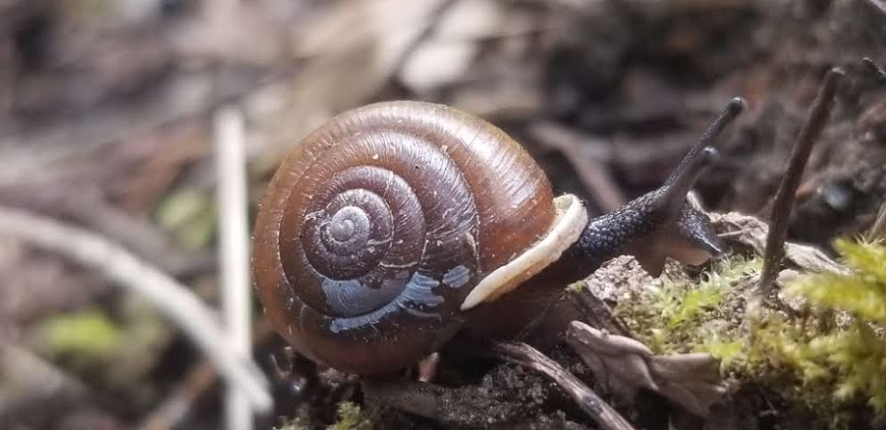
Holistic Understandings: Reflect on the role of FEMA and/or agency representatives in honoring Nimiipuu values, relationships, balance and responsibility in preparation and adaptation to hazards.
Notes:
“Tamálwit is the law that binds us to and makes us accountable to this land” – Nakia Williamson, Nez Perce, 2018.
In considering climate change, floods, wildfires, and disease, the Nimiipuu have held their sacred relationship to their culture and homelands for thousands of years. As a form of emergency management, preparation and adaptation have been vital to the success of the Nimiipuu resilience.
Task: Assigned as homework, students write a reflection on the role of FEMA and/or agency representatives in honoring Nimiipuu values, relationships, balance and responsibility in preparation and adaptation to hazards.
Image courtesy of Sapóoq'is Wíit’as Ciarra S. Greene (2019).

