Slide 1
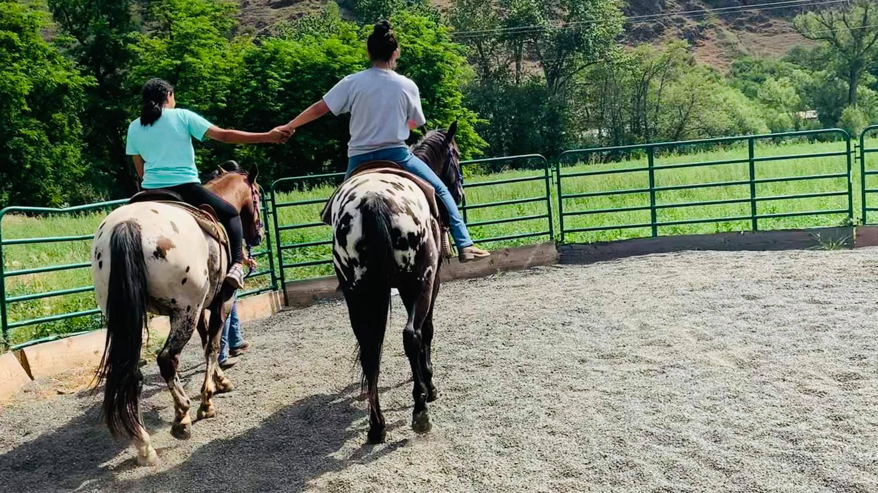
MODULE 6 Resilience: Nimiipuu
Notes:
Image caption: Nimiipuu teenage girl guiding her younger cousin on her first horse ride. Appaloosa horses were selectively bred by the Nimiipuu in the 1700’s and the relationship is still prominent today.
Image courtesy of Tiny Tots Learning Center (2021)

Slide 2
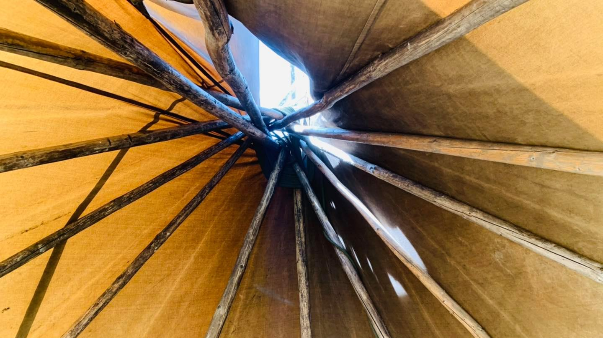
Module Objectives
Gain appreciation for the longstanding practices of Nimiipuu resilience.
Identify relationships of the elements with systemic issues and cultural competency, food sovereignty and security, and education.
Consider the role of FEMA and/or agency representatives in supporting Nimiipuu resilience.
Notes:
Image caption: Looking up from the inside of a modern canvas teepee, the importance of each pole placed is a teaching embodied by the structure itself.
Image courtesy of Tiny Tots Learning Center (2021).

Slide 3
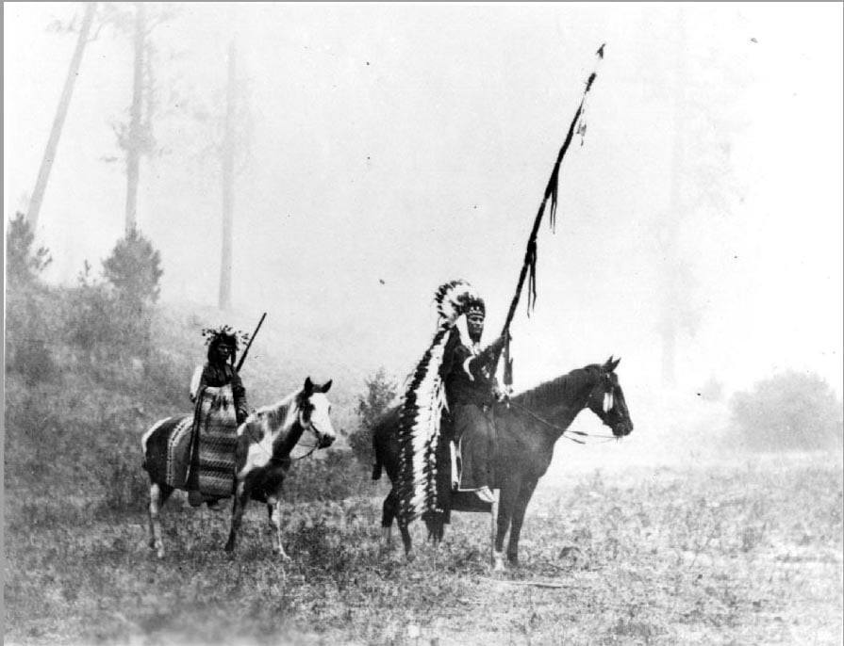
Outline
Exploration Activity: An activity assigned at the beginning of the module where students listen to a podcast of Nimiipuu and take detailed notes addressing themes resilience and sustainability.
Opening Discussion: A two-part activity for students to develop a list of conflicts, barriers, and atrocities Nimiipuu have endured; and describe how resilience is demonstrated in the Battle of Big Hole experience that was shared.
Module Content: Informational content offers insight of the longstanding practices of Nimiipuu resilience including formal initiatives in climate, COVID-19, food sovereignty/security, and education.
Holistic Understandings : Assigned as homework, students write a reflection on the role of FEMA and/or agency representatives in honoring Nimiipuu resilience.
Notes:
Image caption: “áala (Fire) is and was part of the part the landscape of the Nez Perce peoples. Fire is a part of the environment that shapes and aids the landscape. Harnessing fire aids in the preservation and preparation of food sources, it gives warmth and light, and provides a gathering place for stories and histories.” (Nez Perce National Historical Park, 2021)
Image courtesy of Nez Perce National Historical Park (2021).

Slide 4
EXPLORATION ACTIVITY: Nimiipuu resilience is prevalent in the stories of place and culture, the lessons of the land, and the lived experiences of the past, present, and into the future. Two family members, Emily Washines (Yakama) and Josiah Pinkham (Nez Perce), discuss finding resilience, comfort, and strength in times of challenge.
Notes:
An activity assigned at the beginning of the module where students listen to a podcast of Nimiipuu and take detailed notes addressing themes resilience and sustainability.
building understanding and support for Native Americans. Her research topics include the Yakama War, Native women, traditional knowledge, resource management, fishing rights, and food sovereignty. She has been focusing much attention on researching and speaking on the historical aspects of missing and murdered Native women on the Yakama reservation, with particular emphasis on women and girls who were raped and murdered in the years leading up to the Yakama War of 1855-58. Emily speaks Ichiskiin (Yakama language) and other Native languages. Yakima Herald-Republic lists her as Top 39 under 39. She received a Single Impact Event Award for her 2018 presentation from the Association of King County Historical Organizations. She is a board member of the Museum of Culture and Environment, Artist Trust, and Columbia Riverkeeper. She is adjunct faculty at Yakima Valley College. She lives on the Yakama reservation with her husband and three children.
Josiah Blackeagle Pinkham was raised on the Nez Perce Indian Reservation in north-central Idaho and has worked in the cultural resource field for over 20 years as a Nez Perce Tribal Intern, Tribal Traditions Technician, Ethnographer, and a Cultural Specialist. He has also worked on a variety of cultural resource workgroups with several federal, state, and county agencies, as well as private corporations and other tribes. While he believes his knowledge comes from the elders and the Nez Perce landscape he is also a graduate of Lewis-Clark State College with an interdisciplinary honors degree in Native American studies and psychology. Mr. Pinkham regularly speaks to public schools, college classes and the public. He has travelled nationwide and has also travelled overseas for interpretative talks and cultural exchanges.
Image courtesy of Confluence (2020).

Slide 5
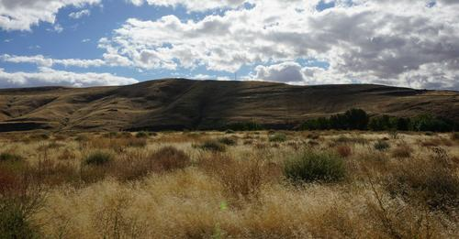
DIRECTIONS: Students listen to the podcast Voices of Family in Land and Sky. This podcast should be reviewed before class and Cornell Notes (Appendix A) while considering:
Descriptions of the resilience of Nimiipuu with examples/quotes
Examples of Nimiipuu relationships with spirit, air, fire, and land.
Summary of the podcast.
Resource List:
Podcast: Voices of Family in Land and Sky
Notes:
An activity assigned at the beginning of the module where students listen to a podcast of Nimiipuu and take detailed notes addressing themes resilience and sustainability.
Resource List:
Podcast: Voices of Family in Land and Sky
Image: Courtesy of Confluence (2020).

Slide 6
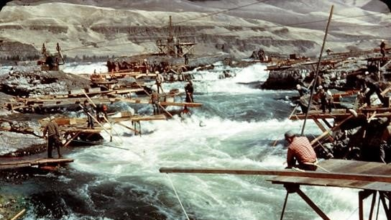
Resilience: the capability of a strained body to recover its size and shape after deformation caused especially by compressive stress; an ability to recover from or adjust easily to misfortune or change. Sustainable: capable of being sustained; of, relating to, or being a method of harvesting or using a resource so that the resource is not depleted or permanently damaged; of or relating to a lifestyle involving the use of sustainable methods
Notes:
A two-part activity for students to develop a list of conflicts, barriers, and atrocities Nimiipuu have endured; and describe how resilience is demonstrated in the Battle of Big Hole experience that was shared.
Nimiipuu resilience is apparent today in the people and the homelands.
Merriam-Webster defines resilience as “1: the capability of a strained body to recover its size and shape after deformation caused especially by compressive stress; 2: an ability to recover from or adjust easily to misfortune or change”.
The definition of sustainable is “1: capable of being sustained; 2a: of, relating to, or being a method of harvesting or using a resource so that the resource is not depleted or permanently damaged; 2b: of or relating to a lifestyle involving the use of sustainable methods”.
There are not formal definitions of resilience or sustainability from a Nimiipuu perspective, because definitions can be limiting. The act of resilience in sustaining livelihood, culture and relationship to place is demonstrated when considering the many initiatives enacted upon the Nimiipuu through colonization.
Image: The Nimiipuu continue their long-standing connection and practice of fishing in the various waters of their homeland. Tribal members caught millions of pounds of salmon at Celilo Falls before it was submerged by The Dalles Dam. The loss of the falls drastically changed the village there, which has been inhabited for at least 9,000 years. What was considered the "Wall Street of the West," became plagued by poverty.
Image citation: Image courtesy of the Nez Perce National Historical Park (2018).

Slide 7
Opening Discussion:
As a class, develop a list of conflicts, barriers, and atrocities Nimiipuu have endured; and
Think, pair, share descriptions of how resilience is demonstrated in the Battle of Big Hole experience that was shared.
Notes:
A two-part activity for students to develop a list of conflicts, barriers, and atrocities Nimiipuu have endured; and describe how resilience is demonstrated in the Battle of Big Hole experience that was shared.
Considering content from Module 1 – 3, ask students to provide a list of conflicts, barriers, and atrocities Nimiipuu have endured. Then, read the passage below provided by the Confluence Project and describe how resilience is demonstrated.
“The 1877 Nez Perce War occurred when the [Oregon Nimiipuu (Wallowa Band)] refused to be forced to move to an Idaho reservation, because the removal violated the June 11, 1855, Treaty with the Nez Perce. The treaty had reserved 7.5 million acres of land in the Washington and Oregon Territories for the Nez Perce. The Battle of Big Hole occurred in August 1877. The US Army, led by Col. John Gibbons attacked a Nez Perce encampment in Wisdom, MT. The band was on their way to join Sitting Bull in Canada. Sixty to ninety Nez Perce were killed. An example of the Nimiipuu retreating from the U.S. Army.”
Wilfred Scott (or Scotty) is a respected Nez Perce elder and veteran. Scotty grew up in Montana and was in the Navy between 1951-72. Scotty was instrumental in initiating the Red Heart Band Memorial ceremony at Fort Vancouver, that honors and mourns the loss of the Nez Perce who were imprisoned there.
Bessie is his high school sweetheart and wife. She speaks Nez Perce and is part of the staff for the Nez Perce Language program keeping the language and culture alive.
Watch Wilfred and Bessie Scott: Battle at Big Hole
Video link: https://vimeo.com/244922624
Task: As a class, 1. develop a list of conflicts, barriers, and atrocities Nimiipuu have endured; and 2. Students think, pair, and share their descriptions of how resilience is demonstrated in the Battle of Big Hole experience that was shared.

Slide 8
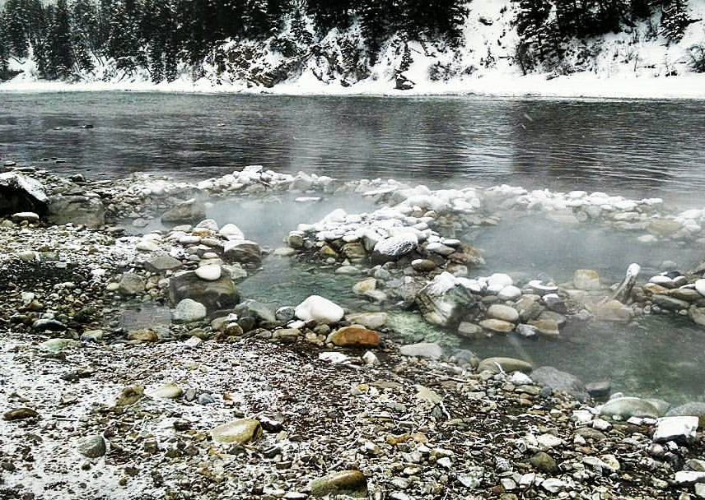
“Nimiipuu culture is not found in this chapter, or in libraries, or in various media; it is found atop the mountains, on the prairies, in the valleys, and within the rivers. As ‘the land’ – wéetes – continues to be altered, there are fewer and fewer Nimiipuu symbols, and there is less and less space and time in which Nimiipuu habitual action, feeling, worldview, and speech can occur.”
(Marshall and Pearson, 2020)
Notes:
“Nimiipuu culture in the mid-18th century was a symbolic pattern of landscape, objects, people, and habits that provided the means to meet the physical, social, and spiritual challenges of their homeland in the Columbia Plateau, in the northern Rocky Mountains, and over the northern Great Plains. The use of these maze ways, or habitus inclusive of the landscape, constituted their world – a taskscape. Thus, their motivations and thoughts come on often differing among individuals, about how to act in meeting those challenges arose from those physical, cognitive, emotional, and behavioral actualities.
This complex setting was already under considerable pressure by the time these people came in on to the written historical horizon in 1805, when Lewis and Clark passed through the homelands of the next church people. Some of these earlier pressures for change, such as the first, enabled expansion, intensification, and innovation of some social cultural patterns at the expense of others. Other changes, such as a new disease environment contributing to constant population decline, or dangerous to the path of life followed by Nimiipuu peoples. Second after Lewis and Clark all these changes increased in pace, intensity, and persistence as Nimiipuu were drawn into the developing world-system. In brief, Nimiipuu in the mid 1800s were already in an apocalypse driven by disease, violence, hunger, social chaos, and ecological change. These ‘stressors’ were not wrought by distant forces but brought into Nimiipuu Wéetespe (Nez Perce Earth) by settlers who, through the use of force, literally ‘made the rough places smooth, and the crooked places straight.’
They continue to do so. Ongoing development by settler-colonists erodes the fundamental aspect of any dominated society: its relationship with ‘the environment.’ Nimiipuu culture is not found in this chapter, or in libraries, or in various media; it is found atop the mountains, on the prairies, in the valleys, and within the rivers. As ‘the land’ – wéetes – continues to be altered, there are fewer and fewer Nimiipuu symbols, and there is less and less space and time in which Nimiipuu habitual action, feeling, worldview, and speech can occur. These changes cue the transgenerational trauma that Nez Perce people often experience. Many contemporary Nimiipuu continue to work to meet these continuing health, social, and cultural challenges by protecting and expanding that ‘traditional’ spacetime…” (Marshall and Pearson, 2020)
Image caption: Hot springs along the Snake River in Wyoming, a sacred place of healing to the Nimiipuu and other tribes of the area.
Image courtesy of Sapóoq'is Wíit’as Ciarra S. Greene (2017).

Slide 9
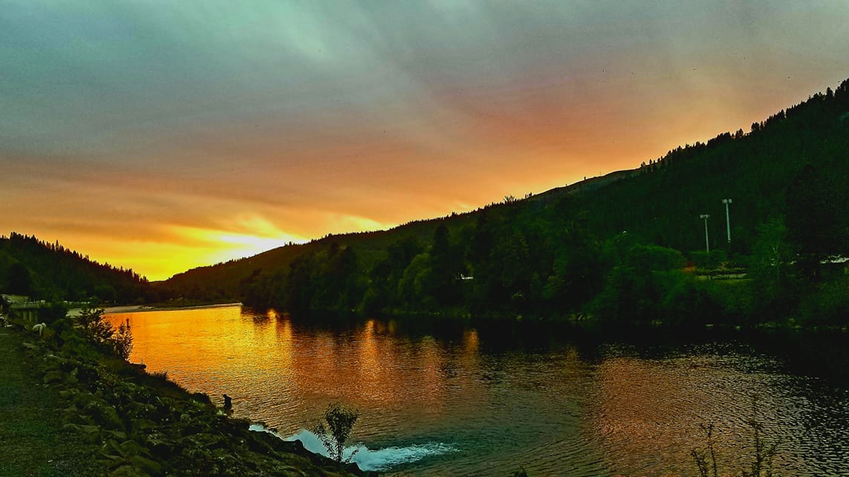
“This goal – to rise from the ashes – is seen in a variety of actions ranging from environmental restoration and land management to jurisdictional/legal issues and land ‘preservation’.” (Marshall and Pearson, 2020)
Notes:
‘The Earth’ – wéetes – has been fragmented and thus Nimiipuu have been fragmented culturally, socially, and individually. Families are often in disarray. These are the ‘soul wounds’ they suffer.
It is true that Nimiipuu are changing as they move into offices and cubicles from the fishing sites, the root-digging grounds, the hunting grounds, the Berry patches, the trails and campsites. This change cannot do anything but alter their toolkits, actions, feelings, and thoughts. And this change creates conflicts in their bodies and identities, and their societies and culture.
But they entered these new places in order to protect what remains of their ancestors’ legacy, to reclaim and revitalize what has been taken. The profound issues of these generations are land ownership, water, fish, and wildlife – and how to protect these. In other words, caring for the earth and restoring, insofar as it is possible, the pattern of life found in kinship and the more-than-human community. This goal – to rise from the ashes – is seen in a variety of actions ranging from environmental restoration and land management to jurisdictional/legal issues and land ‘preservation.’” (Marshall and Pearson, 2020)
Image caption: The spring sunset on the Clearwater River while Nimiipuu fish at the waters edge for Chinook salmon.
Image courtesy of Sapóoq'is Wíit’as Ciarra S. Greene (2021).

Slide 10
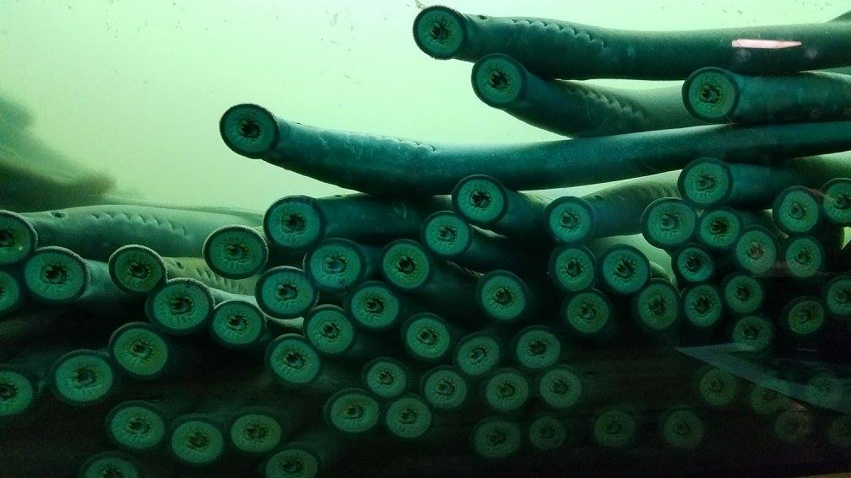
Resilience Initiatives:
Climate Change
COVID-19
Food Sovereignty/Security
Education
Notes:
There are numerous texts that reference the post-colonial history of the Nimiipuu and the experiences endured. Resilience though is the foundation of who the Nimiipuu have been, are today, and will be in the future. Sustainability as a concept, cannot fully address the depth that resilience is.
“People always talk about ‘ecosystem management’ and ‘holistic management.’ Too often I see those concepts focused on such things as sustainability of trees and forage (commercial enterprises). The sustainability of traditional foods and medicines are never discussed. For many of these people the sustainability of the salmon is not important. Many of these people are only interested in sustainability of large commercial economies, such as grazing, mining and timber. So it’s easy for other resources like the salmon to get pushed aside. For many the salmon and other natural resources are looked at as being in the way. who is going to speak on behalf of the salmon question mark up to this point has been the [Nimiipuu] and some special interest groups who have been trying to get the voice of the salmon heard.” (-Jaime Pinkham (Nez Perce)” (Landeen and Pinkham, 1999, p. 113)
The multiple strands of resilience described in this module include formal initiatives in climate, COVID-19, food sovereignty/security, and education. The mere continued existence of each Nimiipuu descendant is an embodiment of resilience, which is based on the individual and collective lived experiences of Nimiipuu since time immemorial and is too immense to address in this module but have been described in previous modules.
Image caption: Héesu (Pacific lamprey) are an ancient species of fish which are culturally-significant to the Nimiipuu. Their resilience over millions of years is honored by the Nimiipuu.
Image courtesy of Sapóoq'is Wíit’as Ciarra S. Greene (2017).

Slide 11
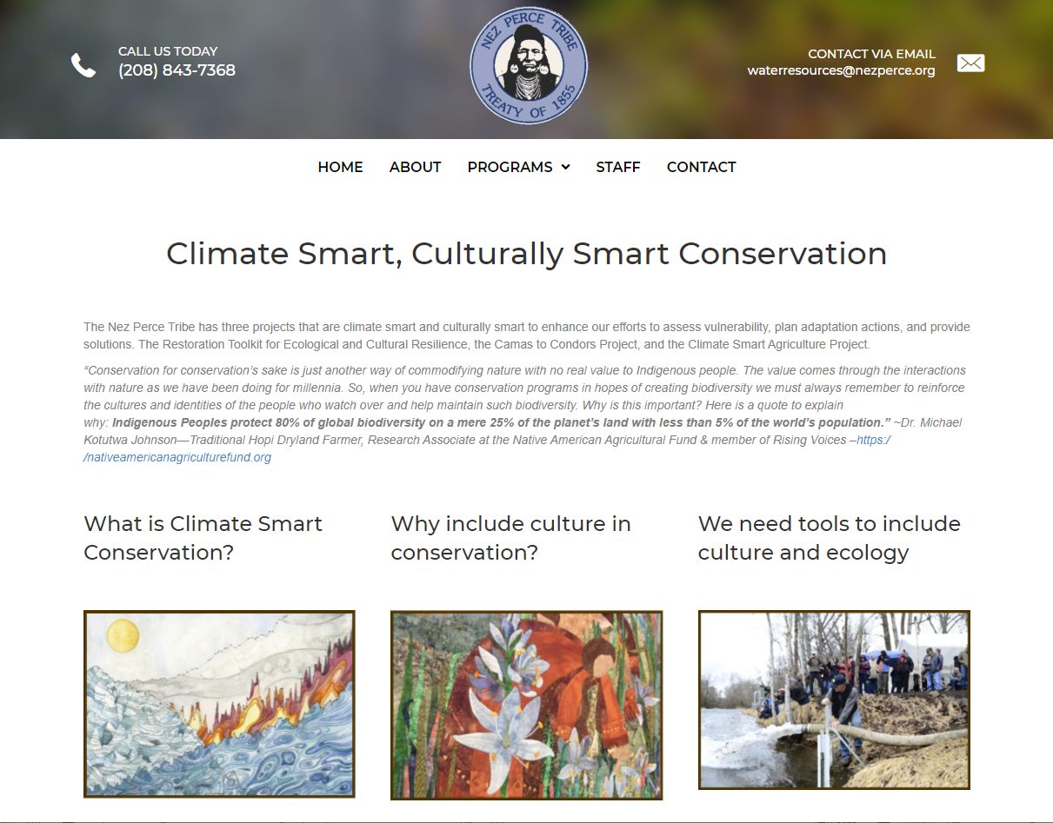
Climate Change
Notes:
Read the text below from the Nez Perce Tribe’s Climate Smart, Culturally Smart Conservation webpage:
The Nez Perce Tribe has three projects that are climate smart and culturally smart to enhance our efforts to assess vulnerability, plan adaptation actions, and provide solutions. The Restoration Toolkit for Ecological and Cultural Resilience, the Camas to Condors Project, and the Climate Smart Agriculture Project.
“Conservation for conservation’s sake is just another way of commodifying nature with no real value to Indigenous people. The value comes through the interactions with nature as we have been doing for millennia. So, when you have conservation programs in hopes of creating biodiversity we must always remember to reinforce the cultures and identities of the people who watch over and help maintain such biodiversity. Why is this important? Here is a quote to explain why: Indigenous Peoples protect 80% of global biodiversity on a mere 25% of the planet’s land with less than 5% of the world’s population.” ~Dr. Michael Kotutwa Johnson—Traditional Hopi Dryland Farmer, Research Associate at the Native American Agricultural Fund & member of Rising Voices –https:/ /nativeamericanagriculturefund.org
What is Climate Smart Conservation?
As the climate crisis intensifies, it is essential to design conservation projects for resilience under a broad suite of potential climate scenarios. Well-connected networks of habitat are more important than ever, as more than fifty percent of species are already on the move worldwide due to climate change. Climate-smart conservation focuses on diversity, refugia, functional integrity, ecosystem processes, evolutionary resilience, and close observation..
Increasing the number of species with flowers or fruit available during all seasons is one way to increase resilience and respond to changing phenology. The Tribe has completed a climate smart, culturally smart planting design tool called the restoration toolkit for ecological and cultural resilience or RTCER.
Why include culture in conservation?
Cultural survival for most indigenous peoples is directly tied to their relationship to place, land, water, and plants and animals in their homelands.
The traditional knowledge of indigenous peoples worldwide maintains records of climate, phenology, wildlife, and land management practices that benefit ecosystems and humans.
Ancient stories and practices are lessons in responsive sustainable management. Including culturally important species, indigenous practices, or access for traditional knowledge keepers into conservation projects can help build resilience for all species, guide us to new scientific questions, and remind us to reconnect with our relationships and responsibilities to each other and to all life.
The Tribe and our partners are also working on the Camas to Condors Project, a project that focuses on cultural survival in landscape level conservation planning. The Tribe, Yellowstone to Yukon, Greater Hells Canyon Council, Nimiipuu Protecting the Environment, and David Mildrexler are the founders of this project.
We need tools to include culture and ecology.
Even for tribal staff, it can be challenging to include cultural uses in restoration projects & management treatments. We believe that finding ways to include culturally significant species in restoration planning design could improve ecosystem resilience, ecosystem services, and assist indigenous peoples with cultural survival. We also recognize the challenges, needs, and guidelines for working with traditional knowledge and tribes.
The Nez Perce Tribe’s Water Resources Division and Point Blue Conservation Science modified a climate smart planting tool with species in the inland PNW, and added cultural values to it. This toolkit is designed to help the tribe’s restoration practitioners and partners include culture and climate in their planting designs.
We are also working on a climate smart agriculture project to help farmers improve their soil and productivity, water retention and drought resilience, and to improve water quality and flow to try to reduce stream temperatures for fish, improve riparian habitat for wildlife, and increase pollinator diversity.
Image: A screenshot of the Nez Perce Tribe’s Climate Smart, Culturally Smart Conservation webpage.
Image courtesy of the Nez Perce Tribe Climate Change Program, 2020.

Slide 12
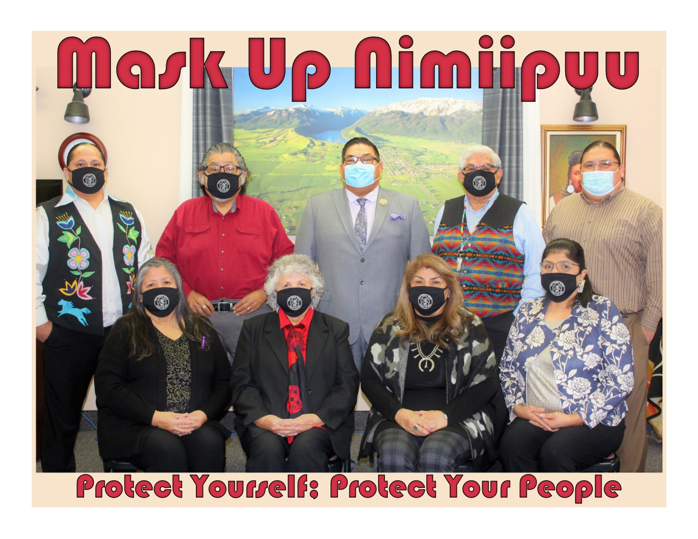
COVID-19
Notes:
With the COVID-19 pandemic prevalent in Nimiipuu homelands and community, there have been multiple avenues in addressing the problem. Reflecting on the past pandemics and continuing to value Nimiipuu culture and traditions, the Nimiipuu have actively addressed the COVID-19 pandemic systematically on the Nez Perce Indian Reservation, but also across their homelands in Idaho, Washington state, and Oregon.
On March 5, 2020 the Nez Perce Tribe COVID-19 Task Force announced that there were no confirmed cases in Idaho. Despite the efforts (i.e. the Nez Perce Tribe Stay-At-Home order), on May 1, 2020 Nimiipuu Health (the Indian Health Services providing healthcare to Nimiipuu and local community) announced the first positive tests of the novel coronavirus. Prior to Nimiipuu community exposure, there was ample planning through the Emergency Operations Command, communication specific for the community (including live updates via social media from the Nez Perce Tribe Executive Committee Chairman, Incident Commander, and Nimiipuu Health Medical Director), webinar and online resources distributed, and guidelines set and implemented.
Review the Nez Perce Tribe COVID-19 Updates: (posted chronologically with the most recent on top).
Image caption: The Nez Perce Tribe Executive Committee guides the Nimiipuu through the pandemic by promoting mask wearing, social distancing, and vaccinations while respecting the cultural values and beliefs of individual community members.
Image courtesy of the Nez Perce Tribe (2020).

Slide 13
COVID-19
Notes:
Support for the community was allocated at various times throughout the pandemic, including financial support, organized subsistence hunts, and food/supply distributions (including cleaning/disinfecting supplies and laptops/tablets for youth). As a sovereign government, the Nez Perce Tribe has taken actions in preparation and adaptation. As a community, countless acts of leadership, protection, and healing have been demonstrated.
The same plants, animals, sacred places, and ceremonial knowledge that sustained the Nimiipuu was deployed to address the COVID-19 pandemic. Preparation, a longstanding value that is emphasized in numerous legends, is prevalent today. Plant medicines had been stockpiled by those who have the knowledge and connection to the relatives; Hunters and fishers were safely organized and supported to harvest animal relatives (buffalo, salmon); and sacred places and ceremonies continued with adaptations to follow COVID-19 protocols as directed by the Nez Perce Tribe Emergency Operations Command. The community continues to rely upon the old ways, the old medicines, the old foods, songs, and prayers for protection and healing through the pandemic. To rely upon ancient old – thousands of years old - practice and knowledge, in tandem with modern protocols and practices, the Nimiipuu community has kept themselves relatively isolated, although not completely clear from COVID-19 deaths.
As of June 25, 2021 Nimiipuu Health administered 2,836 vaccines to tribal citizens and the greater community. The Nez Perce Tribe is currently following the protocol of Stage 4 of the Idaho Rebounds guidelines. This permits gatherings of more than 50 people, with proper protocols in place. Non-essential travel can continue to locations that allow. The Tribe has adapted the Idaho Rebounds guidelines throughout the pandemic with specific notice to the needs for protection and healing that the Nimiipuu require. Every loss in the community is significant, every life is sacred. As previously described, the ways in which cultural protocols are followed during times of pandemics/epidemics are adapted as needed. The Nimiipuu honor the ways of their culture and recognize the need to remain adaptive for their existence to persist.
Watch the Nimiipuu Speaker Series Ep. 1 (link: https://youtu.be/Klhpmna8qjY), a panel discussion with Nimiipuu – Nakia Williamson, Mary Jane Miles & Katherine Jackson – regarding the history and life experiences with pandemics and disease.
The impact of the pandemic has largely been experienced physically, emotionally, economically, environmentally, and spiritually by the Nimiipuu. There is not concern as to what has happened as “good or bad” but instead, seek to understand the balance of tamálwit, Natural Law.

Slide 14
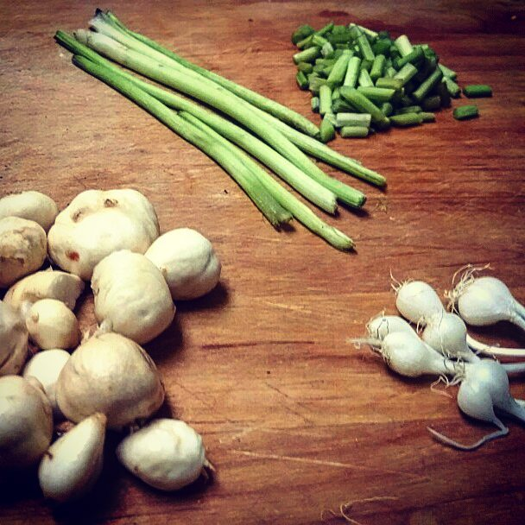
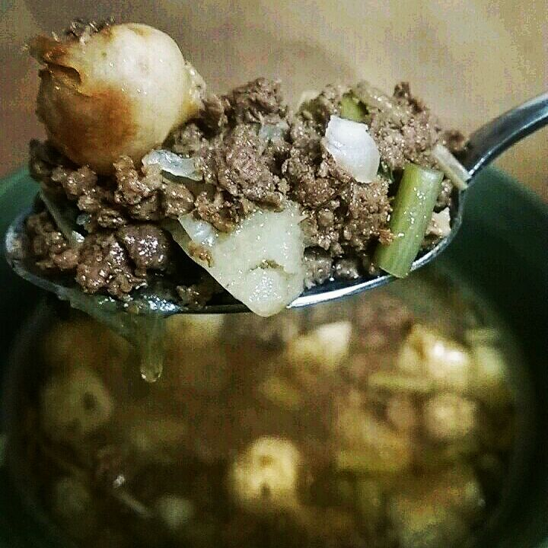
Food Sovereignty/Security
Notes:
Read the text below from an article, Reciprocity of Tradition:
Link: https://www.oregonhumanities.org/rll/magazine/union-spring-2020/reciprocity-of-tradition/
“Throughout human memory, the Indigenous peoples of the Columbia Plateau have adhered to a physical and spiritual philosophy of reciprocal, equitable, and equal relationships between human beings and with the natural world around them. Times of abundance and times of hardship are shared by their communities as a whole. Community members are expected to contribute according to their roles, skills, and abilities, and protocols exist to ensure care for Elders, children, the sick or disabled, and the needy. This philosophy, called Tamanwit by people of the Columbia River watershed like the Yakama, Walla Walla, Umatilla, and Cayuse, and Tamalwit by the Nimiipuu (Nez Perce) living farther up the Columbia, Clearwater, and Snake River watersheds, is also known as the unwritten or original law. Tamanwit provides for a sustainable relationship with the natural world as well as a sustainable human society.
Yakama tribal Elder Wilson Begay, who is from the village at the former site of Celilo Falls on the Columbia River, once told me, “The Big River Council of fish chiefs from the different bands used to meet and talk about livelihood and who they needed to help that year. Who needed help with extra food, or fixing up a fishing site. It wasn’t about controlling, it was just about general life, to help each other and look after each other.”
The reciprocity woven into Tamanwit allowed tribes of the plateau to thrive in their homelands for millennia. It includes rules of conduct such as “Never take more than you need” and “Always leave something for those who come behind.”
After the arrival of imperial colonialism—a way of life that commodifies human and ecological relationships rather than embracing them as reciprocal gifts of sustainable existence—the ecological and social safety nets maintained by Tamanwit began to unravel. Despite colonialist efforts to erase their culture and traditions, Indigenous communities are still embracing those sacred gifts and Ways to help strengthen and repair their union with each other and with the land…
The Nez Perce Tribe has invested resources in restoring the ecology of the waters in their homelands, giving jobs to people like Levi and helping the community access traditional food sources, called First Foods by local tribes.
When a community acts as a whole to prioritize lifeways such as Tamalwit, the benefits cascade throughout that community. Those benefits are particularly necessary today for Native communities struggling to recover from the gaps in opportunity that were forced upon them.
Nearly eliminated by eradication programs, lamprey were once regarded as a “pest fish” by the state of Oregon. But they’ve been a food source for the Plateau Tribes and other native species of the region since time immemorial, and are now understood to serve a vital role in river ecologies. The tribes of the Columbia River watershed have used the sovereign treaty rights they possess to force legal actions that protect ecological interests, such as the construction of fish passageways in many of the region’s dams. The Treaty of 1855, which tribes like the Nez Perce and the Cayuse, Walla Walla, and Umatilla (CTUIR) signed, promises that the tribes shall retain access to all of their original food sources on all federal land and jurisdiction within their homelands. This set a legal standard that forces the federal government to take action to preserve those so-called natural resources where it has the authority to do so.
Tribes have continued to use their treaty rights and ecological protocols to work with other conservation organizations and agencies to aid in the recovery of all threatened species native to their homelands, and to revive subsistence practices that were damaged by environmental destruction and forced assimilation policies. In recent years, 1855 Treaty tribes from the Columbia Plateau have reestablished their seasonal practice of traveling over the Continental Divide to hunt wild American bison near Yellowstone National Park…
The hunts are strictly managed by tribal conservation officers and guided by tribal protocols and expectations. All parts of the animal but the guts must be removed and used. Significant amounts of the meat must be given away to those in need. Hunters don’t hunt just for themselves, but to feed their community and to provide for cultural events, which often involve community feasts and gift-giving ceremonies. Those traditions remind people of the reciprocity required by the unwritten laws.
Many young Indigenous families today are working to ensure that their children and the following generations have the opportunity to embrace all of the sustaining gifts inherent to Ways such as Tamanwit…” (Whittle, 2020)
Image caption: Traditional foods gathered from Nimiipuu homelands to make a nutritious stew of a potato-like root, onions, celery, and moose.
Image courtesy of Sapóoq'is Wíit’as Ciarra S. Greene (2017).

Slide 15
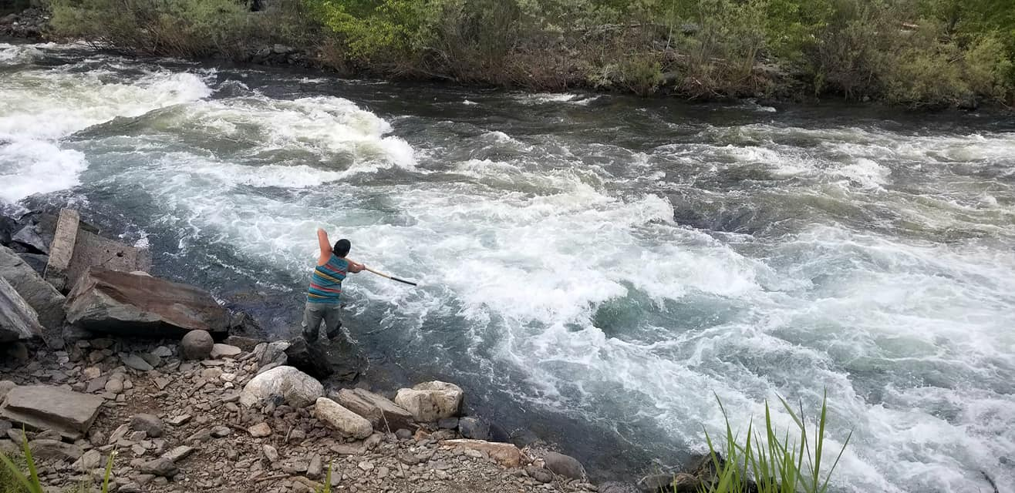
Food Sovereignty/Security
Notes:
Each of the traditional foods experience change – the many species of fish, the small and large game, the roots, and the berries.
Distribute the Student Content: Food Sovereignty/Security text and instruct students to read the article Salmon and the Adaptive Capacity of Nimiipuu (Nez Perce) Culture to Cope with Change. They should consider how resilience and sustainability of Nimiipuu culture are described; and describe how this may also be reflected with the other foods.
Image courtesy of Sapóoq'is Wíit’as Ciarra S. Greene (2018).

Slide 16
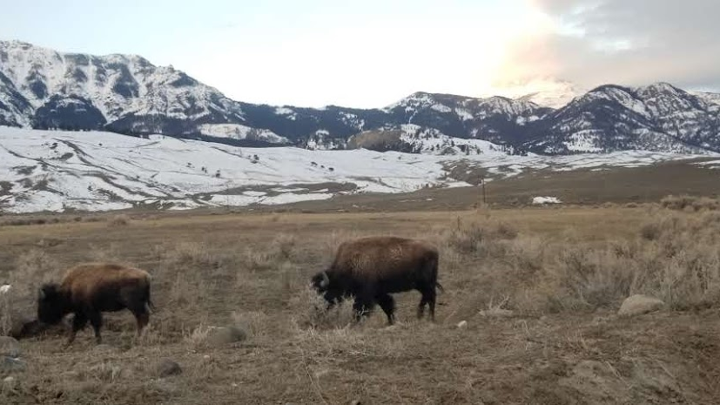
Education
“Indigenous land-based education has implications for science, culture, politics, language, environmental stewardship, land rights, reconciliation – and the future of the planet.” (Canadian Commission for UNESCO, 2021)
Notes:
Nimiipuu have remained resilient by continuing to expand and detail their ancestral knowledge. There are many facets of education, first and foremost, knowledge that comes from tamálwit – Natural Law.
“Indigenous land-based education has implications for science, culture, politics, language, environmental stewardship, land rights, reconciliation – and the future of the planet.” (Canadian Commission for UNESCO, 2021)
The understandings afforded through ancestral knowledge have withstood the test of time, colonization, and continues to remain adaptive, sustainable, and resilient. There are countless approaches to education which Nimiipuu engage with.
Traditional teachings from multiple aspects are experienced individually by Nimiipuu community members, based upon their unique positionality within the community and with their homelands. There are no experts, everyone is a learner, everyone is a teacher; the knowledge system is intimately intertwined and exceedingly diverse.
Education occurs through observation, listening to songs, prayers, and stories, through ceremony and socialization. Education is lifelong. There are cultural, informal, and formal approaches.
Image courtesy of Sapóoq'is Wíit’as Ciarra S. Greene (2018).

Slide 17
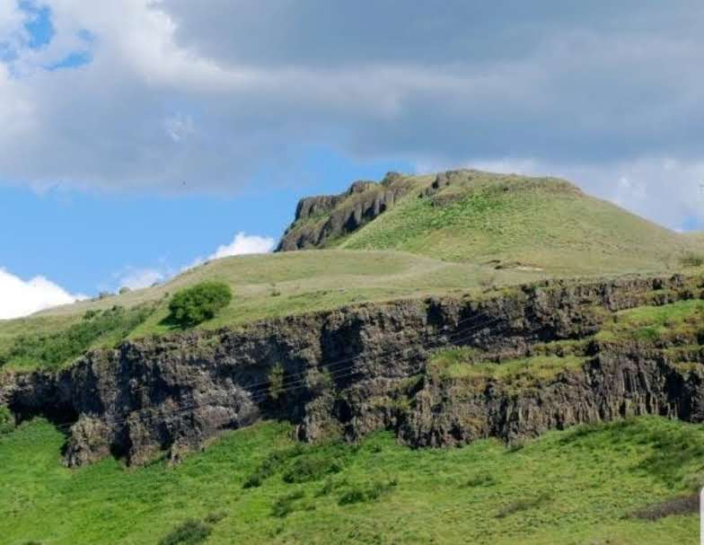
Stories
“Nez Perce stories imparted basic beliefs and [teach] moral values. Stories helped explain the creation of the world, the origin of rituals and customs, and the meaning of natural phenomena. Stories [are] a way of teaching children, promoting communication, and entertainment...” (Landeen & Crow, 1997)
Notes:
“Stories: Nez Perce stories imparted basic beliefs and [teach] moral values. Stories helped explain the creation of the world, the origin of rituals and customs, and the meaning of natural phenomena. Stories [are] a way of teaching children, promoting communication, and entertainment. They [are] normally told by the elders during the winter and during travel. These stories imparted upon children a moral framework and taught them such things as the habits and origins of animals, the location of food and other geographical features, how to use tools and weapons, and cultural traditions.
Stories that include Coyote make up the majority of Nez Perce stories. Because the Nez Perce believe that Coyote helped create them, he is very prominent in stories. Coyote is very complex in his nature and has a great capacity to survive. He represents many of the most basic human drives including lust, power and hunger for food. Coyote is often referred to as a trickster but in many of the stories Coyote is also the victim of tricks perpetrated by others. At times it was Coyote’s greed, curiosity and lack of foresight which were blamed for human hardships such as childbirth, winter, and death.
Coyote isn’t the only animal featured in Nez Perce stories. Horned lizard and sculpin were considered to be weather-changers and doctors. If the horned lizard was treated disrespectfully one should expect a return of winter at root digging time. It was believed that horned lizard could cure the ill or injured by blowing short puffs of healing breath. Rattlesnakes were also considered to be powerful doctors. Crayfish were not eaten because they too were doctors. Metallic wood boring beetles were thought to help in gambling. Cicadas are known as thirst-makers because of the hot summer days when the cicadas are making the most noise. Ticks and mosquitoes were thought to be cannibals, reduced at Coyote’s command to pests that are wish us to this day.
Stories sometimes showed ecological relationships. One story tells of Golden Eagle and his five daughters. They come in order of size: first Kestrel, then Prairie Falcon, then Red-tailed Hawk, then Ferruginous Hawk, and finally, Osprey. Nez Perce stories scarcely mention the bald eagle. “Eagle” is always the prince of raptors, Golden Eagle.
Birds are important as signs. Swallows signal return of the spring Chinook salmon, while the oriole represents the rebirth of life in springtime. The canyon wren, said to attached and drive off rattlesnakes in defense of its rimrock nest, exhibits bravery in defense of home and family. Meadowlark’s song give its flesh “medicinal” power to cure speech impediments, while Mourning Dove’s heart is eater to make a person “quiet.” Meadowlark also speaks to Indians, but in a teasing way. Ravens are powerful Indian doctors and messengers. Those with Raven’s power can interpret the messages they bring of portentous distant events. Generally, Raven bears news of significance over long distances without the chill import of the Great Horned Owl’s tidings. Conversely, talkative crows rarely say anything of significance, being given over to idle gossip. The raven is a more solitary bird partial to wilderness; the crow is gregarious camp-follower…” (Landeen & Crow, 1997)
Image courtesy of Sapóoq'is Wíit’as Ciarra S. Greene (2018).

Slide 18
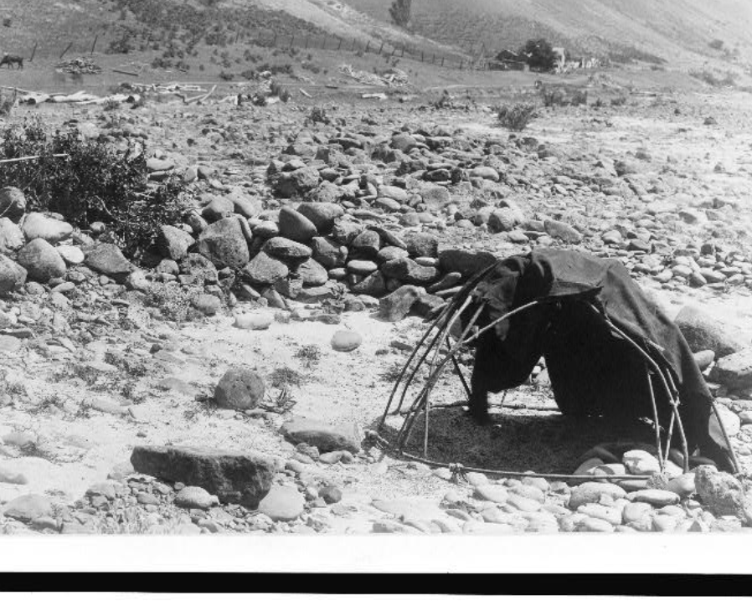
We were there for The Old Man, The One Who Is Wise. We were there to be with him, to get wisdom from him…” (Axtell & Aragon, 2000)
Notes:
The late elder, Horace Axtell shares his in his memoir about learning in the sweat house, which continues to be practiced today by many community members on a daily, weekly, monthly basis as a ceremonial and social practice.
“The Old Man: ever since I grew up using this sweat house I was always told that he is The Old Man. we call him qiwn, which means Old Man. the name for the sweat house is wistitamo. he was the wisest, most knowledgeable, strongest medicine man. He was the healer of broken hearts, aches and pains, and many things. We always referred to him as The Old Man – Wise Old Man. second people use this warehouse for preparing to go hunt, go fishing place that game, preparing to do most anything I learned so much in this warehouse. I was very small when I remembered first going into this White House. I just barely remember sweating with my grandmother and mother. The things I learned right from the start is keep your eyes closed, wait for the older man or elder lady to take care of the water, and listen to what they are talking about.
The Old Man was there all the time. Even when you left to go on a trip, he stayed home and took care of everything. He took care of your home, your sweat house, and watched over them. When we'd go on a journey comment the first thing we do was go visit The Old Man at the sweat house. We’d be happy to get back to The Old Man. He was there all the time.
Now this is what I learned from being at this sweat house. We would go there to see The Old Man to get wisdom. Whenever elders sweat, and whoever they sweat with, they tell the stories. They talk about their experiences. They give you advice. They teach you words. Anything. That's just the way it was in Nez Perce ways….
We were there for The Old Man, The One Who Is Wise. We were there to be with him, to get wisdom from him…” (Axtell & Aragon, 2000)
These teaching are alive and continue to demonstrate the resilience of the Nimiipuu. These teaching have continued for thousands of years. This way of life persists, and the adaptive capacity of the Nimiipuu remains just as prominent in today’s society.
Image caption: Nez Perce sweathouse with landscape, lashed pole framed with blanket, large smooth stones in dry riverbed, house, fence and hills in background.
Image citation: Curtis, E. S., photographer. (ca. 1910) Nez Percé sweat-lodge. , ca. 1910. [Photograph] Retrieved from the Library of Congress, https://www.loc.gov/item/94507922/.

Slide 19
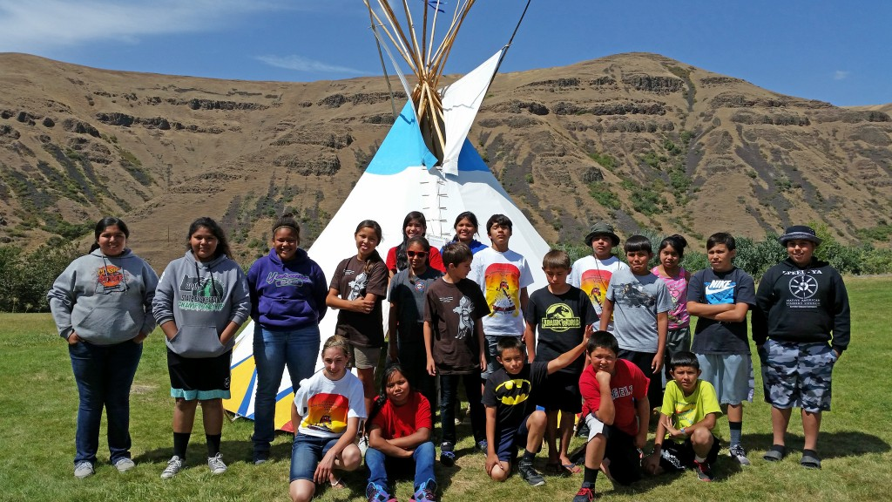
Education
Notes:
. Today the Nez Perce Tribe has multiple programs providing educational opportunities for the Nimiipuu community:
The Nez Perce Tribe Education Department promotes the prosperity of the Nez Perce people through education and career pathways to self-sufficiency.
The Career Center provides an array of education, training and employment services to youth and adults which includes partnership with education providers, ABE/GED, scholarship assistance for career technical education, short term workforce training and development.
Mamáy’asnim Hitéemenwees -Early Childhood Development supports parents and their children, ages 5 and younger, in receiving high-quality early education.
The Students for Success Program promotes student health and achievement by working to prevent substance misuse, chronic disease, and suicide prevention.
Vocational Rehabilitation Services assist people with disabilities in finding and keeping employment and living independently.
Higher Education Scholarship Program provides financial assistance for Nez Perce citizens seeking higher education. The program processes tribal scholarship funds for eligible tribal higher education students to support their academic or vocational technical programs. Expand student support services to assist current or future scholarship students to successfully enroll and complete post-secondary degree programs.
State Tribal Education Partnership (STEP) project helps students excel by through culturally relevant teaching. Under this program, the Tribe collaborates with state educational agencies to enhance student experiences.
Youth Mentoring Program provides college and career readiness mentoring for Native American boys in grades 7–12 who attend school on the Nez Perce Reservation.
The Natural Resources Department (NRD) works to preserve the natural resources that have always provided for the Nimiipuu people.
The Cultural Resource Program: The mission of the Cultural Resource Program (CRP) is to promote the understanding and use of nimiipuu’neewit (traditional Nez Perce life-ways) as integral components of Tribal culture and regional management.
Environmental Restoration and Waste Management (ERWM): ERWM works to protect and restore Nez Perce cultural and natural resources in this area. Projects under ERWM include outreach to educate the public on Hanford issues, and support for Nez Perce college and high school students in developing careers in the STEM field
Additional tribal programs that provide education and outreach include: Air Quality Program, Bio-Control Program, Forestry and Fire Management, Land Services, Water Resources, Wildlife Division, and Fisheries Resources Management.
Image courtesy of the Columbia River Inter-Tribal Fish Commission (2015).

Slide 20
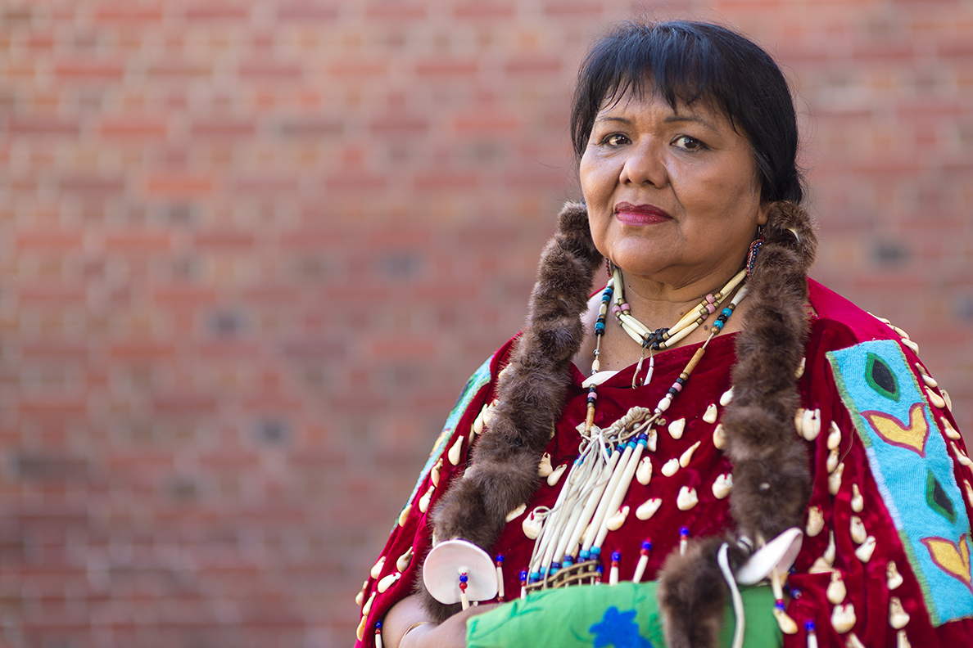
Education
Notes:
There are various educational entities that are separate from the Nez Perce Tribe, but are owned and operated by tribal citizens, including Nez Perce Tourism (preserving our culture, identity and traditions while simultaneously creating jobs that spur the local economy and protect our sacred ecosystem), hipéexnu’ kíi’u núun wisíix. inc. (to promote protect & revitalize the Nimiipuu language & cultural arts of life), and childcare facilities (i.e. Little Roots, Tiny Tots). There are also government agencies that have trust responsibilities to the Nimiipuu, including the US Forest Service (Nez Perce-Clearwater National Forest, Payette National Forest, Bitterroot National Forest, Wallowa-Whitman National Forest, Umatilla National Forest, St. Joe National Forest, Salmon National Forest, Lolo National Forest etc.), and the National Park Service (Nez Perce National Historical Park, Yellowstone National Park, Fort Vancouver National Historical Site, Big Hole National Battlefield, Bear Paw Battlefield, Nez Perce (Nee-Me-Poo) National Historic Trail, etc.) who also provide education and outreach for, by, with, and about Nimiipuu.
There are Nimiipuu doctors, educators, engineers, lawyers, chefs, artists, entrepreneurs, biologists, ecologists, nurses, dentists, authors, historians, ranchers, social workers, construction workers, filmmakers, politicians, foresters, poets, enterprise managers, budget and finance staff, grant writers, etc. Nimiipuu citizens hold PhD, Masters, Bachelors, Associates degrees and a wide variety of certifications, academic accolades, and educational endorsements.
Image caption: Leslie Randall, Nimiipuu, was awarded the Johnson & Johnson PhD Student Award at Washington State University in 2016.
Image courtesy of Washington State University (2016).

Slide 21
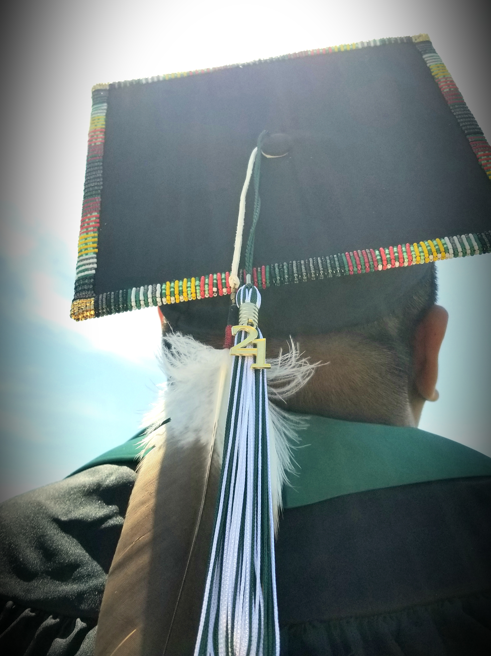
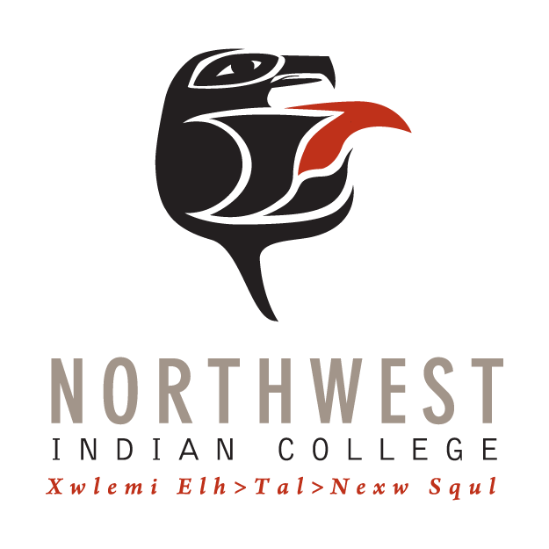
Notes:
There are various educational entities that are separate from the Nez Perce Tribe, but are owned and operated by tribal citizens, including Nez Perce Tourism (preserving our culture, identity and traditions while simultaneously creating jobs that spur the local economy and protect our sacred ecosystem), hipéexnu’ kíi’u núun wisíix. inc. (to promote protect & revitalize the Nimiipuu language & cultural arts of life), and childcare facilities (i.e. Little Roots, Tiny Tots). There are also government agencies that have trust responsibilities to the Nimiipuu, including the US Forest Service (Nez Perce-Clearwater National Forest, Payette National Forest, Bitterroot National Forest, Wallowa-Whitman Formally, Northwest Indian College (NWIC) is a tribal college with a extended campus (Nez Perce) in Lapwai and Kamiah, Idaho. NWIC is an accredited four year college guided by the mission, vision, and core values:
NWIC Mission Statement: Through education, Northwest Indian College promotes Indigenous self-determination and knowledge.
NWIC Vision Statement: We are committed to our students, the Tribes we serve, and advancing Tribal sovereignty for the protection and enhancement of our homelands and future generations.
NWIC Core Values:
Sәla-exʷ: Our strength comes from the old people. From them we receive our teachings and knowledge and the advice we need for our daily lives.
Schtәngәxʷәn: We are responsible to protect our territory. This means we take care of our land and water and everything that is on it and in it.
Xwlәmi-chosәn: Our culture is our language. We should strengthen and maintain our language.
Leng-e-sot: We take care of ourselves, watch out for ourselves and love and take care of one another.
Xaalh: Life balance/sacred
NWIC is an important part of the Nez Perce community. The College offers a variety of educational programs to meet academic, vocational and cultural needs. The NWIC Extended Campus brings those programs conveniently into the community.
At NWIC-Nez Perce, students are encouraged to develop themselves and discover ways to contribute to their communities and families. They learn ways to understand and support the goals of the Nez Perce Tribe, especially in the areas of self-governance, as well as social and economic well-being.
Degree Programs Offered at Nez Perce:
Bachelor of Arts in Tribal Governance & Business Management
Bachelor of Arts in Native Studies Leadership
Bachelor of Science in Native Environmental Science
Associate of Arts in General Direct Transfer
Associate of Applied Science in Early Childhood Education
Education in the Nimiipuu community is offered in diverse and dynamic approaches, providing holistic understandings of their culture, homelands, and community. The teaching are ancient and modern, address physical, social, mental, economic, environmental, and spiritual aspects. The Nimiipuu are wise, knowledgeable, adaptive, and resilient.
Image courtesy of Sapóoq'is Wíit’as Ciarra S. Greene (2018).

Slide 22
Holistic Understandings: Reflect on the role of FEMA and/or agency representatives in honoring Nimiipuu resilience.
Notes:
Watch Traditional Ecological Knowledge & Place-based Learning Communities
“Traditional environmental knowledge is a body of knowledge and beliefs transmitted through oral tradition and first-hand observation. It includes a system of classification, a set of empirical observations about the local environment, and a system of self-management that governs resource use. Ecological aspects are closely tied to social and spiritual aspects of the knowledge system. The quantity and quality of TEK varies among community members, depending upon gender, age, social status, intellectual capability and profession (hunter, spiritual leader, healer, etc.). With its roots firmly in the past, TEK is both cumulative and dynamic, building upon the experience of earlier generations and adapting to the new technological and socioeconomic changes of the present” (Dene Cultural Institute 1995 in English translation, quoted in Stevenson 1996: 281).
Video link: https://youtu.be/liKV74avPso
Task: Assigned as homework, students write a reflection on the role of FEMA and/or agency representatives in honoring Nimiipuu resilience.
Consider:
Content from the video;
The description of traditional environmental knowledge; and
The longstanding practices of Nimiipuu resilience regarding climate, COVID-19, food sovereignty/security, and education.

