Slide 1
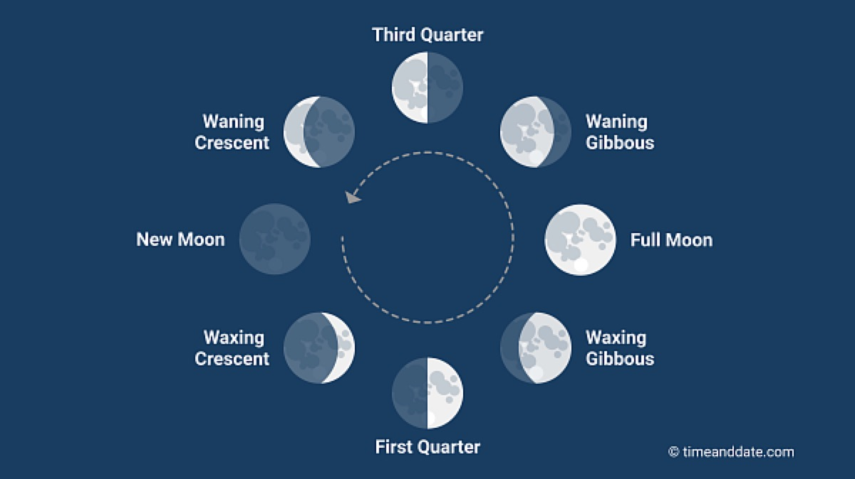
Module #7: Hawaiian Place-Based Identities
Notes:
Moon phase picture from @timeanddate.com website.

Slide 2
Learning Objectives
To understand the connection between people and the elements of reference, i.e., the Moon Phases.
To understand the solar system with the different phases of the moon.
To connect the different moon phases with weather disturbances, traditional practices, and people
To develop an understanding of an oral culture through ancestral knowledge.

Slide 3
Driving Questions
How do place-based identities connect to climate change?
How does knowledge of the moon phases connect to climate change?
How does the knowledge of moon phases connect to emergency management planning?
Notes:
1. Place-based identities connect to climate change by connecting the student to the place they come from. This connection allows for collaborations with community and government officials because of the need to work together.
2. Understanding the moon phases aids in understanding the patterns and cycles of the world and knowing when to expect extreme weather disturbances.
3. Using the moon phases to know days before extreme weather disturbances occur.

Slide 4
Module Sections
Cultural protocol
Introductions Activity
The Moon Phases
Storytelling: Moʻolelo of Hina
Moon phases Days 1-30
King Tides
Case study #1: Nā Pō O Ka Malama: The “Nights” of the Hawaiian Month
Mosaic Art Reflection & Creative Theater activity
Case study #2: How King Tides became Hawaii’s Climate Change Wake-up Call
Reflection for class

Slide 5
Cultural Protocol
Elder and/or leader to start beginning protocol to have everyone on the same page.
Words to E Hō Mai (By: Edith Kanakaʻole Kanahele)
E hō mai ka ʻike mai luna mai ē
O nā mea huna noʻeau o nā mele ē
E hō mai, e hō mai, e hō mai ē (x3)
Notes:
The start of the module opens in traditional protocol with the E Hō Mai chant, which talks about bringing everyone together, both student and educator, with everyone learning from each other. The class and educator chant together, repeating the chant three times, becoming louder each time. The chant is by Edith Kanakaʻole Kanahele and can be played for the class to learn and chant together, https://youtu.be/32vcntOp0i4.

Slide 6
Introductions
Each person introduces themself and where they are from in the Hawaiian language.
Each person explains what connects them to this place. Follow below:
Aloha.
ʻO (first & last name) koʻu inoa.
No (place of residence) mai au.
What makes me pili to Hawaii?
Notes:
After the chant, explain that when doing this in Hawai‘i, each student would introduce themselves and where they are from in the Hawaiian language, and explain what connects them to this place. Introductions would be shared in the following way:
Aloha.
ʻO (first & last name) koʻu inoa.
No (place of residence) mai au.
What makes me pili to Hawaii?
Explain that by doing introductions in the Hawaiian language, the student is being connected to another worldview. Have each student introduce themselves in the Hawaiian language and explain how they connect to the place they come from. This activity allows the students to have a connection to place and creates relationships with communities.

Slide 7
Moʻolelo of Hina
There are many stories about the goddess Hina. She is often connected with the moon and is mostly described as a very smart and attractive woman often pursued by men and other creatures.
In Hawaiian mo’olelo (stories) and chants, there are variations on her name such as Hina-puki-i’a (Hina gathering seafood) a goddess of fishermen and Hina-’opu-hala-ko’a who gave birth to all reef life.
But one of the most well-traveled stories speaks of this beautiful yet determined woman who becomes tired of being on earth and flees to the moon, eventually becoming the goddess of it.
Notes:
The teacher will connect the moon phases through oral history in storytelling. The story talks about the Goddess Hina that is connected to the moon and fishermen. This story is used as another source in learning how to remember stories that can connect the student to the lesson. In learning this story, the student will remember that the moon phases are related to what fishermen do on a daily basis, the connection between deities and people, and the tools of oral culture in remembering stories to help with understanding the solar system and it’s moon phases.

Slide 8
Anahulu Hoʻonui
The following slides have Days 1-10 of the month with their respective names
Anahulu = A period of ten days
Hoʻonui = Rising
Notes:
Western Pacific Regional Fishery Management Council. Hawaiian Lunar Calendar. Published December 16, 2019. The teacher will break up the days of the month in to ten days periods and go in to what happens in those days for the moon phases. The teacher will connect the moon phases to the size of the moon and explain what native people see and use when they fish and plant. The teacher will show the connectedness between moon phases and how men use those phases. Picture from Archive.hokulea.com @ https://images.app.goo.gl/ss9m67jGd.

Slide 9
Anahulu Hoʻonui: Beginning of the Moon Phases
Day 1: Moon phase is called Hilo.
Low to the horizon in the West at sunset.
Fishing: on the shoreline.
Farming: is unproductive.
Day 2: Moon phase is called Hoaka.
In the West at sunset.
Good fishing in lagoon, bay, and deep sea.
Good planting, i.e. ʻulu, ʻuala, kalo, maiʻa, & kō.
Notes:
The teacher will go through each day of the moon phases to show a pattern, shows the moon gradually increase/decrease in size, and what is associated with each moon phases/day for fishermen and farmers. The key days of the month are the full moon in which the moon connects to the ocean and that is a time of increased tides. In order to understand when this happens, an understanding of the moon phases are necessary so that when the full moon is upon us there will be knowledge of an increase in tide before it occurs.

Slide 10
Anahulu Hoʻonui: Kū Moon Phases
Day 3: Moon phase is called Kūkahi
Day 5: Moon phase is called Kūkolu
Visible in early evening.
Excellent fishing in lagoon, bay, and deep sea.
Good farming, i.e. for ʻuala, kalo, & maiʻa.
Visible in day.
Good fishing in canoe and beach. Collect wana and limu.
Good planting, i.e. ʻuala, kalo, & maiʻa.
Day 4: Moon phase is called Kūlua
Day 6: Moon phase is called Kūpau
Visible through evening.
Excellent fishing in lagoon, bay, and deep sea.
Good planting, i.e. ʻuala, kalo, & maiʻa.
Visible through late evening.
Good fishing in lagoon, bay, and offshore.
Good planting, i.e. ʻuala, kalo, & maiʻa.
Notes:
The teacher will show the different phases in the moon phases. The Kū phases is seen as important days for fishermen and farmers because of the size of moon. This means that when the moon is a certain size there are many intangible perceptions involved as to how to best fish and farm.

Slide 11
Anahulu Hoʻonui: ʻOle Moon Phases
Day 7: Moon phase called ʻolekūkahi
Day 9: Moon phase called ʻolekūkolu
Visible until middle of night. Time to rest and prepare.
Poor fishing.
Unproductive planting, time for maintenance.
Visible until after midnight. A time to rest and prepare.
Poor fishing.
Unproductive farming.
Day 8: Moon phase called ʻolekūlua
Day 10: Moon phase called ʻolepau
Visible until after midnight.
Poor fishing.
Unproductive planting.
Visible until after midnight.
Poor fishing.
Unproductive planting.
Notes:
The moon phases for day 7 – 10 show the moon phase in a position that does not show a visible moon and therefore these days are used for rest and preparation.

Slide 12
Anahulu Poepoe
The following slides have Days 11-20 of the month with their respective names
Anahulu = A period of ten days
Poepoe = Full
Notes:
Western Pacific Regional Fishery Management Council. Hawaiian Lunar Calendar. Published December 16, 2019. Picture from Archive.hokulea.com @ https://images.app.goo.gl/ss9m67jGd.

Slide 13
Anahulu Poepoe
Day 11: Huna
Day 13: Hua: Sacred night to Kāne and Lono
Visible until after midnight.
Good fishing.
Good planting rooted plants such as ʻipu.
Visible until near dawn.
Good fishing.
Excellent planting.
Day 12: Mohalu: Sacred night to Kāne
Visible until before dawn.
Good night for fishing.
Excellent planting flowering plants, ʻipu, ʻuala, & kalo.
Notes:
The teacher will highlight these days that lead to the full moon. By learning these days and what size the moon will be the student will know before hand when the full moon will be in the sky.

Slide 14
Anahulu Poepoe: Full Moons
Day 14: Akua: 1 of 3 full moons.
Day 16: Māhealani: 3 of 3 full moons.
Sacred to Kāne and Lono.
Visible throughout night.
Good fishing.
Excellent planting.
Visible until early morning.
Excellent fishing.
Excellent planting, ex: ʻuala, kalo, maiʻa, & fruit plants.
Day 15: Hoku: 2 of 3 full moons.
Visible throughout night.
Good fishing.
Excellent planting, ex: maiʻa & root plants.
Notes:
The teacher will highlight the full moons because during these days there are different phenomena that occur each month that are related between the moon and the ocean.

Slide 15
Anahulu Poepoe
Day 19: Lāʻaukūlua: 2 of 3 lāʻau moons
Day 17: Kūlua: First moon to rise after twilight
Visible until mid morning.
Descent fishing.
Collect plants for medicinal use. Plant maiʻa & trees.
Visible until early morning.
Good fishing.
Good planting.
Day 18: Lāʻaukūkahi: 1 of 3 lāʻau moons
Day 20: Lāʻaupau: 3 of 3 lāʻau moons
Lāʻau refers to medicine, wood, & plant life.
Descent fishing.
Collect plants for medicinal use. Plant maiʻa & trees.
Visible until late morning.
Descent fishing.
Collect plants for medicinal use. Plant maiʻa & trees.
Notes:
Teacher will highlight these days and show a pattern between the size of the moon and what to do during those days with fishing and farming.

Slide 16
Anahulu Emi
The following slides have Days 21-30 of the month with their respective names
Anahulu = A period of ten days
Emi = Falling
Notes:
Western Pacific Regional Fishery Management Council. Hawaiian Lunar Calendar. Published December 16, 2019. Picture from Archive.hokulea.com @ https://images.app.goo.gl/ss9m67jGd.

Slide 17
Anahulu Emi
Day 21: ʻOlekūkahi: 1 of 3 ʻole moons.
Time of rest & preparation.
Day 23: ʻOlepau: 3 of 3 ʻole moons.
Time of rest & preparation.
Visible late night until around noon.
Unproductive fishing & planting.
Preparation day.
Visible after midnight until afternoon.
Unproductive fishing & planting.
Preparation day.
Day 22: ʻOlekūlua: 2 of 3 ʻole moons.
Time of rest & preparation.
Visible after midnight until mid day.
Unproductive fishing & planting.
Preparation day.
Notes:
The teacher will show how the moon size decreases and what happens in this stage of the ʻole moon.

Slide 18
Anahulu Emi
Day 26: Kāloapau: 3 of 3 kāloa moons.
Day 24: Kāloakūkahi: 1 of 3 kāloa moons. Kanaloa honored. kāloa moons known for good fishing.
Best viewing at sunrise.
Good fishing in lagoon & offshore.
Good planting, ex: kō, wauke, hala, maiʻa, & ʻohe.
Best viewing to the east at sunrise.
Good fishing.
Descent planting, ex: kō & ʻohe.
Day 25: Kāloakūlua: 2 of 3 kāloa moons.
Kāloa moons known for good fishing.
Good fishing in lagoon & offshore.
Good planting, ex: kō, wauke, hala, maiʻa, & ʻohe.
Notes:
The teacher will highlight these days as being good for fishing and farming. Also, highlight the size of the moon as it decreases.

Slide 19
Anahulu Emi
Day 29: Mauli
Day 27: Kāne: A time of prayer & gratitude for life.
Rarely visible Viewing to the east at dawn.
Good fishing.
Excellent for planting dark green vegetables.
Best viewing to the east at sunrise.
No fishing & planting.
Day 28: Lono: A time of prayer & gratitude for life.
Day 30: Muku: Rises with the sun.
Best viewing to the east at sunrise.
No fishing & planting.
Not visible.
Good fishing to collect wana & limu.
Good planting, ex: maiʻa & kō.
Notes:
The teacher will show that each day has a different moon size and there are specific traditions to follow when understanding each day and their moon size.

Slide 20
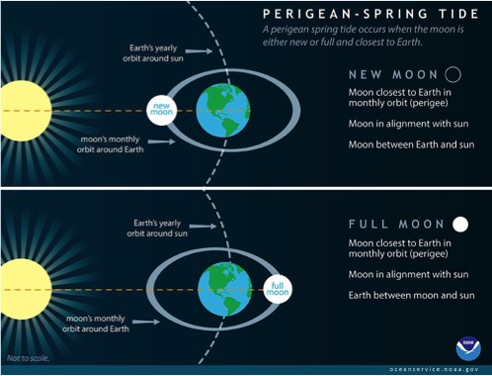
King Tides (Perigean Spring Tide)
King Tides: Highest astronomical tides during the summer & winter months.
This event occurs:
When the moon is closest to the Earth in its monthly orbit during the new moon.
When the sun, moon, & Earth are in alignment during the full moon.
Both events create a strong gravitational pull.
This dynamic means that the sun and moon’s Individual gravitational pulls work together, producing the highest high tides of the year, or the King Tides.

Slide 21
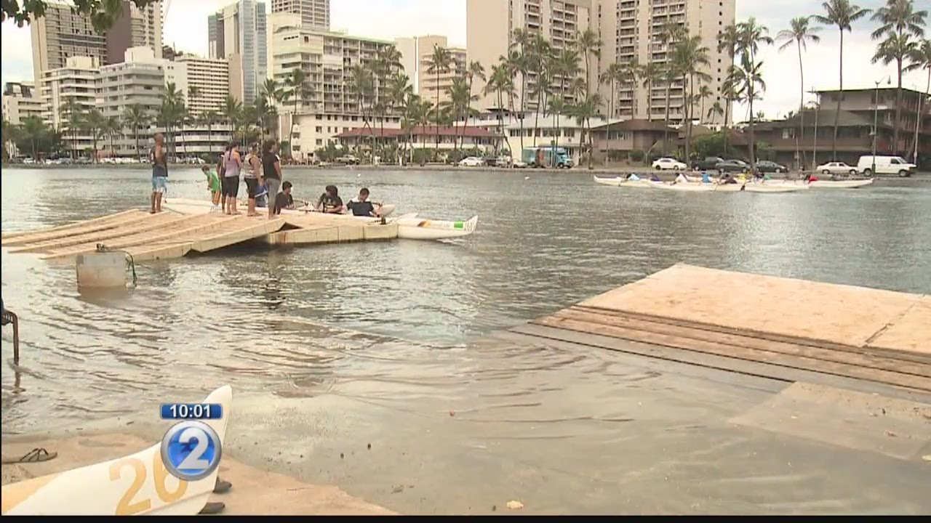
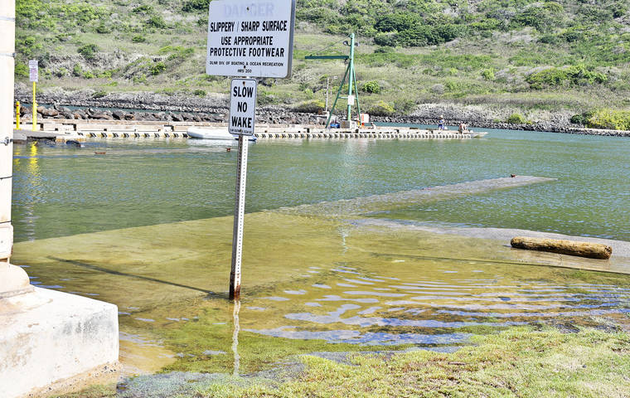
King Tides & Full Moons Occurring Simultaneously
When King tides occur at the same time as the moon phases of Akua, Hoku, & Mahealani, extreme levels of sea level rise occur. This phenomena allows for communities to know when they need to do the following:
Prepare for shoreline flooding in low lying areas.
Will know before hand that this phenomena will occur based on ʻike Hawaiʻi (Hawaiian knowledge).
Prepare for emergency management if home and business is along the shoreline.
Prepare for family to stay at home and/or relocate to safe area ahead of time instead of in an emergency situation.
Notes:
Photo Credit: KHON2 News. Understanding this dynamic will help in finding solutions to the flooding and help to create management plans that are mindful of this dynamic while using Indigenous knowledge of the moon phases.

Slide 22
Case Study #1
Read Langlas, Charles M. “Nā Pō O Ka Malama: The “Nights” of the Hawaiian Month.” Palapala, 1: 2017. 101-112.
Discuss as a group:
Four opinions regarding pō.
Primary Hawaiian language sources.
Secondary sources & Tsuhaʻs Masterʻs thesis proposal.
Polynesian comparisons.
Notes:
Teacher will use this case study to discuss pō or the beginning of time, to discuss how Hawaiian language sources have answers from the past for the present, a Masterʻs thesis proposal including Indigenous knowledge to modern knowledge, and what to look for when discussing the polynesian worldview.

Slide 23
Group Activity: Mosaic Art Reflection & Creative Theater
Get together in groups of 4 or 5
Discuss 5 important dynamics to know about place-based identities and the connection to climate change.
Each person will draw on a 5 inch x 5 inch canvas a picture that represents their vision of how place-based identity can help in disaster and/or emergency plans.
Each group will create a moʻolelo (story) as to how they will create a plan for emergency management by using place-based management.
Each group will act out their vision.
Notes:
The teacher will put the students in groups of 4 or 5 to discuss the connection between place-based identities and climate change. Each student will receive a 5 inch x 5 inch canvas to draw their vision of how place-based identity helps with a disaster and/or emergency plans. Each group will development the skill of story-telling by creating a moʻolelo or story of how they created an emergency plan by using art and story-telling for the presentation in developing an a place-based management plan.

Slide 24
Group Activity: End Product
ʻIke Kuʻuna Art Reflection 6x2ft poster board.
Each student will be given a square to draw and color their own reflection.
All squares will be joined together to form a Mosaic Art piece at the end of the specific curriculum.
The Mosaic Art Reflection will be a visual board of the "self-reflection" that includes reactions from the driving question, moʻolelo, hana, loina/lawena, importance of ʻike kuʻuna, understanding ʻike hawaiʻi.
Notes:
Each group will put together an art reflection on a poster board to present to stakeholders and government officials in presentations discussing how to be informed by Indigenous knowledge for solutions in climate change. The student will emphasize using art and storytelling to explain the process of why and how to create emergency management plans for climate change solutions.

Slide 25
Case Study #2
Read: Tucker, Keahi. 2017 in Review: How King Tides became Hawaiiʻs Climate Change Wake-up Call. Hawaii News Now. December 27, 2017.
Discuss as a group:
What are the main ideas from this article?
What is missing from this dialogue?
What would you add to this dialogue?
Notes:
The teacher will direct the student to read the article and answer the questions. This will be a group discussion and everyone is made to give at least one answer/reflection/concern of the article. The purpose of case studies is to understand what has been done before and see where to be informed by the failures and successes of the project they are reading about. This dynamic will help to create an emergency plan that is informed by what has been done prior yet including place-base to be more appropriate in active solutions.

Slide 26
Reflection For All
Gather together to share
Connect different worldviews
What will you take-away from this curriculum?
Will you incorporate an Indigenous worldview for future practices?
How can your organization use this type of culture-based curriculum?
Notes:
The teacher will want the class to come together and share about what they thought of the class. These questions will guide them in discussion.

Slide 27
Oli Mahalo
ʻThank you chantʻ in Hawaiian Language:
English Translation:
ʻUhola ʻia ka makaloa lā Pūʻai i ke aloha lā Kūkaʻi ʻia ka hā loa lā Pāwehi mai nā lehua Mai ka hoʻokuʻi a ka hālāwai lā Mahalo e Ke Akua* Mahalo e nā kupuna lā ʻeā Mahalo me ke aloha lā Mahalo me ke aloha lā
The makaloa mat has been unfolded Food is shared in love The great breath is exchanged The Lehua honors and adores From zenith to horizon Gratitude to God Gratitude to our ancestors Gratitude with love Gratitude with love
Notes:
At the end of this instruction, the teacher will start off oli mahalo as a way to say ʻthank youʻ for the instruction. Chant by Kehau Camara.. Blogs.ksbe.edu.

Slide 28
References:
Ke Kā o Makaliʻi (The Canoe-Bailer of Makaliʻi). Webpage at: archive.hokulea.com/ike/hookele/hawaiian_star_lines. Last seen December 09, 2018.
Kilselka, Will. Polynesian Stars and Men: The Puzzle of the Ancient Navigation of the Polynesians. Bishop Museum Science Center. Honolulu, HI. 1969.
Makemson, Maud W. American Anthropologist. New Series. Journal Article, Vol. 40, No.3. 1938. 370-383.
Papakū Makawalu (Kanahele, P. K., Kanahele-Mossman, H., Nuuhiwa, K., and Kanahele, K. H.). (2011). Mahina. Hilo, HI: Edith K. Kanakaʻole Foundation. Retrieved from http://edithkanakaolefoundation.org/wp- content/uploads/2012/06/Mahina_BookDigital_v2.pdf.
Notes:
This list of references is to provide sources of information.

