Slide 1
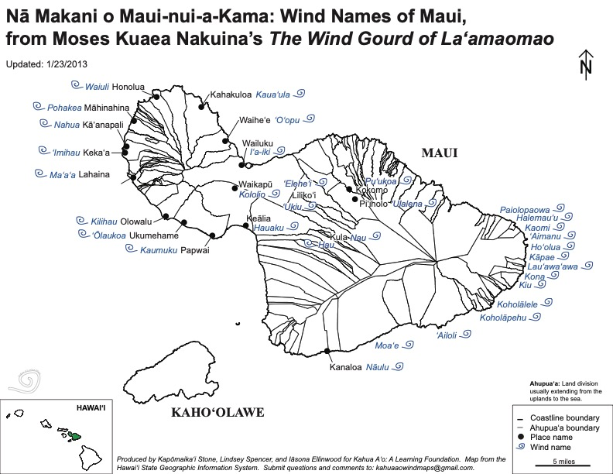
Module #8 Hawaiian Wind Names and Emergency Management
Add image here
Notes:
This map highlights the names to the winds on the Island of Maui, Hawaii. Map is from the Hawaii State Geographic Information System. Produced by Kapomakai Stone, Lindsey Spencer, and Meona Elmwood for Kahua Aʻo.

Slide 2
Learning Objectives
Participate in an activity that is inclusive and collaborative.
Show how each member of your group is contributing to the team and community.
Reclaim Hawaiian identity through understanding winds & directional points through ʻike kuʻuna (Hawaiian knowledge, belief system, philosophy, and practices).
Perpetuate ʻike kuʻuna in order to form a Hawaiian foundation for the lāhui (Nation).
Understanding how winds can contribute to Emergency Management Plans.

Slide 3
Needs to Know
Where does the sun rise and set?
Where is the East and West?
What are the names to the winds in that area and/or family Ahupuaʻa?
What is the ʻike kuʻuna and ʻike kūpuna about the significance of the winds?
How is the wind connected to Emergency Management?
How did my kupuna show appreciation to this ʻike?
How is the wind important in the bigger picture of Climate Change?
Notes:
This need to know list will be discussed in class to give the students guidance of what will be learned in the class.

Slide 4
Module Sections
Cultural protocol
Introductions Activity
Moʻolelo of Laʻamaomao
Information on Laʻamaomao & the Wind Gourd
Re-tell the moʻolelo
Moʻolelo and Critical Dialogue
Group Activity: Winds of Maui
Station 1: Wind Descriptions
Station 2: Wind Characteristics
Station 3: Wind Names
Benefits of knowing the wind
Group Activity: Gather to Share
Case Study
Additional references
Oli Mahalo

Slide 5
Cultural Protocol
Elder and/or leader to start beginning protocol to have everyone on the same page.
Words to E Hō Mai (By: Edith Kanakaʻole Kanahele)
E hō mai ka ʻike mai luna mai ē
O nā mea huna noʻeau o nā mele ē
E hō mai, e hō mai, e hō mai ē (x3)
Notes:
The beginning of class will start with traditional protocol by chanting E Hō Mai by Edith Kanakaʻole Kanahele. The teacher will handout a copy of the words and explain the chant and start the chant for the students. The students will chant along with the teacher together. To listen to the chant, https://youtu.be/32vcntOp0i4.

Slide 6
Introductions
Each person introduces themself and where they are from in the Hawaiian language.
Each person explains what connects them to this place. Follow below:
Aloha.
ʻO (first & last name) koʻu inoa.
No (place of residence) mai au.
What makes me pili to Hawaii?
Notes:
After the chant, explain that when doing this in Hawai‘i, each student would introduce themselves and where they are from in the Hawaiian language, and explain what connects them to this place. Introductions would be shared in the following way:
Aloha.
ʻO (first & last name) koʻu inoa.
No (place of residence) mai au.
What makes me pili to Hawaii?
Explain that by doing introductions in the Hawaiian language, the student is being connected to another worldview. Have each student introduce themselves in the Hawaiian language and explain how they connect to the place they come from. This activity allows the students to have a connection to place and creates relationships with communities.

Slide 7
Moʻolelo of Laʻamaomao
In legends, it is believed that there was a wind gourd that could summon these winds upon chanting for them. The gourd represents the God Lono and the guardian of the gourd is called Laʻamaomao. Laʻamaomao was the name of Moʻikeha’s crewmember that sailed back and forth with Moʻikeha as the person that called out to the winds. This gourd today can be found at the Bishop Museum collection and has an inscription [that] reads....
The wind gourd of Laʻamaomao that was in the keeping of Hauna, personal attendant of Lonoikamakahiki I [Keawenuiaʻumi’s youngest son]. It was passed on to Pakaʻa, a personal attendant of Keawenuiaumi. It was placed in the royal burial cave of Hoaiku on the sacred cliffs of keoua, at kaawaloa, island of Hawaii, and received by King Kalakaua I on January 1, 1883, from Kaʻapana, caretaker of Hoaiku. (Kawaharada 2)
Notes:
The teacher will get the students to read the story of Laʻamaomao. In Indigenous cultures, moʻolelo or stories discuss a storyline to remember certain key aspects of a dynamic. The wind names exist throughout the Hawaiian islands and for every island. These names discuss their respective areas and talks about who lived there, different winds brings different weather dynamics to the area, farming, fishing, when to go to ocean and when not to go there, and other dynamics that becomes useful in everyday life. These stories help to remember these dynamics.

Slide 8
Information on Laʻamaomao and the Wind Gourd
This wind gourd was donated to the Bishop Museum by Princess Kalanianaʻole in 1923 where it sits in the basement in a cold room.
It is another testament that traditional sites hold pieces of knowledge that can explain the phenamena of the world.
The wind can also be seen on the ocean pathways as the water is disturbed by the wind interacting with the ocean. What can be felt by using your face to feel the wind can also seen on top of the ocean pathways.
One of many examples is the wind channel that can be seen from an advantage point on Kahoʻolawe at Kealaikahiki as the Kealaikahiki(same name) ocean channel follows in the same direction. The wind path can be seen on the water when the wind is blowing over 10mph.
Notes:
The teacher will discuss the history of the wind gourd, where the students can find it, and show how the gourd can be used depending on where you are in the Hawaiian islands.

Slide 9
Re-tell the Moʻolelo
Where does the story take place?
Who are the people involved?
What was one thing from the moʻolelo that you remembered in the:
Beginning
Middle
End
Notes:
The teacher will have the class retell the story, include who the key players were, and see if they can remember the beginning, middle, and end of the story. This activity shows how to remember a dynamic through storytelling by using the key references.

Slide 10
Moʻolelo & Critical Dialogue
Why is the moʻolelo important to Hawaiian people?
How does this moʻolelo connect to Emergency Management?
Is it important to understand the elements of reference in Emergency Management? In this case, referring to the winds.
What are other examples from other native cultures that are similar?
How does moʻolelo help to understand another worldview?
What are other dynamics to note regarding moʻolelo of a native culture and modern day management plans?
Notes:
The teacher will direct the class with the questions above and write the answers on the board. At the end of this activity, the teacher will ask the class which answer stood out in each question and/or which answer was given more than once. Those answers will be circled perquestion and placed on another sheet and/or chalkboard for deeper discussion by the class.

Slide 11
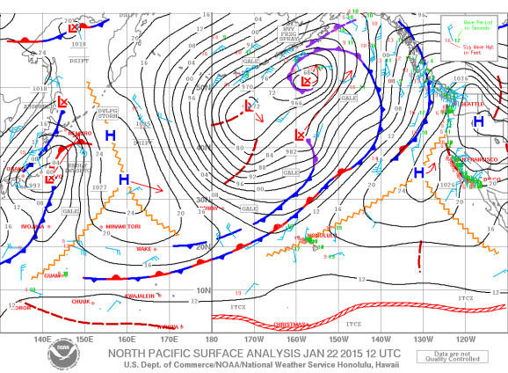
Group Activity
Each group will have 4 or 5 people.
Each group to go through Station 1, 2, & 3 together. (The stations are outlined in following slides).
Look for the common denominator in each group.
Each name and/or description has a moʻolelo and/or directional marker of each wind. Why is this important? How does this connect to Emergency Management?
Notes:
The teacher will give a group activity for the class by having 4 or 5 students in each group. Each group will go through the three stations and highlight the key dynamics.

Slide 12
Winds of Maui
Notes:
This map highlights the names to the winds on the Island of Maui, Hawaii. Map is from the Hawaii State Geographic Information System. Produced by Kapomakai Stone, Lindsey Spencer, and Meona Elmwood for Kahua Aʻo.

Slide 13
Station 1: Wind Descriptions
Aʻe – northeast tradewind.
Kaiāulu – pleasant, gentle tradewind breeze.
Kaumuku – wind squall.
Kiu – strong, cold northwesterly wind.
Kū – strong Moaʻe tradewind.
Kualau – shower accompanied by seawind.
Moaʻeaʻe – tradewind.
Puʻewai – a cold wind.
Notes:
Teacher will describe the wind directions and connect the name of the wind with the strength of the wind.

Slide 14
Station 2: Wind Characteristics
Aʻala Loloa – wind name; Aʻe Loa – name for the tradewind; Ahe (aheahe) – softly blowing; light gentle breeze; Ahe kolo – gentle-moving breeze; ʻĀlaʻi – gentle as a breeze; ʻEna makani – stormy wind.
Hāʻao – a wind driving rain; Hau – a cool breeze; Hauna ʻĪloli – wind name; Haunone – name of a cold wind; Hauʻoki – frost, ice, cold, icy wind; Hihio – draft or gust of wind; Hinaleʻa – to blow favorably, as wind; Hio – a sweep or gust of wind; to blow in gusts; Hoene – to sound softly, rustle, to sound softly, as the wind; Holomakani – breezy, airy; Hoʻoheu – name of strong wind threatening to gale; Hoʻolua – a strong north wind; Huehu – name of a strong northwesterly wind of the winter months. (PE:85) Inuwai – a sea breeze (Lit. water drinking).
Notes:
The teacher will show the name of the winds and the definitions of the wind to show how the winds are describing the area.

Slide 15
Station 2: Wind Characteristics (continued)
Kākea – name of a strong wind; Kalaʻiākea – wind name; Kalio – a gusty breeze; Kāluʻu – to sweep and swerve as a gust of wind; Kauahae – wind name; Kanoenoe – to blow, of the tradewind; Kauaheahe – gentle as breeze, light; Kīkīao – sudden wind gust, squall; Kilipoe – wind name; Kiu – strong, moderately cold northwesterly wind; Kiuwailehua – a cold wind (Lit. Ki of the lehua honey); Kōaheahe – blowing gently as the wind; Kōaniani – to waft as a soft cooling breeze; Kohai – to sway in the breeze, as a tree; Kokololio also kololio – sharp, swift wind gust; Kokolowini – sharp, penetrating wind or gust; Kolo – to creep, crawl; to move along, as a gentle breeze or shower; Kolonahe – gentle, pleasant breeze. (Lit. gentle creeping)l Kolopuʻepuʻe – wind name; Kona – wind on the leeward side of the island; Kona Hea – name of a cold Kona storm; Kona Hili Maiʻa – name of a Kona wind with protracted rains; Koāku – Kona wind with heavy rain; Kona Lani – Kona wind with slight showers; Kona Mae – a cold Kona wind (Lit. withering Kona); Konanuianiho – a strong Kona storm (Lit. great Kona that bites teeth).
Notes:
The teacher will show the name of the winds and the definitions of the wind to show how the winds are describing the area.

Slide 16
Station 3: Wind Names
ʻAhaʻaha – gentle breeze from Waiheʻe to Niua Point; ʻAʻa – same as the Maʻa’a wind at Lahaina; Aʻe – northeast tradewind; ʻAiloli – wind at Kaupō (Lit. sea cucumber eating); ʻAimaunu – wind (Lit. bait eating) at Hāna; ʻAkipohe – wind at Waihe’e; Alau – east wind at Hāna; Apiolopaowa – wind at Hāna; Halemauʻu – wind at Hāna (Lit. grass house); Hau – cool breeze at Kula;
Hoʻolua – strong north wind from the ocean at Hāna; Hulialopali – wind at Lahaina (Lit. turn to the face of the cliff); Iʻaiki – wind at Wailuku and Hāna (Lit. little fish);ʻImihau – stormy west wind (Lit. dew seeker) at Kekaʻa and Lahaina; Kaiāulu – pleasant, gentle tradewind breeze.; Kaomi – northeast tradewind at Hāna; Kāpae – tradewind at Hāna; Kāuaʻula – strong destructive mountain wind at Lahaina (Lit. the red rain referring to red soil washed away by a storm). Kaʻula – wind at Pōhakuloa.; Kaumuku – wind squall; Kēhau – gentle land breeze at Kula; Kiliʻoʻopu – wind at Waiheʻe; Kilipohe – wind at Iao; Kiu – strong, cold northwesterly wind; Koholālele – wind (Lit. leaping whale) blowing from east to west at Hāna and Kīpahulu; also called Koholāpehu; Kololio – wind at Kīpahulu; also at Waikapu; Kona – wind at Hāna; Kū – strong Moaʻe tradewind; Kualau – shower accompanied by seawind; Kui – wind at Hāna; Kūlōlio – wind of Hāmākua, East Maui;
Notes:
The teacher will show the name of the winds and the definitions of the wind to show how the winds are describing the area.

Slide 17
Station 3: Wind Names
Lauʻawaʻawa (Lauʻawa) – gentle wind at Hāna; Laukōwai – wind at Kekula (Lit. water dragnet); Līlīlehua – wind at Waiehu (Lit. lehua chill); Maʻaʻa – famous sea breeze at Lahaina; Makakena – wind at Mikimiki; Malanai – gentle breeze at Hāna; Moaʻe – tradewind at Kahikinui; Moaʻeaʻe – tradewind; Nahua – wind at Kaʻanapali; Naʻu – wind at Kula; Nāulu – sea breeze at Kanaloa, Mākena; Olaukoa – wind at Ukumehame, Olowalu; ʻOʻopu – wind at Waiheʻe; Paʻalaā – wind at Mākaha, Kahakuloa, West Maui; Paiolopaowa – inland wind at Hāna; Pākololiokaiāulu – wind at Keālia, Kihei; Papa – wind at Honuaʻula, Mākena; Pōhakea – wind at Māhinahina, Honolua, Lahaina district;Puʻewai – a cold wind; ʻŪkiu – chilly north wind at Makawao and Piʻiholo; Ulalena – wind at Piʻiholo (mountain at Haʻikuū); Ulumano – wind at Punahoa; ʻUnuloa – a wind also in Puna, Hawaiʻi; Waiʻuli – wind at Honolua, Lahaina; Wāwahihale – wind at Olowalu; Wehelaunu – wind at Māla, Lahaina.
Notes:
The teacher will show the name of the winds and the definitions of the wind to show how the winds are describing the area.

Slide 18
Benefits of Knowing the Wind
Connection to ʻike Hawaiʻi (Hawaiian Knowledge).
Connection to ʻāina (land).
Connection to a different worldview that is in sync with nature.
During times of Emergency Management, understanding the wind is crucial in putting together a management plan for safety, disaster relief, & eco-friendly options.
Wind directions in the Hawaiian moʻolelo and language is informed from centuries of ancestral knowledge that has experienced some type of disaster event. Through moʻolelo the solutions at that time are given and passed down through these stories to allow for a continuation of ʻike Hawaiʻi (Hawaiian knowledge) to emergency situations.
Notes:
The teacher will discuss the connection between Indigenous knowledge and wind directions/strength.

Slide 19
Group Activity: Gather to Share
What are some things that stood out to you or questions you have about what you shared?
How is Hawaiian knowledge beneficial to Emergency Management through examples of knowing about the winds?
What does this mean for your work?
What changes might you need to make this example?
What kinds of support might you need?
How can all of us here today ensure that the information shared is used and refined to have a positive impact on your emergency management system?
Notes:
The teacher will start a group activity in which the students will discuss what they have learned. These questions will guide them in discussion which will be presented to the rest of the class at the end of the session.

Slide 20
Case Study
Yeng, Yeng & Yi-Leng Chen. “Circulations and Rainfall on the Lee Side of the Island of Hawaii during HaRP.” American Meteorological Society. Volume 131, Issue 10. October 01, 2003. 1-18.
Read the article and discuss the following questions as a group.
How does Hawaiian knowledge of the winds prepare a person/group/organization for disaster/emergency/management?
How can Hawaiian knowledge be added to this research in the case study for a more thorough conclusion?
Notes:
The teacher will have the class ready the article above and discuss the questions together in a group setting. The discussion will be presented at the end of the session in front of the class.

Slide 21
Oli Mahalo
ʻThank you chantʻ in Hawaiian Language:
English Translation:
ʻUhola ʻia ka makaloa lā Pūʻai i ke aloha lā Kūkaʻi ʻia ka hā loa lā Pāwehi mai nā lehua Mai ka hoʻokuʻi a ka hālāwai lā Mahalo e Ke Akua* Mahalo e nā kupuna lā ʻeā Mahalo me ke aloha lā Mahalo me ke aloha lā
The makaloa mat has been unfolded Food is shared in love The great breath is exchanged The Lehua honors and adores From zenith to horizon Gratitude to God Gratitude to our ancestors Gratitude with love Gratitude with love
Notes:
A gratitude chant from the student to teacher to say ʻThank youʻ for the instruction in class. The day ends in protocol. Chant by Kehau Camara.

Slide 22
References:
Kawaharada, Dennis. "Introduction to The Wind Gourd of Laʻamaomao." 1992. Retrieved October 02, 2018 from website: www.2.hawaii.edu/~dennisk.
Nakuina, Moses Kuaea. The Wind Gourd of Laamaomao. CreateSpace Independent Publishing Platform, 2016.
Kirch, Patrick. On the Road of the Winds: an Archaeological History of the Pacific Islands before European Contact. University of California Press, 2017.
Fornander, Abraham. "Hawaiian Antiquities and Folk-Lore; The Hawaiians' Account of the Formation of their Islands and Origin of their Race, with the Traditions of their Migrations, Etc., as Gathered From Original Sources. Kamahualeleʻs chant. Moʻikeha story." Bishop Museum Press, vol. IV, 1918, pp. 12-128. doi: 10.1038/107391c0.
Notes:
This list of references is to provide sources of information.

