Slide 1
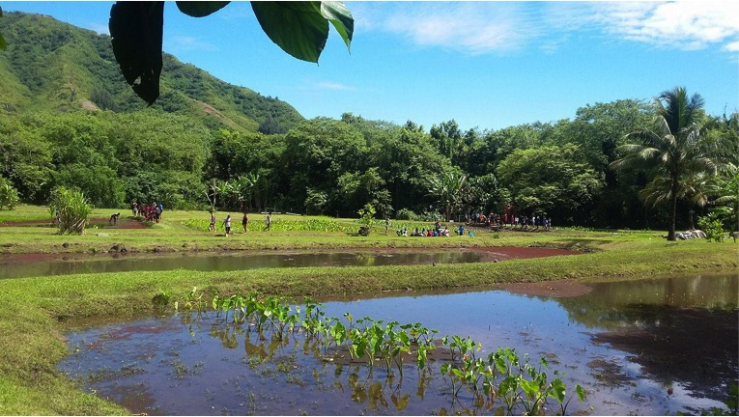
Module #9 Traditional, Sustainability Practices and Emergency Management
Notes:
Picture taken by Lesley Iaukea at Loʻi o Punaluʻu.

Slide 2
Learning Objectives
To gain appreciation for the Hawaiian worldview.
Develop an appreciation for ʻāina (land).
Develop a deeper understanding of ʻike hawaiʻi (Hawaiian knowledge).
To understand the connection between man and land.
Identify the cyclical connection through story & traditions.
To be aware of traditions that can aid in sustainability practices during times of emergencies and non-emergencies.

Slide 3
Module Sections
Cultural protocol
Introductions
Connecting to Moʻolelo
Moʻolelo of Hāloa
Re-tell the Moʻolelo
Moʻolelo & Critical Dialogue
Group Activity
Station 1: Kalo (Taro) Plant
Station 2: Information & benefits of Kalo (Taro)
Station 3: Tour of the Kahawai (Stream)
Case Study: connecting different worldviews
Additional references
Mahalo Oli

Slide 4
Cultural Protocol
Elder and/or leader to start beginning protocol to have everyone on the same page.
Words to E Hō Mai (By: Edith Kanakaʻole Kanahele)
E hō mai ka ʻike mai luna mai ē
O nā mea huna noʻeau o nā mele ē
E hō mai, e hō mai, e hō mai ē (x3)
Notes:
The start of the module opens in traditional protocol with the E Hō Mai chant, which talks about bringing everyone together, both student and educator, with everyone learning from each other. The class and educator chant together, repeating the chant three times, becoming louder each time. The chant is by Edith Kanakaʻole Kanahele and can be played for the class to learn and chant together, https://youtu.be/32vcntOp0i4.

Slide 5
Introductions
Each person introduces themself and where they are from in the Hawaiian language.
Each person explains what connects them to this place. Follow below:
Aloha.
ʻO (first & last name) koʻu inoa.
No (place of residence) mai au.
What makes me pili to Hawaii?
Notes:
After the chant, explain that when doing this in Hawai‘i, each student would introduce themselves and where they are from in the Hawaiian language, and explain what connects them to this place. Introductions would be shared in the following way:
Aloha.
ʻO (first & last name) koʻu inoa.
No (place of residence) mai au.
What makes me pili to Hawaii?
Explain that by doing introductions in the Hawaiian language, the student is being connected to another worldview. Have each student introduce themselves in the Hawaiian language and explain how they connect to the place they come from. This activity allows the students to have a connection to place and creates relationships with communities.

Slide 6
Connecting to Moʻolelo

Slide 7
Moʻolelo O Hāloa
The genealogy of the Hawaiian islands. Kahiko (husband) & Kūpūlanakehau (wife) had a son, Wākea. Kūkalaniʻehu (husband) & Kahakauakoko (wife) had a daughter, Papahānaumoku or Papa. Wākea lived with Papa. The eldest island and their eldest child, Hawaii, was born. Maui, Kanaloa (also known as Kahoʻolawe) was born soon after. Papa decided to leave Hawaii and travel to Tahiti.
Wākea took a new wife, Kaʻula. They had a child, Lānaʻikaʻula or Lānaʻi.
Wākea took another wife, Hina. They also had a child, Molokainuiahina or Molokaʻi.
Papa returned from Tahiti and became upset over Wākeaʻs two new wives. Papa takes on a new husband, Lua. Born to them was Oahulua or Oʻahu.
Papa eventually returns to Wākea and they end up having Kauaʻi, Niʻihau, Lehua, and Kaʻula.
Notes:
The teacher will have the class read the Moʻolelo of Hāloa and prepare for a discuss in a group setting after the reading is finish. Moolelo Hawaii Kahiko, Mokuna III, Ka Naʻi Aupuni, Volume II, Number 18, 22 June 1906.

Slide 8
Moʻolelo O Hāloa
Wākea and Hoʻohōkūkalani had a premature birth and named him Hāloanakalaukapalili. They buried him outside their house and from that spot grew a taro plant. This plant is known to be the source of all taro plants in Hawaii.
This couple had another child and they named him Hāloa. Hāloa lives and becomes the first ancestor, first man, first chief of the Hawaiian race. Both the taro plant and the land are older siblings to the Hawaiian people just the same as the Hawaiian people are younger siblings to the taro plant and land. Therefore, the younger sibling always takes care of the older sibling and in return the older sibling takes care of the younger sibling.
This relationship is shown in how Hawaiian people see land. The land is not owned but rather should be taken care of and in return, the land will take care of its people in all ways through sustenance: physically, spiritually, and mentally.
Notes:
Page two of the Moʻolelo O Haloa for the students to read. Moolelo Hawaii Kahiko, Mokuna III, Ka Naʻi Aupuni, Volume II, Number 18, 22 June 1906.

Slide 9
Retell the Moʻolelo
Where does the story take place?
Who are the people involved?
What was one thing from the moʻolelo that you remembered in the:
Beginning
Middle
End
Notes:
The teacher will have the class retell the story, include who the key players were, and see if they can remember the beginning, middle, and end of the story. This activity shows how to remember a dynamic through storytelling by using the key references.

Slide 10
Moʻolelo & critical dialogue
Why is the moʻolelo important to Hawaiian people?
How does this moʻolelo connect to sustainability?
What are other examples from other native cultures that are similar?
How does moʻolelo help to understand another worldview?
What are other dynamics to note regarding moʻolelo of a native culture and modern day management plans?
Notes:
The teacher will have the class discuss the above questions.

Slide 11
Group Activity

Slide 12
Group Activity Instructions
Get in groups of 4 or 5 people.
Learn each section of the station.
Present in front of the group
Each person will offer information on at least part of the kalo plant.
In the presentation to include:
The Hawaiian name
Where it is located
What are the uses for it
How it connects to the bigger picture of the culture.
As a group, discuss how this plant can be used during times of disaster.
Notes:
The teacher will put 4 or 5 students in a group. The groups will go through the following three stations as a team and follow the directions above. The above instructions will guide the team for the end of class presentation.

Slide 13
Station 1: Kalo (Taro) Plant
Learn about the kalo plant.
The Hawaiian name to the parts.
Where the part of the plant is located.
What the uses are for.
Fill-in a blank space picture of names of the parts of the kalo plant.
Notes:
The teacher will discuss the kalo plant and name the different areas and uses of the plant.

Slide 14
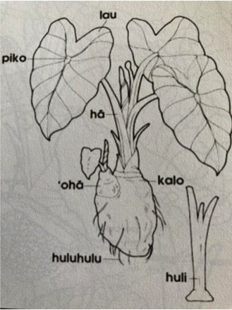
Part of the Kalo (Taro)
Lau: leaf, cook food inside
Piko: middle, belly button, center of man
Hā: stalk, breath of man
ʻohā: baby shoots, regeneration
Kalo: taro, sustenance for mind/body/spirit
Huluhulu: roots, genealogy/cosmology
Huli: baby roots replanted, future generations
Notes:
The teacher will go over the Hawaiian names and connect the students to the definitions in English. Those definitions will be linked to the plant and cultural traditions.

Slide 15
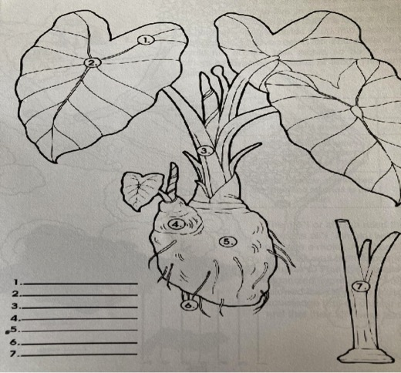
Group Activity
Notes:
The teacher will have the students fill in the numbers as to what part of the plant it is. Each member in the group will pick one item to introduce to the class and talk about what they learned.

Slide 16
Station 2: Information & Benefits of Kalo (Taro)
Learn the information & benefits of Kalo.
Understand the different varieties of kalo.
Understand the location that the kalo plant can be found in.
Learn the many different uses for the kalo plant.
Learn at least one use for each section of the kalo plant.
Notes:
The teacher will discuss the kalo and the benefits that comes from the many different parts of the plant.

Slide 17
Information & Benefits of Kalo (Taro)
300+ varieties of kalo known to early Hawaiians.
Wet/dry varieties
Found in lowland/upland
Used for many different reasons:
Medicine: stem of the leaf can be rubbed on an insect bite; Raw rootstock stops bleeding; mashed poi used as a bandage.
Paste: glue pieces of kapa together.
Fishing: Used as bait.
Dye: juice can be used to dye material. Many different colors.
Food: poi to eat now, paʻiʻai to eat in 2-4 weeks, dried kalo to eat past 4 weeks, kulolo to eat as dessert.
Notes:
The teacher will discuss the many different reasons for using the kalo plant.

Slide 18
Station 3: Tour of the Kahawai (Stream)
Understand the water system surrounding the loʻi.
Trace the water system from the mountains to the sea.
Understand the use of each section and the benefits that goes along with it.
Notes:
The teacher will discuss the water/stream in the loʻi and discuss the importance to knowing the waterways.

Slide 19
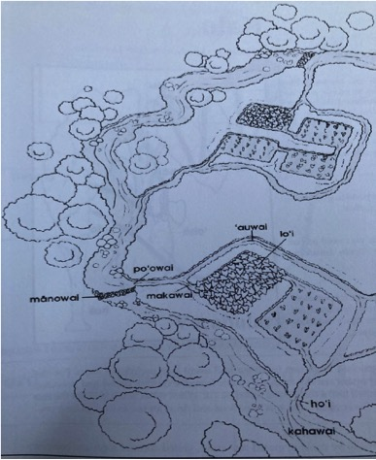
The stream surrounding the Loʻi
Poʻowai: The head of the water leading into irrigated ditches that flow into the loʻi. The water is control from the poʻowai.
Mānowai: Rocks slow the water down to help channel it to different areas.
Makawai: Water enters and exits from each loʻi.
ʻAuwai: Carries the water from the stream to the loʻi.
Kahawai: The source of water begins in the mountains and provides water for the loʻi.
Hoʻi: Water leaves the loʻi and returns to the kahawai.
Notes:
The teacher will give a worksheet to the students and go over each area for the quiz at the end of this session.

Slide 20
Group Activity: Gather to share
What are some things that stood out to you or questions you have about what you shared?
What does this mean for your work?
What changes might you need to make this example?
What kinds of support might you need?
How can all of us here today ensure that the information shared is used and refined to have a positive impact on your emergency management system?
Notes:
The teacher will bring in all of the students to present and share what each group worked on together.

Slide 21
Case Study
Cho, John J., Roy A. Yamakawa, & James Hollyer. “Hawaiian Kalo, Past and Future.” Sustainable Agriculture, SA-1. Feb 2007, 1-8.
Read the article and answer the questions as a group.
Questions to answer:
What are the key ideas of this article?
What examples can be incorporated in to possible solutions for sustainability practices and climate change agricultural stability? Please use examples from this article.
How does Indigenous knowledge speak to sustainable practices?
Notes:
The teacher will introduce this case study and have the groups be directed by and answer the above questions.

Slide 22
Oli Mahalo
ʻThank you chantʻ in Hawaiian Language:
English Translation:
ʻUhola ʻia ka makaloa lā Pūʻai i ke aloha lā Kūkaʻi ʻia ka hā loa lā Pāwehi mai nā lehua Mai ka hoʻokuʻi a ka hālāwai lā Mahalo e Ke Akua* Mahalo e nā kupuna lā ʻeā Mahalo me ke aloha lā Mahalo me ke aloha lā
The makaloa mat has been unfolded Food is shared in love The great breath is exchanged The Lehua honors and adores From zenith to horizon Gratitude to God Gratitude to our ancestors Gratitude with love Gratitude with love
Notes:
At the end of this instruction, the teacher will start off oli mahalo as a way to say ʻthank youʻ for the instruction. Chant by Kehau Camara.. Blogs.ksbe.edu.

Slide 23
References:
Cho, John J., Roy A. Yamakawa, & James Hollyer. “Hawaiian Kalo, Past and Future.” Sustainable Agriculture, SA-1. Feb 2007, 1-8.
Kaʻōpua-Goodyear, Noelani. “Rebuilding the ʻAuwai: Connecting Ecology, Economy and Education in Hawaiian Schools.” Alternative, Volume 5, Number 2. 2009, 46-77.
Kirch, P. V. and D. Lepofsky. "Polynesian Irrigation: Archaeological and Linguistic Evidence for Origins and Development." Asian Perspectives 32, no. 2. 1993, 183-204.
Teves, Glenn I. Growing Upland Taro.” Molokai Native Hawaiian Beginning Farmer Quarterly – July to September 2015. 1-14.
Notes:
This list of references is to provide sources of information.

