Slide 1
Module #1:
The Intersectionality of Colonial Systems in the US
Image Credit:
Paulette Blanchard
Notes:
Title slide + Image Option 2

Slide 2
Learning Outcomes
To lay a foundation of knowledge regarding core colonial systems and their combined influences on Indigenous communities.
To build a contextual understanding of historical intersections of said systems, which have led to climate emergencies.
To identify the ways in which these systems interact against climate justice during the COVID-19 pandemic

Slide 3
Before diving in, ask yourselves…
Why do we do this work?
Image Credit:
Jonathan Larson
Apr. 1, 2019

Slide 4
Addressing the Consumer Mentality
When individuals from dominant groups only hear sad stories of marginalized groups, they are susceptible to the following behaviors:
The [White] Savior Complex
Feeling accomplished for “saving” a marginalized group from their conditions or themselves. (E.g. The Blind Side).
American Paternalism
Feeling that (in this context) Indigenous Peoples need “guidance” or “civilizing” from the “Great White Father” (first coined for the late Pres. Andrew Jackson).
Addiction to “Trauma Porn”
Finding and consuming sad stories to feel pity, rather than to become informed.
Notes:
http://culture.affinitymagazine.us/does-trauma-porn-really-exist/
http://anthropology.msu.edu/anp336-us13/2013/07/06/the-great-white-father/

Slide 5
Combating the Consumer Mentality
We must all acknowledge the prevalence of consumerism in media portrayals of marginalized peoples.
During this module:
Take breaks to decompress and reflect.
Survey your motivations.
Think critically of the modern manifestations of historical colonization efforts.
Assess your privileges, and how they can be used to uplift Indigenous efforts.
If you are Indigenous:
Be intentional about caring for your mind, body, and spirit.
You do not have to do this alone! Reach out to your mentors, your family, and other loved-ones for support.

Slide 6
What does “intersectionality” mean in the context of colonial systems?
Intersectionality is used in this module to describe the ways in which the societal structures implemented by settler colonists interact in order to bolster American/colonial dominance and to extinguish and/or marginalize Indigenous communities.
Image Credit:
Paulette Blanchard

Slide 7
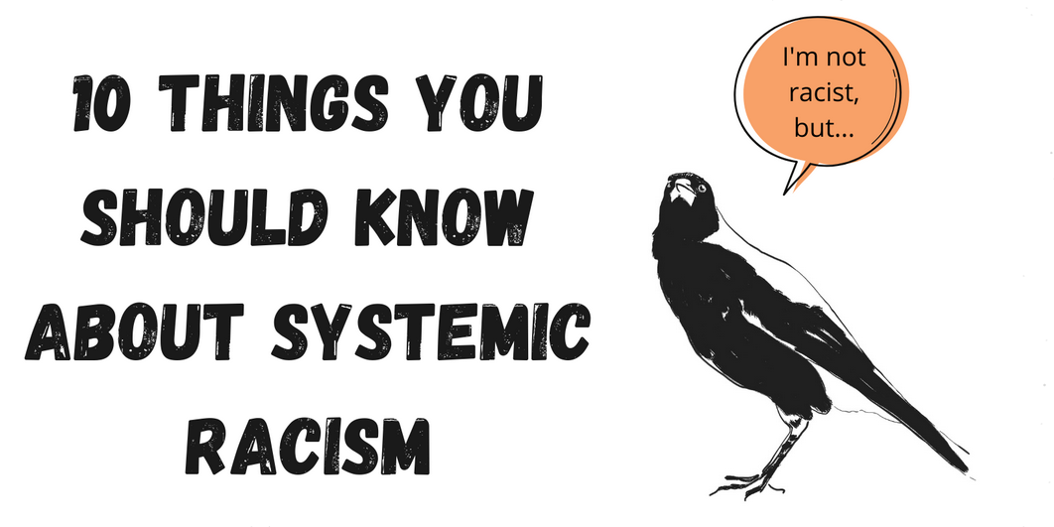
This Intersectionality Amounts to Systemic Racism & Heterosexism Against Indigenous Peoples
As we begin to discuss the historic and on-going genocide of Indigenous Peoples in the US, we must start on the same level of understanding regarding these systems.
Notes:
https://indigenousx.com.au/10-things-you-should-know-about-systemic-racism/?fbclid=IwAR0oeyopYGsnqrBehBXmCO4DFfh_4XTgN0RJ7CA9zXpwNTUg0MdEwyqaXqU

Slide 8
Reviewing “Colonization”
In the context of North American Indigenous peoples, colonization in the process in which European powers have exerted control over Indigenous communities through “legislation”, religion, education, and violent force in order to subordinate them. Through this, European settlers seized ownership of land, capital, and natural resources for financial and political power.
Colonization today can be both external (systemic oppression) and internal (lack of self/cultural worth).
Image Credit:
Paul Brodie
State Historical Society of North Dakota
Notes:
At this point, users should have already viewed the list of definitions including one for Colonization. This is just a review + context

Slide 9
Pillars of Colonization
Capitalism
“An economic system characterized by private or corporate ownership of capital goods, by investments that are determined by private decision, and by prices, production, and the distribution of goods that are determined mainly by competition in a free market.”
Imperialism
“The policy, practice, or advocacy of extending the power and dominion of a nation especially by direct territorial acquisitions or by gaining indirect control over the political or economic life of other areas.”
Notes:
Sentence versions of the Merriam-Webster Dictionary definitions
https://www.merriam-webster.com/dictionary/capitalism
https://www.merriam-webster.com/dictionary/imperialism

Slide 10
Upheld By Federal/State Laws & Policy
Indian Removal Act, 1830
Civilization Fund Act, 1819
The Code of Indian Offenses, 1883
House Concurrent Resolution 108, 1953
Dawe’s Act, 1887
Establishment of the Bureau of Indian Affairs, 1824
Public Law 115-97
Public Law 280
Image Credit:
Cameron Smith
Aug. 11, 2020

Slide 11
Manifestations of Colonization
Imperialism
Nutrition
Healthcare
Treaties
Imprisonment
Education Access
Labor Access
Capitalism
Federal Law & Policy
These intersections directly impact Indigenous communities’ access to Life, Liberty, and the Pursuit of Happiness

Slide 12
Nutrition
Image Credit:
Melanie Hughes
Oct. 13, 2017

Slide 13
Pre-Contact Diet
Heavily Place-Based! For example…
Cherokee Region: corn, squash, beans, greens, fruits/berries, game, etc.
Alaska Native: Seafood, game, marine mammals, greens, berries, birds, etc.
Hawaiʻi: Kalo, coconut, fish, pigs, breadfruit, candlenut, seaweed, etc.
Diets could be seasonal and were rich in nutrients needed for locational survival.
Image Credit:
Sunira Moses
Oct. 2, 2020

Slide 14
Post-Contact Diet
CC by 2.0 via flickr/tsausawest
Starvation followed forced removal and other genocidal policies.
The “Commodity Diet” (1960s-Present)
Canned meats, soups, juices, corn syrup, flour, vegetable oil, evaporated milk, cheese, etc.
“Within a generation, the problem of malnutrition was replaced by the problem of obesity” (Chino et. al. 2009).
Present Issues: Food Deserts, Chronic Illness
Photo by R. L. Sheehan, 2007
Notes:
https://digitalscholarship.unlv.edu/cgi/viewcontent.cgi?article=1050&context=env_occ_health_fac_articles

Slide 15
Food Deserts
Described as a “census tract vapid of fresh fruit, vegetables, and other healthful whole foods” (2019).
In 2017, Partnership with Native Americans reported “60 reservations in the United States grapple[d] with food insecurity”
The Navajo Nation (2019):
13 grocery stores served 300,000+ people
The average resident experienced 3-hour drives to access a store
Packaged/commodity items priced lower, and more accessible than whole/organic foods
Activity: Identify Food Deserts using this site.
Notes:
https://www.nicoa.org/the-importance-of-food-sovereignty/
http://www.nativepartnership.org/site/DocServer/2017-PWNA-NPRA-Food-Insecurity-Project-Grow.pdf?docID=7106
https://www.planetforward.org/idea/13-grocery-stores-the-navajo-nation-is-a-food-desert
https://www.ers.usda.gov/data-products/food-access-research-atlas/go-to-the-atlas.aspx

Slide 16
Commodities: A Weapon of Mass Production
A Band-Aid Solution
Lasting Community Effects
Food Distribution Program on Indian Reservations (FDPIR)
Starting in the 1960s, commodity foods were distributed to Indigenous Communities to curb malnutrition.
Foods were usually cheap, packaged, and processed for preservation measures.
Known as the “Commodity Diet”
American Indians & Alaska Natives (AI/AN) disproportionately suffer from:
Diabetes
Heart Disease
Obesity
Exposure to commodity foods have left lasting negative impacts on Native youth perceptions of traditional foods.
Mihesuah 2016
Image Credit:
Salvation Army USA West
Flickr, 2013
Notes:
https://spectrum.diabetesjournals.org/content/23/4/272
1. https://aihd.ku.edu/documents/Frybread.pdf

Slide 17
Commodities: A Weapon of Mass Production
Climate Impacts
More Processing & Packaging = More Waste and Pollution
In 2014:
FoodPrint reported, “out of the 258 million tons of municipal solid waste generated in the US, more than 63 percent was of packaging materials (for food and other purposes) and, overall, only 35 percent (89 million tons) was recycled or composted.”
View the 2020 report on waste attributed to food packaging here.
Top 3 Food Profiteers In 2020: PepsiCo. Inc, Tyson Foods Inc, Nestle
Notes:
1. https://foodprint.org/issues/the-environmental-impact-of-food-packaging/
2. https://foodprint.org/wp-content/uploads/2020/09/2020_09_22_FP_FoodPackagingReport_5FINAL.pdf
3. https://www.foodprocessing.com/top100/2020/
https://www.epa.gov/facts-and-figures-about-materials-waste-and-recycling/advancing-sustainable-materials-management-0

Slide 18
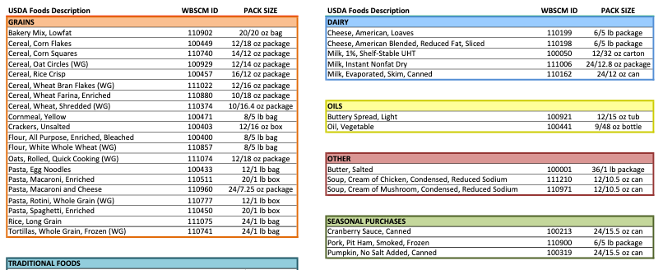
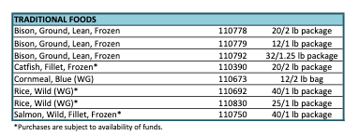
FDPIR Boxes Today
Traditional foods and other healthy options are now periodically available, but there are still many commodity foods included.

Slide 19
Healthcare
Image Credit:
Caleb Pudewell
May 26, 2020

Slide 20
The Road to Healthcare Is Riddled With Barriers
Chronic Underfunding of Indian Health Service
Historical Distrust of US Provided Services
Leads to a severe lack of medical technology on reservations:
“IHS facilities often don't have services that people elsewhere expect, such as emergency departments or MRI machines. And those limited facilities can be hours away by car” (Friedman 2016).
Of 567 tribes, there are 28 acute-care hospitals that IHS directly operates.
1973-1976: US Government forced sterilization on 3,406 Indigenous women (Torpy 2000)
AI/AN Communities were stripped of traditional medicines until August 1978
American Indian Religious Freedom Act
Today: Nonconsensual sterilization alleged in for-profit ICE Detention Centers
Hospital and clinic personnel continue to perpetuate racism against Indigenous Peoples, sometimes leading to death.
Notes:
https://www.npr.org/sections/health-shots/2016/04/13/473848341/health-care-s-hard-realities-on-the-reservation-a-photo-essay
https://oig.hhs.gov/oei/reports/oei-06-14-00011.pdf
2. https://www.law.berkeley.edu/php-programs/centers/crrj/zotero/loadfile.php?entity_key=QFDB5MW3
3. https://www.govtrack.us/congress/bills/95/sjres102
4. https://www.aclu.org/news/immigrants-rights/immigration-detention-and-coerced-sterilization-history-tragically-repeats-itself/
5. https://www.aljazeera.com/features/2020/10/5/it-was-sheer-hatred-indigenous-peoples-react-to-echaquan-death
https://www.americanbar.org/groups/crsj/publications/human_rights_magazine_home/the-state-of-healthcare-in-the-united-states/native-american-crisis-in-health-equity/
https://www.usatoday.com/in-depth/news/nation/2020/10/20/native-american-navajo-nation-coronavirus-deaths-underfunded-health-care/5883514002/
https://www.businessinsider.com/coronavirus-native-american-health-center-ppe-tests-body-bags-2020-5
https://www.ncbi.nlm.nih.gov/pmc/articles/PMC7226312/
https://www.ncbi.nlm.nih.gov/pmc/articles/PMC4608273/
https://spectrum.diabetesjournals.org/content/23/4/272
https://www.npr.org/sections/health-shots/2016/04/13/473848341/health-care-s-hard-realities-on-the-reservation-a-photo-essay

Slide 21
To Indigenous Communities, Yet Another Pandemic
August 2020: Centers for Disease Control and Prevention (CDC) reported AI/AN communities were disproportionately affected by COVID-19
Indigenous Health Clinics Faced Neglect:
Seattle Indian Health Board received body bags instead of personal protective equipment (PPE).
Navajo Nation reported receiving broken PPE and insufficient funding (‘Still killing us’).
Native Hawaiian/Pacific Islanders hardest hit on West Coast (Kaholokua et. Al. 2020)
https://i0.wp.com/thebfd.co.nz/wp-content/uploads/2020/04/GettyImages-1209679043-scaled.jpg?fit=2560%2C1440&ssl=1
Notes:
CDC - https://www.cdc.gov/mmwr/volumes/69/wr/mm6934e1.htm
SIHB - https://www.businessinsider.com/coronavirus-native-american-health-center-ppe-tests-body-bags-2020-5
Navajo Nation - https://www.usatoday.com/in-depth/news/nation/2020/10/20/native-american-navajo-nation-coronavirus-deaths-underfunded-health-care/5883514002/
NHPI - https://www.ncbi.nlm.nih.gov/pmc/articles/PMC7226312/

Slide 22
Beyond the Pandemic
Native communities will continue to lose ancestral lands or access to clean air, water, fields, etc. This 2016 EPA Report gives an insight to these climate crises.
Notes:
EPA - https://www.cmu.edu/steinbrenner/EPA%20Factsheets/indigenous-health-climate-change.pdf
Another Resource: https://nativephilanthropy.issuelab.org/resources/9923/9923.pdf

Slide 23
Indigenous Sovereignty
Image Credit:
Sam Bark
Oct. 23, 2017

Slide 24
The American Empire
“This Constitution, and the laws of the United States which shall be made in pursuance thereof; and all treaties made, or which shall be made, under the authority of the United States, shall be the supreme law of the land; and the judges in every state shall be bound thereby, anything in the Constitution or laws of any State to the contrary notwithstanding” (Article VI of the US Constitution).
1777 – 1868: Approx. 368 Treaties Signed Between US and Indigenous Nations.
Many were:
Improperly translated
Signed by unauthorized tribal members
Violated by the US time and time again
Image Credit:
Jeff Finley
Mar. 2, 2018
Notes:
https://www.law.cornell.edu/constitution/articlevi

Slide 25
The Illegal Occupation of a Sovereign Nation
To enact cession of powers over a territory from one government to another, there must be:
A legal treaty signing the cession of an entire territory
A legal treaty signing of a portion of a territory.
The annexation of Hawaiʻi was illegal because there was no treaty signing. There was only a Joint Resolution between the United States and itself.
1810: The 9 main Hawaiian islands were united.
1840: The first Constitution of Hawaiʻi was established and internationally recognized.
1887: Illegal Bayonet Constitution
1893-1898: Illegal Annexation
Image Credit:
Ansel Adams
flickr
Notes:
Further Reading: Ua Mau Ke Ea: Sovereignty Endures by Dr. Keanu Sai

Slide 26
US Systemic Strategies of Community Disruption
Extermination of Resources
In the Plains, this looked like the mass hunting of buffalo, from about 30 million bison, to a few hundred left in the wild by the end of the 19th century.
“The Army wasn’t in the business of guiding hunting trips for soft-skinned Wall Streeters, but it was in the business of controlling the Native Americans in the area, and that meant killing buffalo” (Phippen 2016)
Relocation from Ancestral Homelands
The Long Walk, briefly summarized by TikTok creator Chad Lorenzo in this video
Unlawful Arrests of Tribal Members Exercising Treaty Rights...
Just to name a few.
Notes:
1. https://www.theatlantic.com/national/archive/2016/05/the-buffalo-killers/482349/
2. https://www.tiktok.com/@ashkiijosh/video/6922161264621800710?source=h5_m&is_copy_url=0&is_from_webapp=v2&sender_device=pc&sender_web_id=6877615790792279558
Ellipses = GO TO NEXT SLIDE

Slide 27
The Fish Wars (1950s-1974)
https://www.nceas.ucsb.edu/news/disentangling-effects-competition-and-warming-ocean-sockeye-salmon-across-northeast-pacific
Notes:
https://www.canva.com/design/DAEPyQKyaXI/EZ93qiPrt1g_Gwg7ANiSjw/view?utm_content=DAEPyQKyaXI&utm_campaign=designshare&utm_medium=link&utm_source=sharebutton
Treaty tribal members cannot exercise the right to fish if there are no fish (Further Reading): https://ecology.wa.gov/Waste-Toxics/Reducing-toxic-chemicals/Toxics-studies/Source-assessments/Toxic-chemicals-in-Chinook-salmon

Slide 28
The US Onslaught Against Indigenous Sovereignty Continues
Activity: Debunking Development
1. Find an example of public/private development or imposition on Indigenous lands/sovereignty.
2. Research Indigenous perspectives of the situation.
Trump Admin Opened Arctic National Wildlife Refuge
DAPL & The Keystone XL
Trump Admin Revoked Mashpee Wampanoag Reservation Status
Responses to the Sioux COVID-19 Checkpoints
Rosemont Copper Mine and Other Mineral Mines in the SW
Thirty-Meter Telescope
Image Credit:
Benjamin Massello
Apr. 28, 2019
US-Mexico “Border Wall”
Notes:
Below are examples of development projects to research
https://time.com/5834749/south-dakota-governor-native-american-tribes-coronavirus/
https://www.npr.org/transcripts/954115993
https://apnews.com/article/joe-biden-us-news-alaska-wildlife-arctic-cdd89af06cb892e042782ace3abca8eb
https://escholarship.org/uc/item/70z6w502
https://www.wbur.org/news/2020/06/06/judge-reconsider-revoking-mashpee-reservation
https://news.azpm.org/s/83547-us-army-corps-of-engineers-weighs-its-authority-over-rosemont-mine/

Slide 29
Environmental Impacts of “Development”
Since the construction of the Keystone XL Pipeline:
During the most recent oil spill, “an estimated 9,120 barrels of crude oil have spilled… That's equivalent to about 383,000 gallons of oil” (Winsor 2019).
The History of Telescope Construction on Mauna Kea:
According to the Mauna Kea Comprehensive Management Plan in 2009, there have been 18 instances of hazardous material and sewage spills at the summit, as well as cultural & habitat disturbances due to lack of proper management, among other impacts (2009, pp. 101-109).
The Arctic National Wildlife Refuge:
Opening the refuge to oil drilling and other development “is anticipated to cause habitat displacement, increased predation, and reduced calf survival rates” (Zentner et. al. 2019)
Copper Mining Impacts on Clean Water:
Acidification of groundwater occurred in many places, including Gila River (2019)
These are just 4 examples from this century.
Notes:
1. https://abcnews.go.com/US/380000-gallons-oil-spill-keystone-pipeline-north-dakota/story?id=66683075
2. http://www.malamamaunakea.org/uploads/management/plans/CMP_2009.PDF
3. https://link-springer-com.ezproxy.library.wwu.edu/article/10.1007/s10584-019-02489-4
4. https://www.congress.gov/116/meeting/house/110436/documents/HHRG-116-II06-20200205-SD036.pdf

Slide 30
Image Credit:
Meg Jerrard
Nov. 10, 2020
Access to Potable Water in the US
The Navajo Nation
In the Midst of COVID-19
“This remote and ecologically sensitive semi-arid region has suffered prolonged drought combined with increasing temperatures. These changes, in addition to challenging socioeconomic circumstances, are significantly altering the habitability of a region already characterized by harsh living conditions”
(Redsteer, Kelley, & Harris 2015).
+33% of NN residents lack access to running water (Hansman 2020)
Some get by on just 2-3 gal./day for eating, cooking, & cleaning
The average American uses 88 gal./day
Lack of clean water = hindered ability to clean/disinfect = hindered ability to fight COVID-19
Some wells also contain trace amounts of uranium
Notes:
1. https://www.researchgate.net/publication/267328342_Increasing_Vulnerability_of_the_Navajo_People_to_Drought_and_Climate_Change_in_the_southwestern_United_States_Accounts_from_Tribal_Elders
2. https://www.outsideonline.com/2413938/navajo-nation-coronavirus-spread-water-rights
3. https://www.epa.gov/navajo-nation-uranium-cleanup
For an up-to-date graphic on the Navajo Nation COVID-19 rates: https://navajotimes.com/coronavirus-updates/covid-19-across-the-navajo-nation/

Slide 31
An Indigenous Action for Sovereignty and Nutrition
Food Sovereignty!
“GATHER TRAILER 031020”
Director: Sanjay Rawal
“Food sovereignty: Valerie Segrest at TEDxRainier”

Slide 32
Justice & Imprisonment
Image Credit:
Patrick Hendry
Nov. 14, 2018

Slide 33
Tribal Jurisdiction
“All three branches of the federal government shared a common historical understanding that tribes could not exercise criminal jurisdiction over non-Indians.”
In the Treaty of Point Elliott, the tribe “acknowledged its dependence on the US Thus, the court at the time recognized the US” as having exclusive criminal jurisdiction over non-Indians.
“Intrinsic Limitations”: By federal law, tribal governments are ”quasi-sovereign” and dependent upon the US They may exercise only those governmental powers consistent with that dependent status.
Royster 2003
Case: Oliphant vs. Suquamish Tribe
1978: Mark David Oliphant was prosecuted for assaulting a Suquamish tribal officer and resisting arrest.
The court decided Oliphant could not be prosecuted by Indian Tribes as a non-Indian because…
Image Credit:
Wesley Tingey
Apr. 15, 2019

Slide 34
“The decision has impacted law enforcement in Indian country, undermined the territorial integrity of tribal governments, and launched the Supreme Court's on-going efforts to sweep away much of tribal civil jurisdiction over non-tribal citizens.” - Judith Royster (2003)

Slide 35
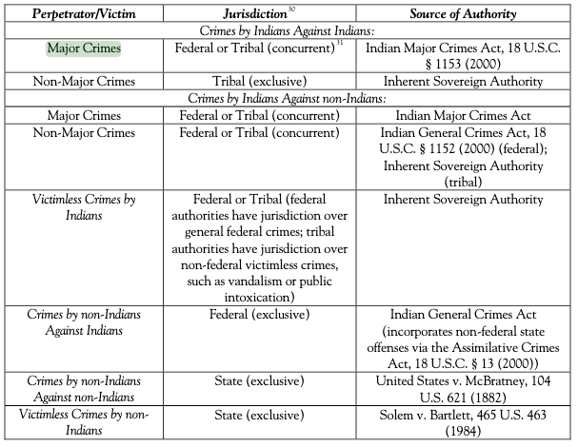
Notes:
https://www.uclalawreview.org/pdf/57-2-5.pdf
This is a quick and easy list from 2009 on where jurisdictions lie when it comes to various scenarios. Look especially at the Major Crimes row, as well as the last three rows. Crimes by non-Indians against Indians never go to the jurisdiction of the Tribe. This is inherently oppressive to Tribal sovereignty.

Slide 36
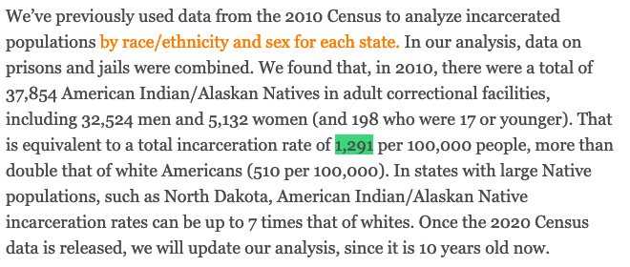
Incarceration of Indigenous Peoples in the US
According to Prison Policy Initiative:
Notes:
https://www.prisonpolicy.org/blog/2020/04/22/native/
In 2016: 19,790 Native men and 2,954 Native women (22,744 total) were incarcerated in US state and federal prisons, according to the Bureau of Justice Statistics’ (BJS) National Prisoner Statistics (NPS) series. (https://www.icpsr.umich.edu/icpsrweb/NACJD/studies/37003#)

Slide 37
Indigenous Youth Are Targeted by the Prison Industrial Complex
Prison Policy Initiative reports:
“Contributing to these confinement rates is disproportionate police contact: Native youth are arrested at a much higher rate than white youth. The 2018 arrest rate for Native youth was 2,251 per 100,000 while white youth were arrested at a rate of 1,792 per 100,000” (PPI 2020).
People under the age of 21 make up 42% of the AI/AN population
In 2015: 225 out of everyone 100,000 Indigenous youths were confined
This rate is 3 times higher than that of white youth
Notes:
1. http://criticalresistance.org/about/not-so-common-language/
2. https://www.ojjdp.gov/ojstatbb/crime/JAR_Display.asp?ID=qa05260&selOffenses=1&text=yes
https://www.prisonpolicy.org/blog/2020/04/22/native/ (repeat)
Further:
https://csw.ucla.edu/2017/03/03/wilderness-raw-material-dispossession-native-land-enables-prison-industrial-complex/
Another way that prisons impede Indigenous communities has to do with their effect on the environment: Prisons, Policing, and Pollution (https://scholarship.claremont.edu/cgi/viewcontent.cgi?article=1198&context=pomona_theses)

Slide 38
Police Brutality
https://fair.org/home/the-fight-doesnt-end-until-we-stop-it-at-the-source/
1999-2015: CDC reported an average of 2.9 per 1 million Native Americans were killed in “law enforcement actions” per year.
Many believe this rate could be higher, as many police-related deaths involving mixed-race individuals or individuals experiencing homelessness lack reporting of race/ethnicity.
Police Violence Against Indigenous Women
Approximated 1 in 5 murdered Indigenous women were victims of police brutality or lethal neglect.
12% of victims were unsheltered.
Find the MMIWG2 report here.
Notes:
The average AI/AN rate of death by law enforcement (over the given span of time) is higher than that of any other race or ethnicity in the United States. By year, this rate ties or alternates for highest with that of African American people’s rate of death by law enforcement.
Matthew Fletcher Interview: https://www.cnn.com/2017/11/10/us/native-lives-matter/index.html
MMIWG2 report: https://2a840442-f49a-45b0-b1a1-7531a7cd3d30.filesusr.com/ugd/6b33f7_c7031acf738f4f05a0bd46bf96486e58.pdf

Slide 39
Missing & Murdered Indigenous Women, Girls, and Two-Spirit Peoples
According to the Coalition to Stop Violence Against Native Women:
“Homicide is the 3rd leading cause of death among 10-24 years of age and the fifth leading cause of death for American Indian and Alaska Native women between 25 and 34 years of age.”
2016: There were 5.712 reports of missing AI/AN women and girls.
2018: The Urban Indian Health Institute reported 71% of AI/AN women live in urban areas, where very little research has been done on the violence this population faces.
Some Barriers to Effective Data Collection Include:
Underreporting
Racial Misclassification
Mismanaged records and lack of protocol
Historic distrust between law enforcement and Indigenous communities
Image Credit:
Glenbow Museum
Notes:
1. https://www.csvanw.org/mmiw
2. http://www.uihi.org/wp-content/uploads/2018/11/Missing-and-Murdered-Indigenous-Women-and-Girls-Report.pdf

Slide 40
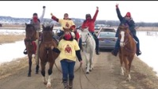
Sacrificing Climate and Criminal Justice
These women ride to raise awareness of MMIWG2
“Man Camps”:
Temporary housing for (mostly) male laborers working on construction projects like oil pipelines and fracking.
Usually located on or near Indigenous territories & communities
Reports from the Secwepemcul’ecw community have shown a direct correlation between man camps and violence against women.
Image Credit:
Asif Haroon Raja
Notes:
Man Camps: TransCanada, Exxon, and Chevron and other Big Oil companies have created man camps for projects like the Keystone XL and Dakota Access Pipelines
https://www.secwepemculecw.org/no-mans-camps
Further Reading: https://journals.library.columbia.edu/index.php/cjgl/article/view/4603/2055

Slide 41
The US Has Disrupted Indigenous Relationships for Centuries
Incarceration of Indigenous Peoples in the US Became (and continues to be) a tool of genocide:
Bosque Redondo
Boarding Schools (A Trans-Colonial Tactic of Indigenous Family & Knowledge Disruption)
Book: Stolen Lives
The Hiawatha Insane Asylum
Notes:
Bosque: https://americanindian.si.edu/nk360/navajo/bosque-redondo/bosque-redondo.cshtml
Boarding: https://digitalcommons.unl.edu/cgi/viewcontent.cgi?article=1009&context=historyfacpub
https://www.facinghistory.org/sites/default/files/publications/Stolen_Lives_1.pdf
The “American Dream” was cast in blood and stolen lands.

Slide 42
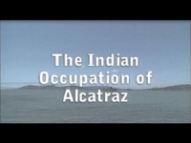
Yet, The Spirit Has Not Left the Peoples
Notes:
https://www.nps.gov/alca/learn/historyculture/we-hold-the-rock.htm

Slide 43
Education & Income
Image Credit:
Paulette Blanchard

Slide 44
Today’s Indigenous Learners Face Intergenerational Trauma and Lack of Support
Inheriting Trauma:
In a 2011 study, researchers found that “Native American students who experience historical loss have higher levels of depression, anxiety, negative feelings toward oneself and lower levels of resilience” (Altaha & Kraus 2011).
Graduation Rates of AI/AN Students, According to The Red Road:
Compared to the national average of 82%, “Only 70% of the Native students who start kindergarten will graduate from high school…”
Some barriers tribal learners face may include…
Curriculums that do not meet federal requirements
Lack of skilled teachers, funding, and/or technology
Physical structural issues of the school facilities
Notes:
1. https://metamorphosis.coplac.org/index.php/metamorphosis/article/view/67/101
2. https://theredroad.org/issues/native-american-education/
https://nces.ed.gov/pubs2012/2012045.pdf
More on this: http://blog.nativepartnership.org/challenges-to-education-within-native-american-communities/
https://www.tandfonline.com/doi/abs/10.1080/15313204.2016.1263818
https://vtechworks.lib.vt.edu/bitstream/handle/10919/89187/RaceEthnicityHighEducation.pdf?sequence=1&isAllowed=y
http://www.corntassel.net/Activist_Academic.pdf

Slide 45
A Glance at Washington State
 | Native High School Student Ranking | % of Native Learners | % of Avg. WA students
Drop-out Rate | 1 out of 6 | 24% | 9%
Success in ELA | 6 out of 6 | 31% | 60%
Success in Math | 6 out of 6 | 22% | 49%
Success in Science | 5 out of 6 | 24% | 47%
In a committee meeting for the ATNI Annual Convention in Oct. 2020, Jon Claymore with OSPI reported the following data on high school students from 2019:
Notes:
These rankings are out of 6 racial demographic groups recorded in WA State
ATNI = Affiliated Tribes of Northwest Indians
OSPI = Office of Superintendent of Public Instruction, WA
% = % of Native High School Students that are meeting the federal standardized criteria of success in the respective subject. For the drop-out rate, this refers to the percent of Native learners dropping out of high school out of the entire Native Learner population.

Slide 46
Indigenous Learners in High Education
Partnership with Native Americans reports:
+60% of US high school students go on to college, while only 17% of AI/AN students are able to access higher education. (Oliff 2017)
Postsecondary National Policy Institute reported 25% of AI/AN Peoples aged 25+ held associate’s degree (or higher) in 2019, compared to 42% of Americans aged 25+.
Indigenous learners face challenges & barriers, including…
Lack of access to technology, educational resources, and/or the physical campus
Lack of culturally-responsive mental health support
The ever-present white colonial structures from which many disciplines are founded
MAJOR lack of Indigenous faculty (making up less than 1% of all US-based faculty)
Discrimination from non-Indigenous faculty
Wikimedia Commons
July 2011
Notes:
1. https://pnpi.org/native-american-students/
2. http://blog.nativepartnership.org/graduation-rates-american-indian-education/
3. https://nces.ed.gov/fastfacts/display.asp?id=61
http://blog.nativepartnership.org/challenges-to-education-within-native-american-communities/
https://indiancountrymedianetwork.com/news/the-myth-of-indian-scholarships-and-the-native-dropout-epidemic/
https://muse.jhu.edu/article/629813/pdf
https://nces.ed.gov/programs/coe/indicator_csc.asp
*The person who wrote this curriculum faced a whole lot of discrimination in her time as an undergraduate, and gave support to many students facing discrimination for the reason that we were Native and they were not.
Indigenous academics straddle the world of activism and academia

Slide 47
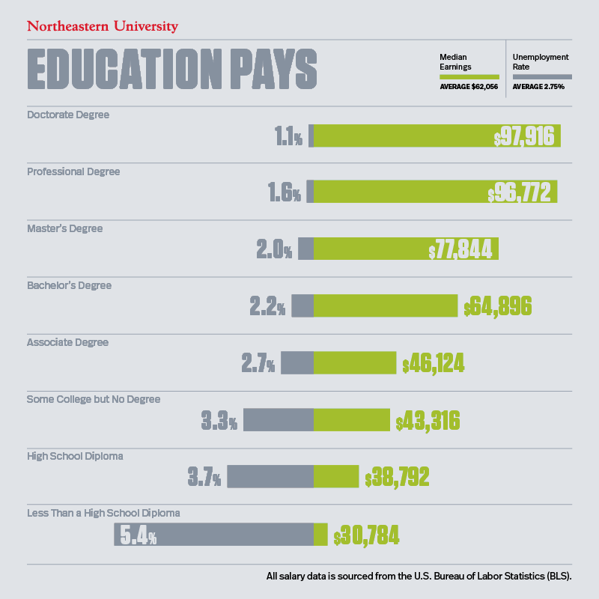
Higher Education Is a Class Barrier With a Lasting Cost
Notes:
https://www.northeastern.edu/bachelors-completion/news/average-salary-by-education-level/

Slide 48
Doing the Math…
On some reservations...
Workers face unemployment rates as high as 85%.
While tribal & federal government entities are the largest employers:
The scarcity of economic opportunity leave 4-8/10 adults without jobs.
~28.2% of AI/AN Peoples live below the poverty line.
Many heads of household are forced to leave their homelands to find work.
If only 25% of AI/AN Peoples hold degrees, then 75%:
Earned less than $43,000 annually
Faced unemployment at +3.3%
In addition…
31-33% of Native American workers reported experiencing discrimination through pay, consideration for promotion, or just applying for a job (Findling, Casey, et. al. 2019).
Image Credit:
Paul Shultz
Dec. 29, 2004
Notes:
https://onlinelibrary.wiley.com/doi/full/10.1111/1475-6773.13224
https://indianyouth.org/assets/uploads/2020/07/Poverty-Cycle.pdf
http://www.nativepartnership.org/site/PageServer?pagename=naa_livingconditions
Living Wage: https://livingwage.mit.edu/articles/61-new-living-wage-data-for-now-available-on-the-tool
https://opportunitynation.org/latest-news/blog/native-american-poverty/
http://blog.nativepartnership.org/labor-day-and-native-american-employment-disparities/
From the BLS 2019: https://www.bls.gov/opub/mlr/2019/article/american-indians-and-alaska-natives-in-the-u-s-labor-force.htm

Slide 49
Where do you stand?
Notes:
When Indigenous peoples have faced genocide by disease, colonial violence, forced removal, internment and incarceration, forced medical procedures, lack of justice for their own peoples, lack of education access or cultural acceptance, lack of religious freedom, and the construction of systems intended to erase them. It is up to you to position yourself accordingly. As an emergency responder, you have the duty to serve a community’s best interest - sometimes this means looking at yourself in the mirror, but with a different lens.

Slide 50
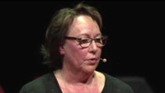
“Human Trauma and Climate Trauma As One”

